Slide 1
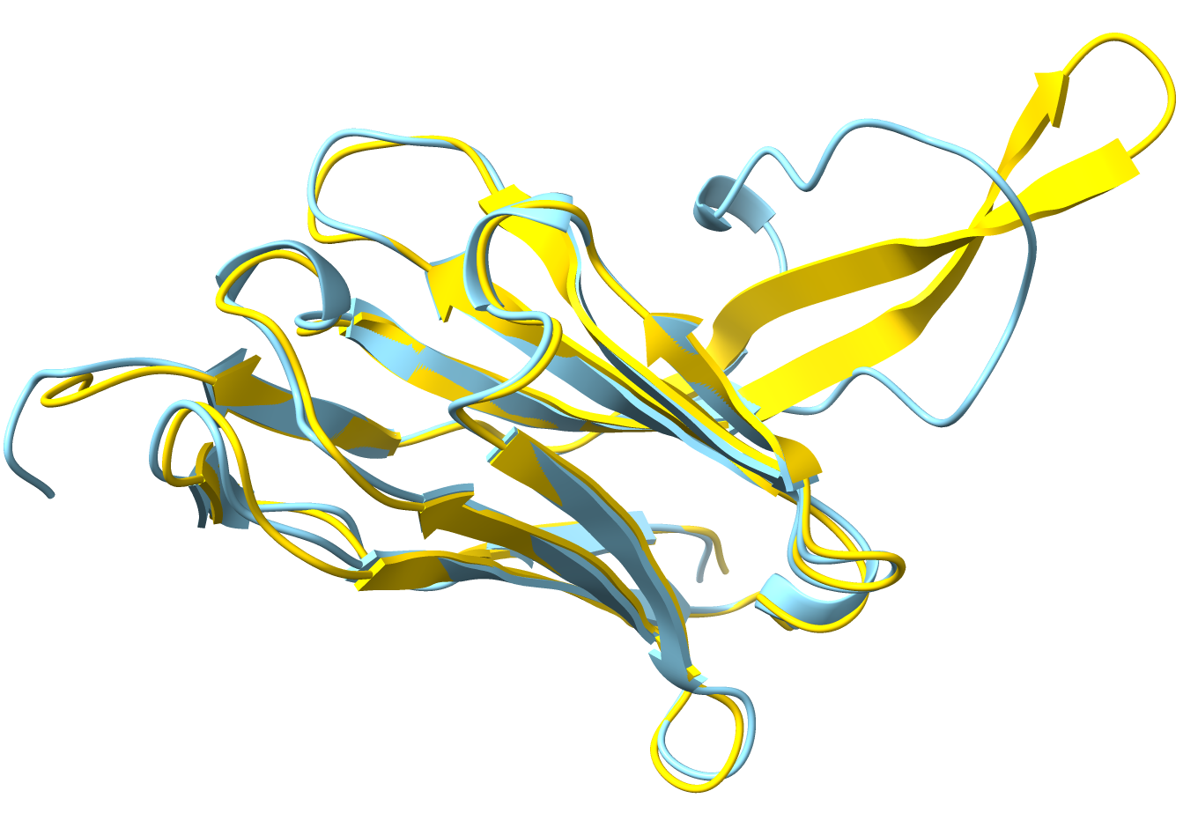





X-ray and cryo-EM structure solution using AlphaFold
Phenix Workshop
August 22, 2023, IUCr Congress, Melbourne
Tom Terwilliger
The New Mexico Consortium
Los Alamos National Laboratory
Notes:
Let’s talk about how to solve an X-ray or Cryo-EM structure in the age of advanced AI structure prediction
How many have used AlphaFold models in your work?
I’ll talk for a moment about what to expect from an AlphaFold model, focusing on confidence measures that come with your AF model.
I’ll then talk about strategies and tools for structure determination in Phenix that take advantage of AF models

Slide 2
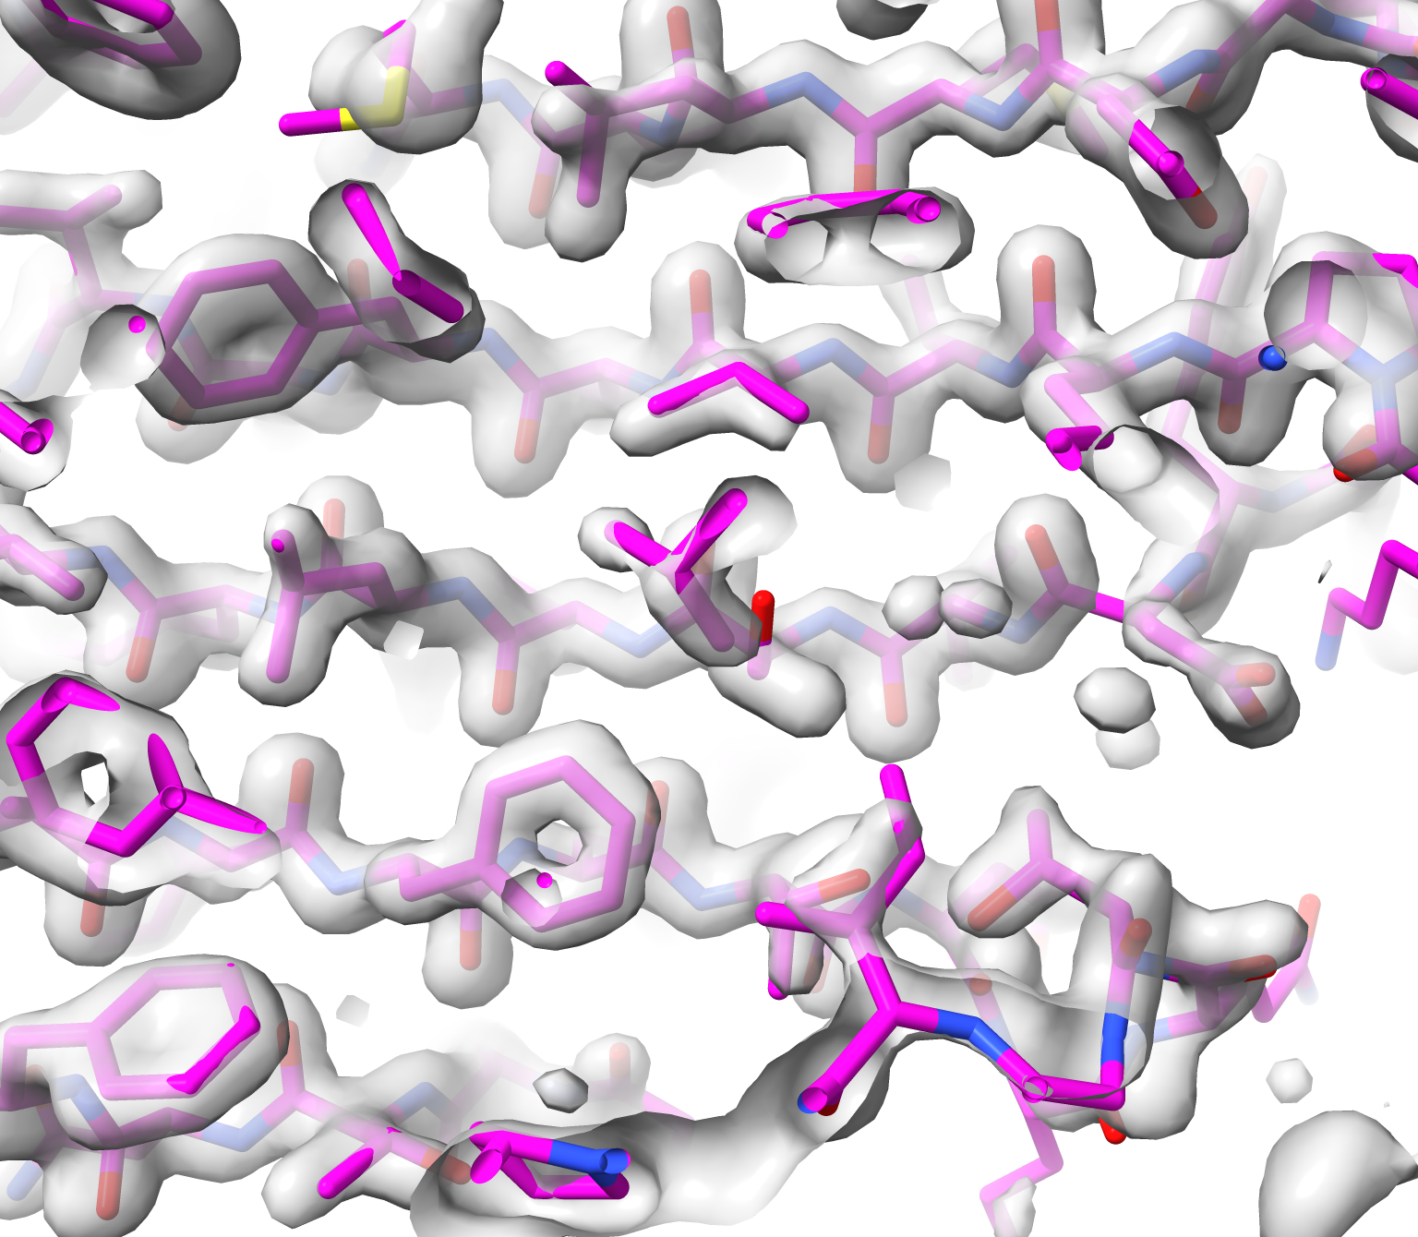
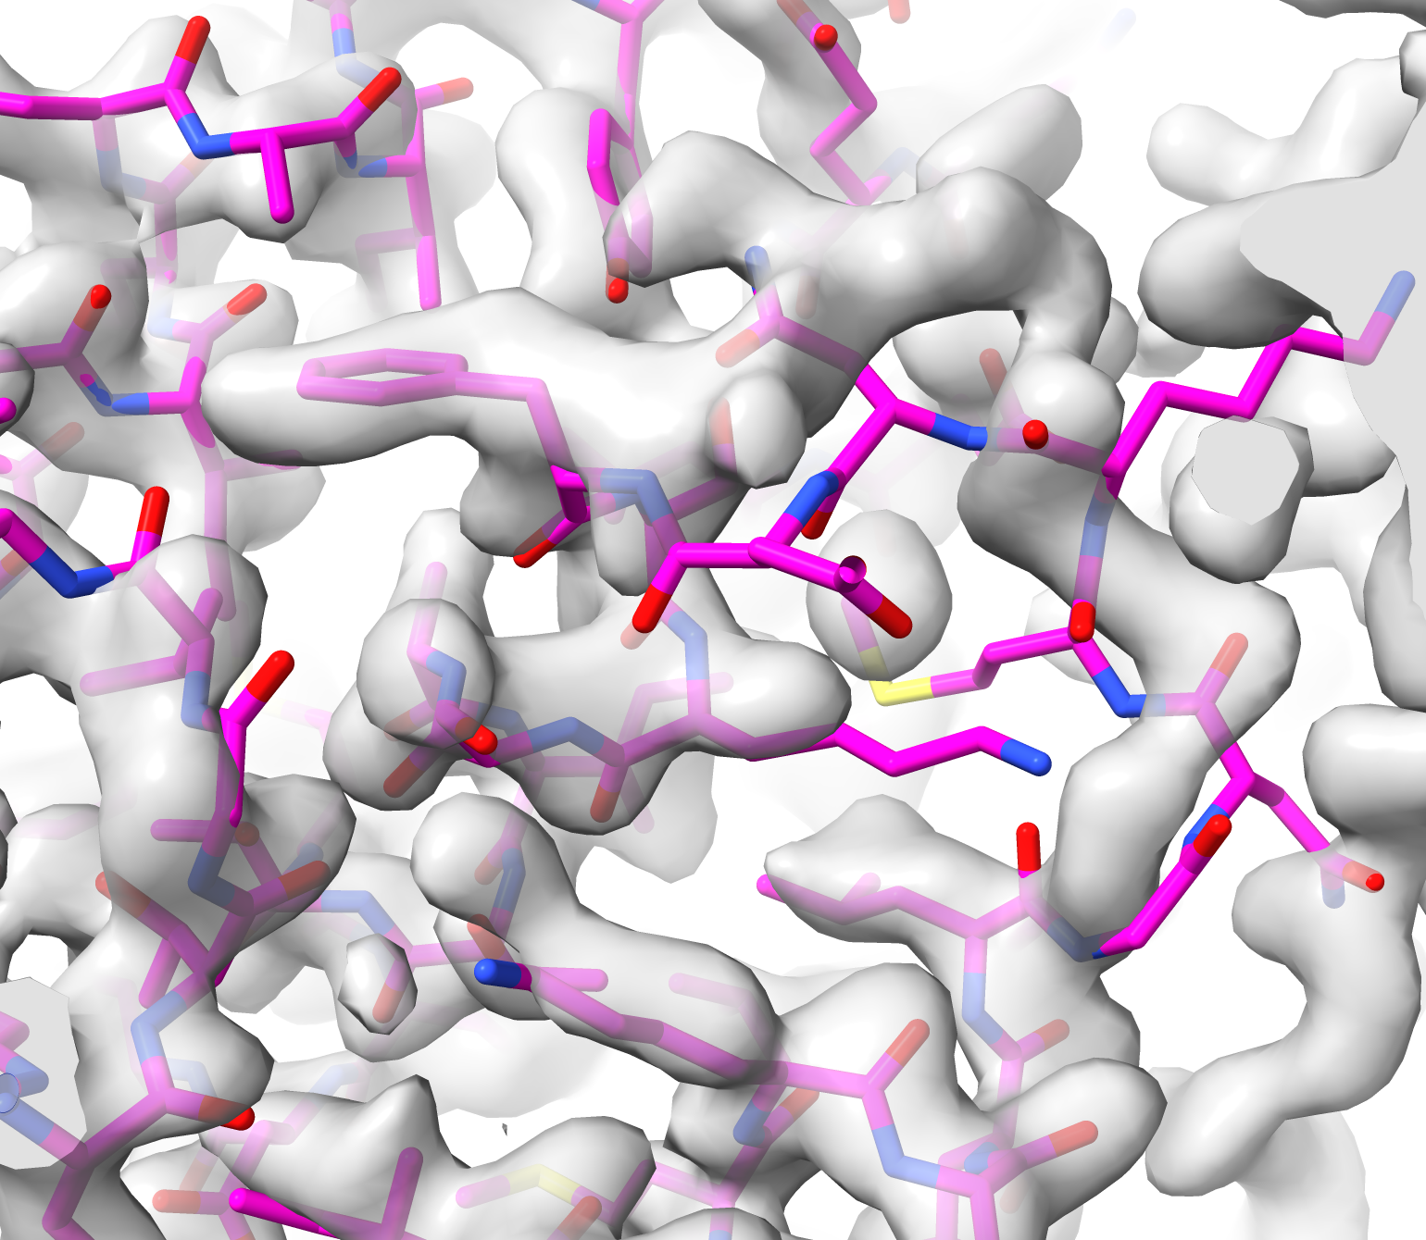
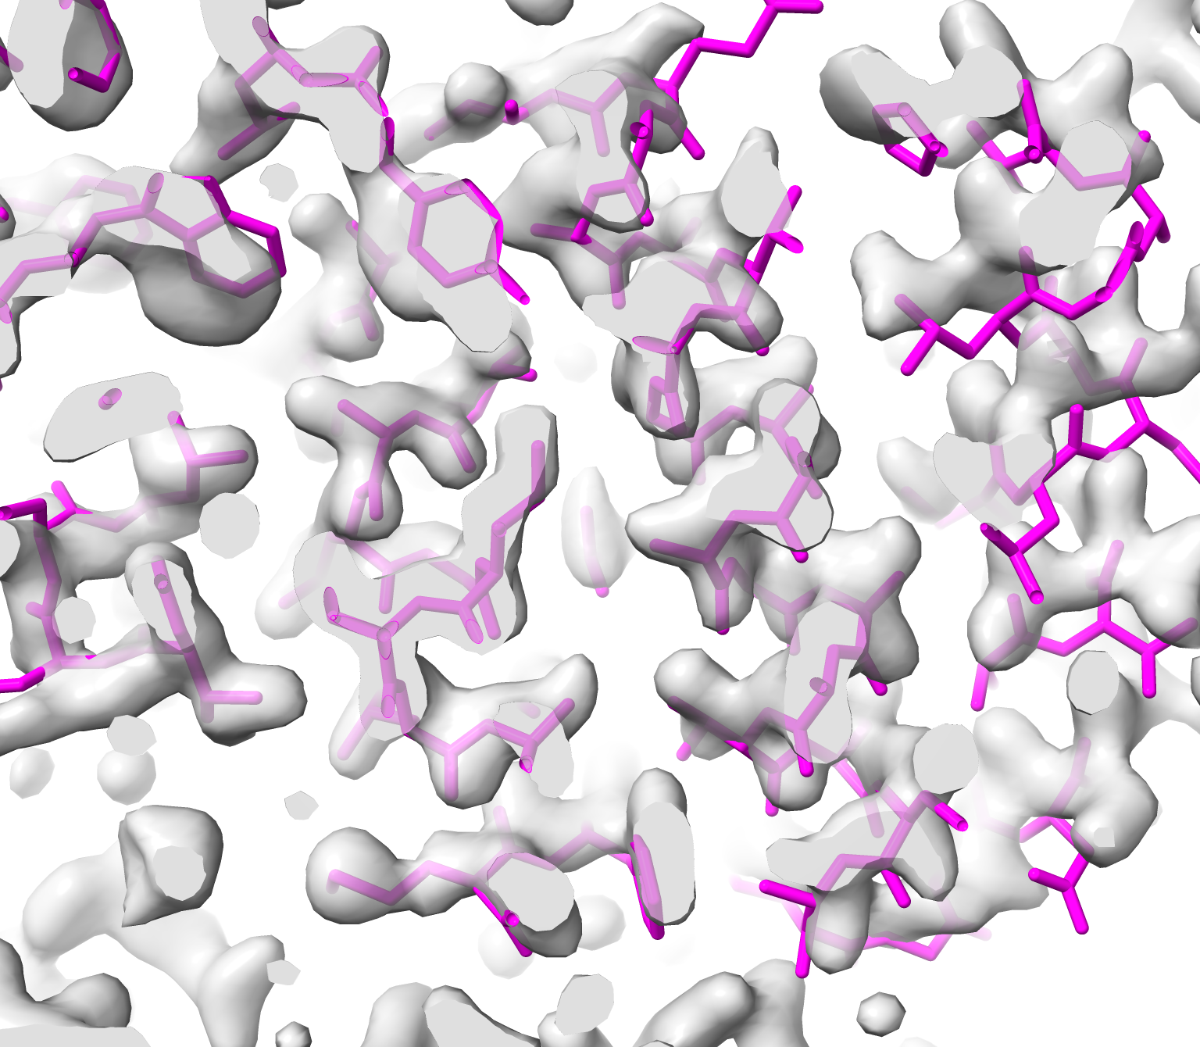
AlphaFold predictions are great hypotheses
AlphaFold models can be….
Awesome
Wrong
Distorted
Notes:
Here is the big message: AF models are great hypotheses
All these examples are very high-confidence predictions (pLDDT > 90)

Slide 3
AlphaFold predictions and confidence estimates
Residue-specific confidence (pLDDT) identifies where errors are more likely
AlphaFold confidence (pLDDT) | Median prediction error (Å) | Percentage with error over 2 Å
>90 | 0.6 | 10
80 - 90 | 1.1 | 22
70 - 80 | 1.5 | 33
<70 | 3.5 | 77
Awesome
Wrong
Distorted
Terwilliger et al. (2023), AlphaFold predictions are valuable hypotheses, and accelerate but do not replace experimental structure determination. BioRxiv 2022.11.21.517405
Notes:
Here is a handy chart showing what to expect from an AF model, depending on the prediction confidence...

Slide 4
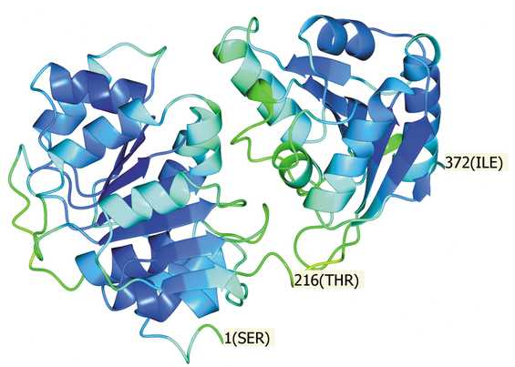
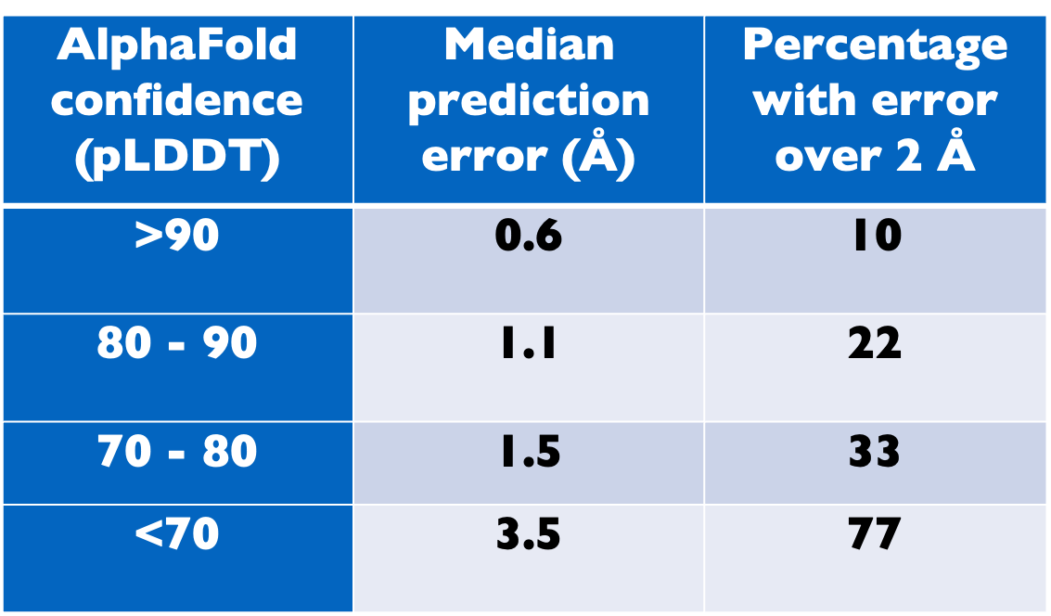
AlphaFold confidence measure
(pLDDT, Predicted difference distance test)
Confidence:
Blue: > 90
Green: 80 - 90
AlphaFold prediction for RNA helicase
(PDB entry 6i5i)
Oeffner et al. (2022). Acta Cryst. D78, 1303-1314
Notes:
Here's a real-world case. An AF prediction of DExD-box RNA helicase DDX21 (6I5I)

Slide 5
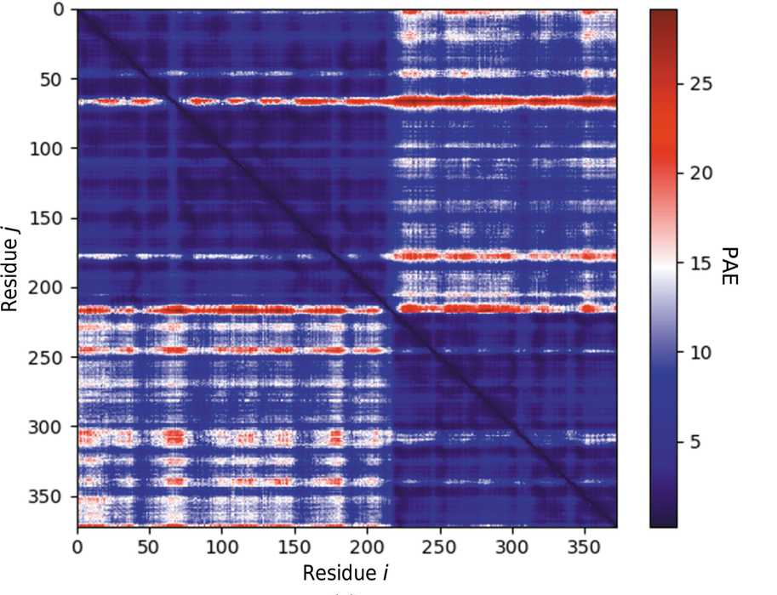
PAE matrix (Predicted aligned error)
PAE matrix identifies accurately-predicted domains
Confidence:
Blue: > 90
Green: 80 - 90
AlphaFold prediction for RNA helicase
(PDB entry 6i5i)
Dark blue: uncertainty in relative positions < 5 Å
Notes:
AF prediction of DExD-box RNA helicase DDX21 (6I5I)
The PAE matrix shows that the protein has 2 domains

Slide 6
Strategy for structure determination in the AlphaFold era
1. Predict your structure
Design your experiment based on predicted models
(choose experimental approach, consider trimming at domain boundaries
2. Solve your structure
Cryo-EM or X-ray MR with trimmed predicted model, SAD
3. Update your prediction
Run AlphaFold with your best model as a template
Iterate
4. Improve your structure
Use your new predictions as hypotheses
Notes:
Strategy for structure determination in the AlphaFold era

Slide 7

Phenix AlphaFold prediction server
Available from the Phenix GUI
Predicts structures of protein chains
(one at a time)
Can use a template to guide the prediction
You do not need an MSA (multiple sequence alignment) if you supply a template
The template should not be an AlphaFold model
Many thanks for AlphaFold, ColabFold scripts, and the MMseqs2 server for MSAs
Notes:
MSA is optional if template is supplied
Templates that are AlphaFold models result in new predictions that have greatly inflated confidence

Slide 8
Process predicted model
Convert pLDDT to B-value
Trim low-confidence parts of model
Identify high-confidence domains
Compact high-confidence regions
Groupings of residues with low PAE values
Notes:
Can identify domains with either simple identification of compact groups of high-confidence residues (just looking at the trimmed model) or groupings of residues with low mutual PAE values (using the PAE matrix)

Slide 9
Cryo-EM structure determination with AlphaFold
Half-maps (optional processed map)
Sequence file
Density modification
Predict structure
or
Anisotropic sharpening
Trim, identify domains
Optimized map
High-confidence domains
Dock domains in map
Docked domains
Morph full prediction onto domains and rebuild
Iterate
Rebuilt model
Predict using rebuilt chains as templates
Updated predictions
Notes:
The key new element is that the prediction step can be iterated so that each predicted model is better than the previous one.

Slide 10
X-ray structure determination with AlphaFold
Sequence file
Predict structure
Trim, identify domains
X-ray intensity data (mtz file)
High-confidence domains
Molecular replacement
Working structure and map
Density modification and autobuilding
Iterate
Rebuilt model and optimized map
Predict using rebuilt chains as templates
Updated predictions
Notes:
The key new element is that the prediction step can be iterated so that each predicted model is better than the previous one.

Slide 11
Input and output from structure determination with AlphaFold
Experimental data (maps or X-ray data)
Input
Contents of asymmetric unit (sequence file)
Rebuilt model
Optimized map
Docked predicted models
Output
Map and model ready for next steps
Useful as high-quality reference models
Notes:
The key new element is that the prediction step can be iterated so that each predicted model is better than the previous one.

Slide 12
Phenix tools for structure determination with AlphaFold
PredictModel (Predict with AlphaFold)
AlphaFold models
ProcessPredictedModel (Trim and identify domains)
ResolveCryoEM, LocalAnisoSharpen (map improvement)
EMPlacement, DockInMap (Docking of single, multiple chains)
Cryo-EM
DockAndRebuild (Morphing and rebuilding)
RealSpaceRefine (Refinement)
Phaser-MR (Molecular replacement)
AutoBuild (Density modification and rebuilding)
X-ray
Phenix.refine (Refinement)
PredictAndBuild (Prediction and structure determination)
Full automation

Slide 13




The Project
Lawrence Berkeley Laboratory
Los Alamos National Laboratory
New Mexico Consortium
Paul Adams, Pavel Afonine, Dorothee Liebschner, Nigel Moriarty, Billy Poon,
Oleg Sobolev,
Christopher Schlicksup
Tom Terwilliger, Li-Wei Hung
UTHealth
Matt Baker
University of Cambridge
Randy Read, Airlie McCoy,
Alisia Fadini
Duke University
Jane Richardson, Vincent Chen, Michael Prisant, Christopher Williams,
An NIH/NIGMS funded Program Project
Liebschner D, et al., Macromolecular structure determination using X-rays, neutrons and electrons: recent developments in Phenix.
Acta Cryst. 2019 D75:861–877

