Slide 1
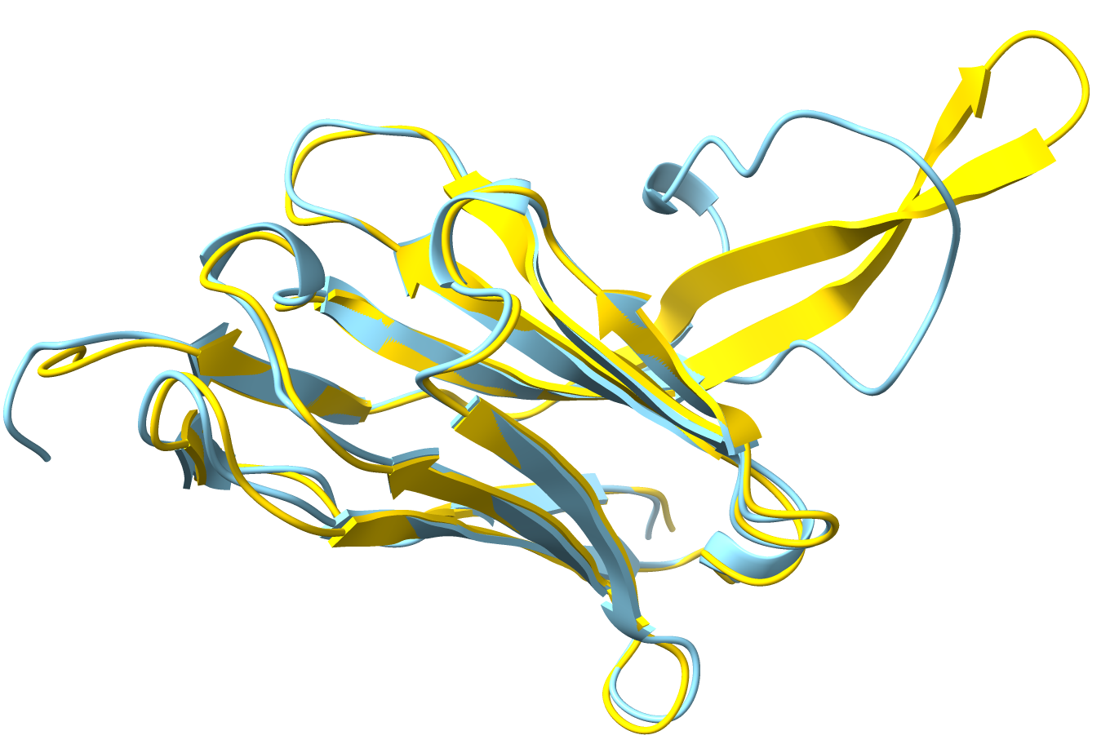





AlphaFold changes everything:
Incorporating predicted models in X-ray and Cryo-EM structure determination
Presentation available at:
phenix-online.org/presentations
January 18, 2022
RéNaFoBiS Webinar
How you can benefit from AlphaFold …
Tom Terwilliger
The New Mexico Consortium
Los Alamos National Laboratory
… by determining structures more easily
Randy Read, Tristan Croll, Claudia Millán, (Cambridge, University), Paul Adams, Billy Poon, Pavel Afonine, Christopher J. Schlicksup (Lawrence Berkeley National Laboratory); Jane Richardson (Duke University)
… and getting better models
Notes:
AlphaFold changes everything
Purposes of this talk

Slide 2
AlphaFold models …
are great hypotheses for protein structures
jump-start structure determination by X-ray and CryoEM
can be iteratively improved with a density map
allow a new work-flow for structure determination
Notes:
Big message: AlphaFold models are great hypotheses for protein structures. They are hypotheses, not the answers

Slide 3
AlphaFold models …
are great hypotheses for protein structures
jump-start structure determination by X-ray and CryoEM
can be iteratively improved with a density map
allow a new work-flow for structure determination
Notes:
Learn how AlphaFold models are great hypotheses for protein structures

Slide 4
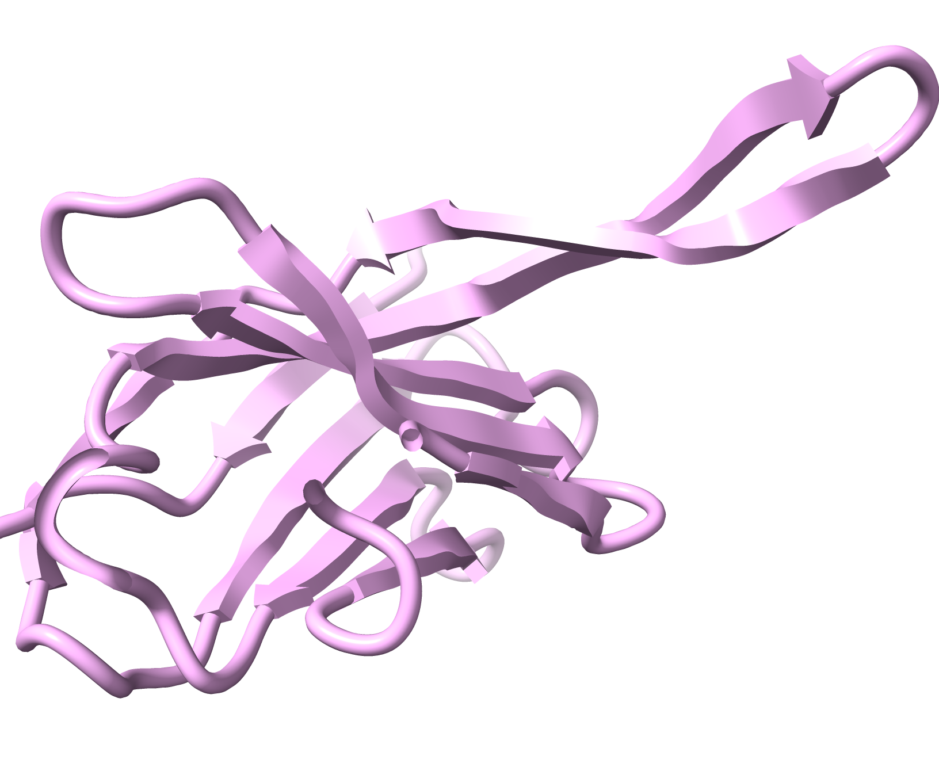
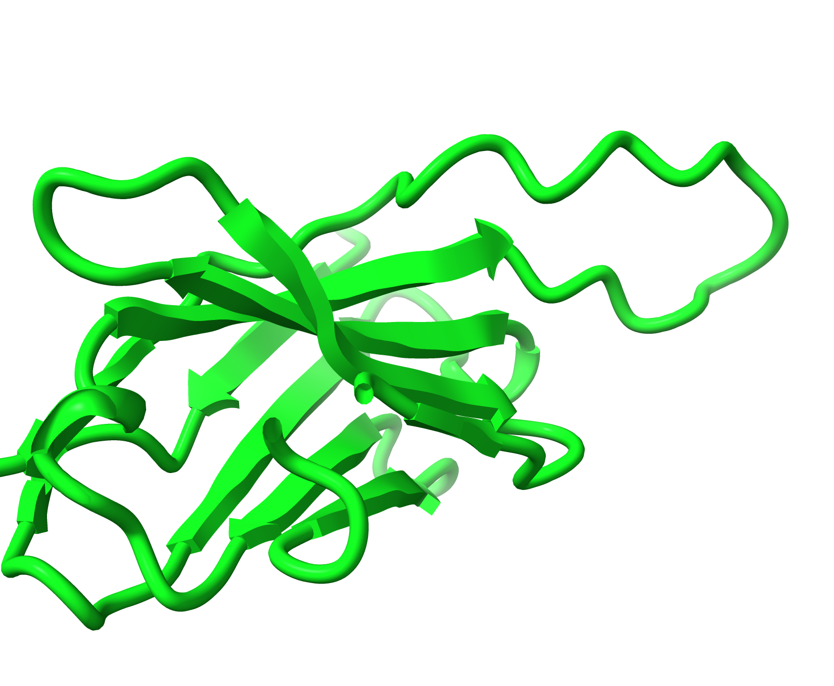
Machine-learning prediction of protein structure
    }
Training
Sequence
Multiple sequence alignment
180,000 protein structures in the PDB
EVQLVESGGGLVQPGGSLRLSCAASGFNIYSSSIHWVRQAPGKGLEWVAYI
............................F....M........Q........
..................K.........Y....L.......A.........
..............A.............................V......
....................A..............................
............................L....V....E............
.........A...................................Q.....
3D structure
21 million parameters
Prediction
Sequence
Multiple sequence alignment
21 million parameters
3D prediction
EVQLVESGGGLVQPGGSLRLSCAASGFNIYSSSIHWVRQAPGKGLEWVAYI
............................F....M........Q........
..................K.........Y....L.......A.........
..............A.............................V......
....................A..............................
............................L....V....E............
.........A...................................Q.....
Focus attention on important relationships
Confidence estimates (plDDT)
Notes:
Information used to train AF and procedure for prediction.
Note step in which attention is focused on important relationships based on residue-residue distances in internal AlphaFold working models

Slide 5
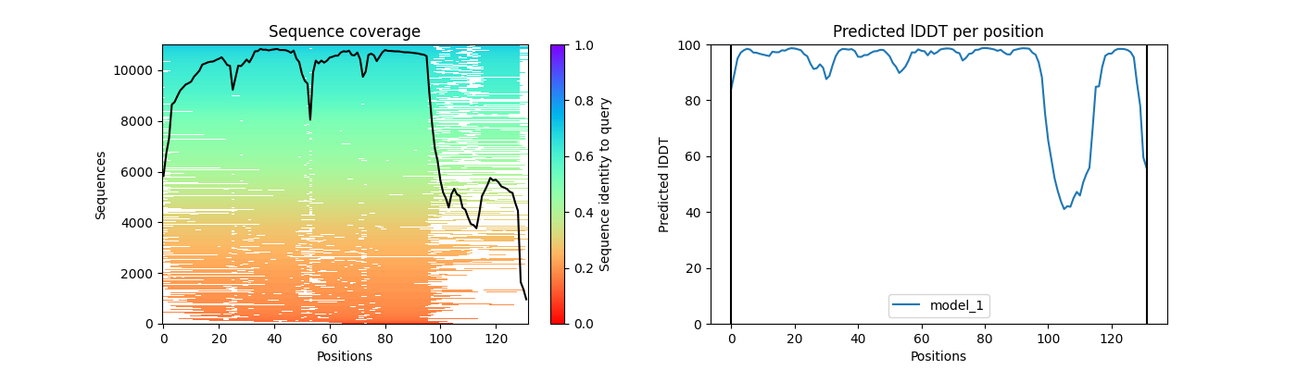
Multiple sequence alignment is key information for AlphaFold
Residues that co-vary are probably close in 3D structure
All sequences in alignment should be compatible with the right structure
Multiple sequence alignment
EVQLVESGGGLVQPGGSLRLSCAASGFNIYSSSIHWVRQAPGKGLEWVAYI
............................F....M........Q........
..................K.........Y....L.......A.........
..............A.............................V......
....................A..............................
............................L....V....E............
.........A...................................Q.....
Sequence coverage
Confidence
Data from 7mjs, Cater, R.J., et al. (2021). Nature 595, 315–319
Notes:
Residue covariation is a key source of information for AF
Also all the sequences in multiple sequence alignment should be compatible with (more or less) the same structure.

Slide 6
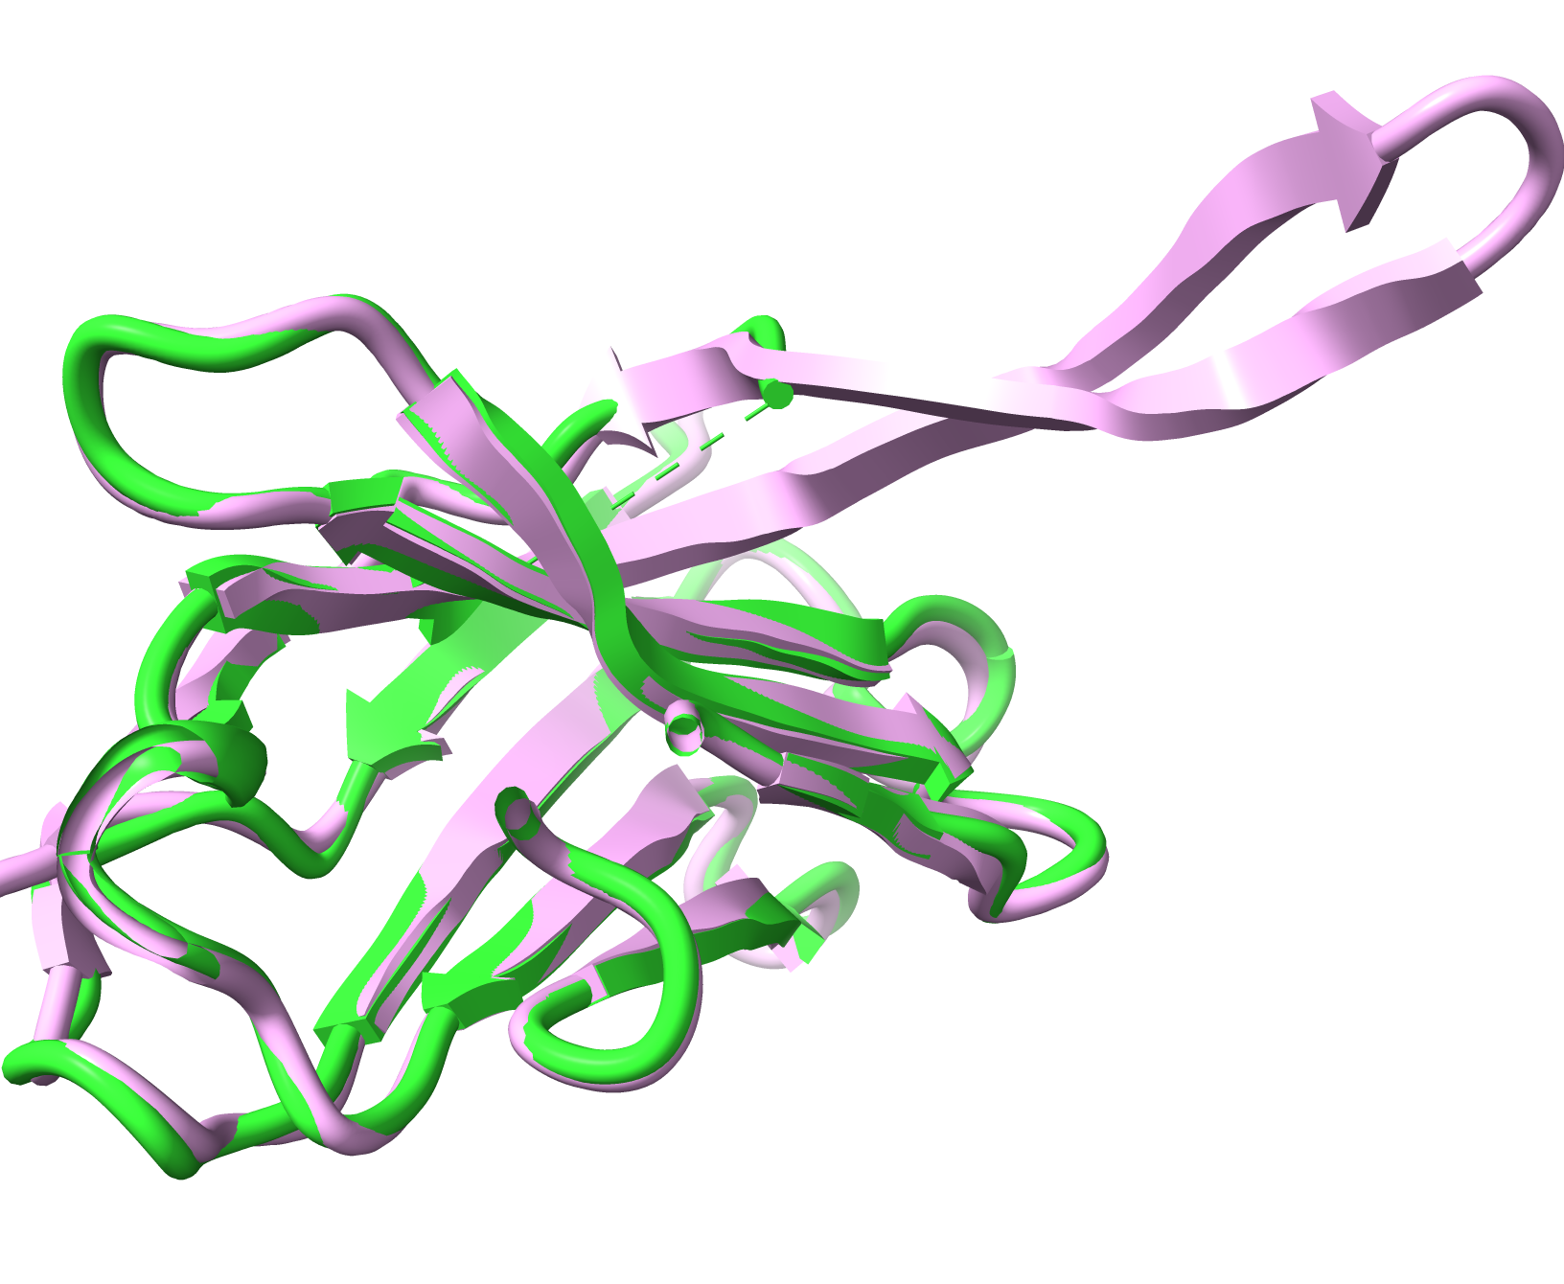
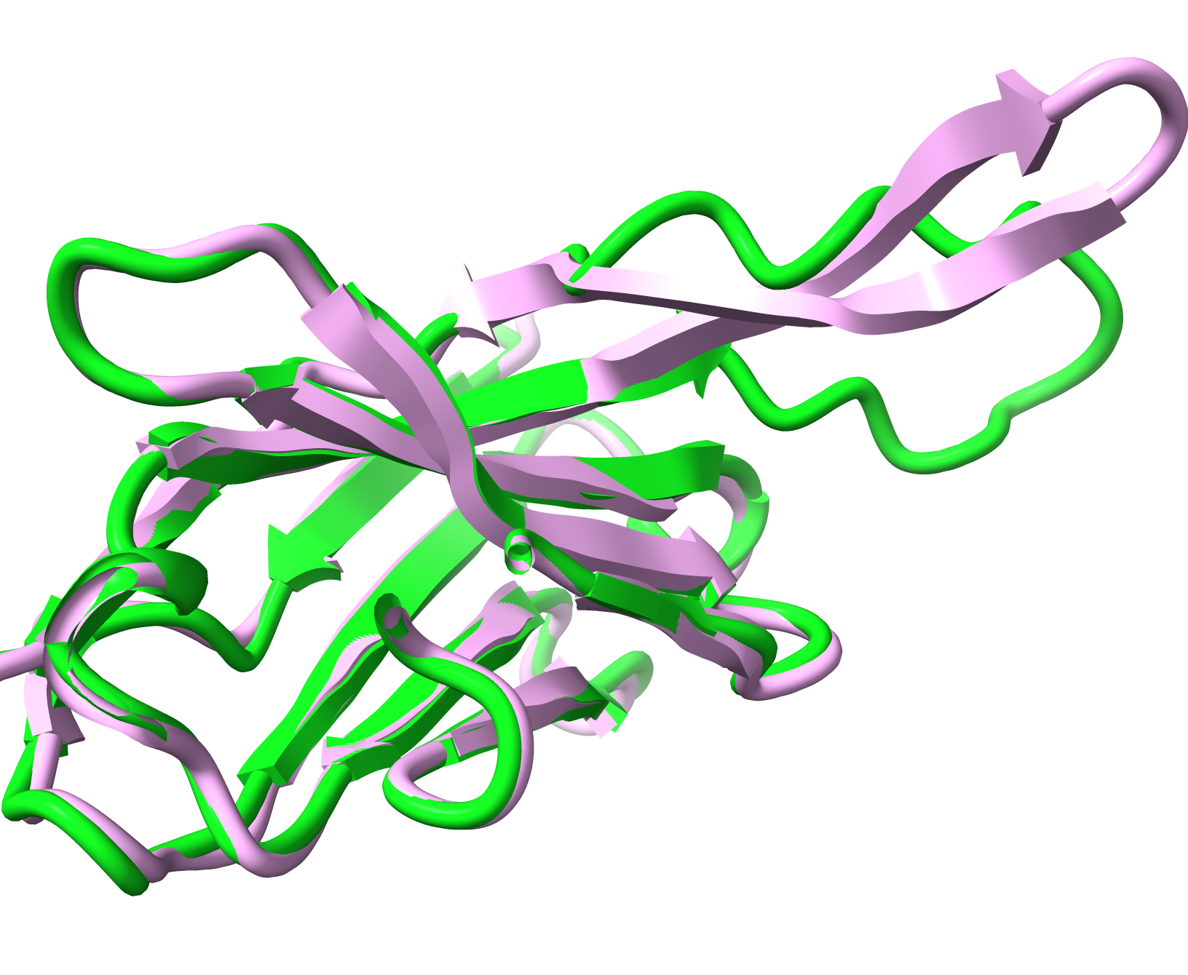
Models are accurate where sequence coverage is high
7mjs (3 Å, EMDB 23883)
7mjs
AlphaFold
Residues 100-120
Low sequence coverage, low confidence, low accuracy
Residues 1-100
High sequence coverage and confidence
Data from 7mjs, Cater, R.J., et al. (2021). Nature 595, 315–319
Notes:
AF predictions can be accurate where sequence coverage is high and much poorer if little sequence coverage

Slide 7
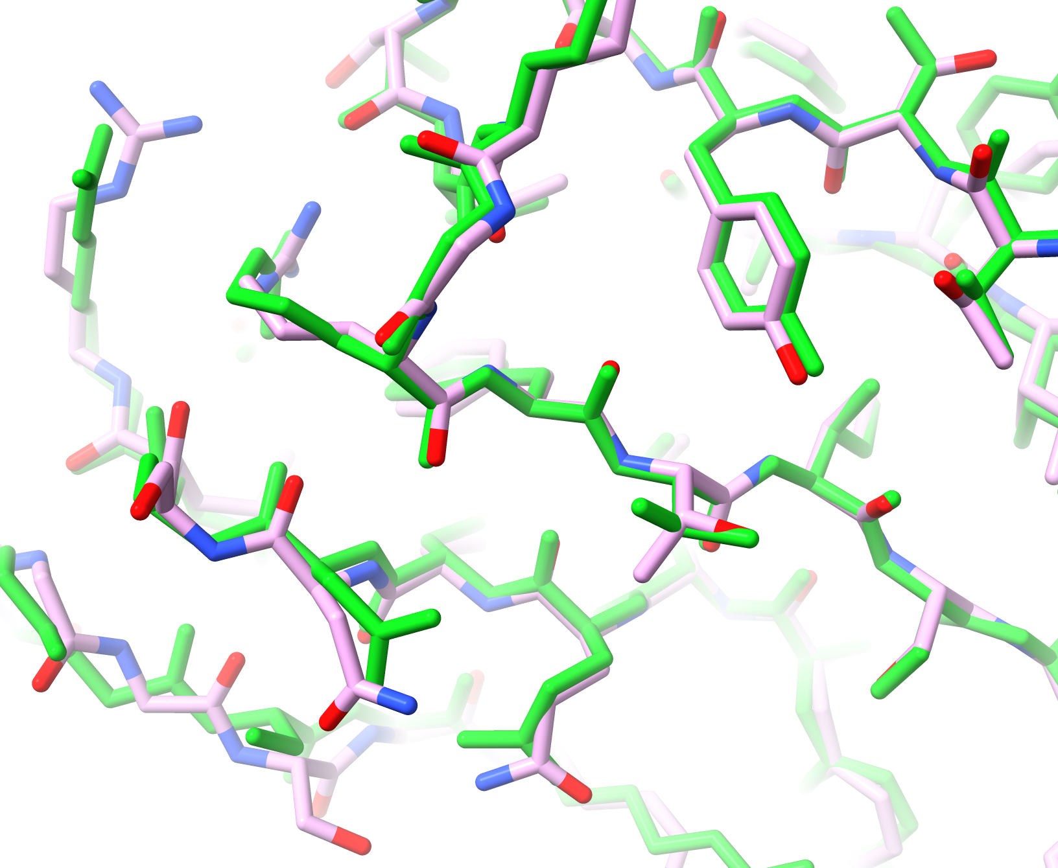
Models are accurate where sequence coverage is high
7mjs (3 Å, EMDB 23883)
7mjs
AlphaFold
Residues 1-100
High sequence coverage and confidence
→High confidence residues can be accurate
Data from 7mjs, Cater, R.J., et al. (2021). Nature 595, 315–319
Notes:
Some parts of AF models are very accurate

Slide 8
Limitations
No water, ions, covalent modifications, carbohydrates, ligands, DNA, RNA
Only protein
Trained on good and poor structures
Parameters may systematically include poor geometry
Models may have distortions and incorrect domain relationships
Little information about residues that are far apart
Notes:
Limitations of AlphaFold models

Slide 9
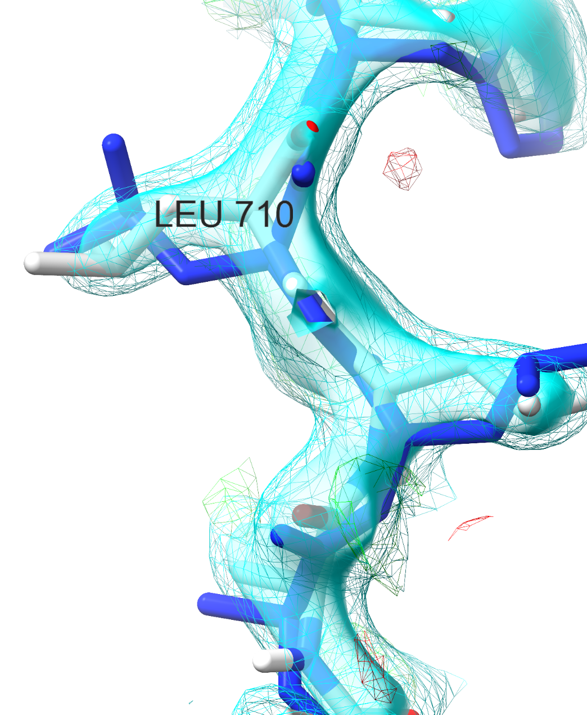
Limitations
Two interpretations of PDB entry 6te3 … which is right?
AlphaFold
Uncommon rotamer
Poor fit to density
High-confidence (plDDT =0.97)
Common rotamer
Fits density
ISOLDE
→AlphaFold models are great hypotheses
ISOLDE rebuilding of 6te3 and slide by Tristan Croll
Notes:
Example of strengths and weaknesses of a good AlphaFold prediction. In this example from 6te3 (light grey atoms after rebuilding in ISOLDE; corresponding AlphaFold model in blue; 2mFo-DFc map shown at 1σ (wireframe) and 2σ (surface) the sidechain of Leu710 was predicted “backwards” (as the ~1.4% prevalence tt rotamer) with pLDDT=96.7, whereas the best fit to the density actually matches the most common mt rotamer. This is associated with a ~0.8 Å shift in the relative positioning of this strand and the facing helix. Fixes made by Tristan Croll with ISOLDE.

Slide 10
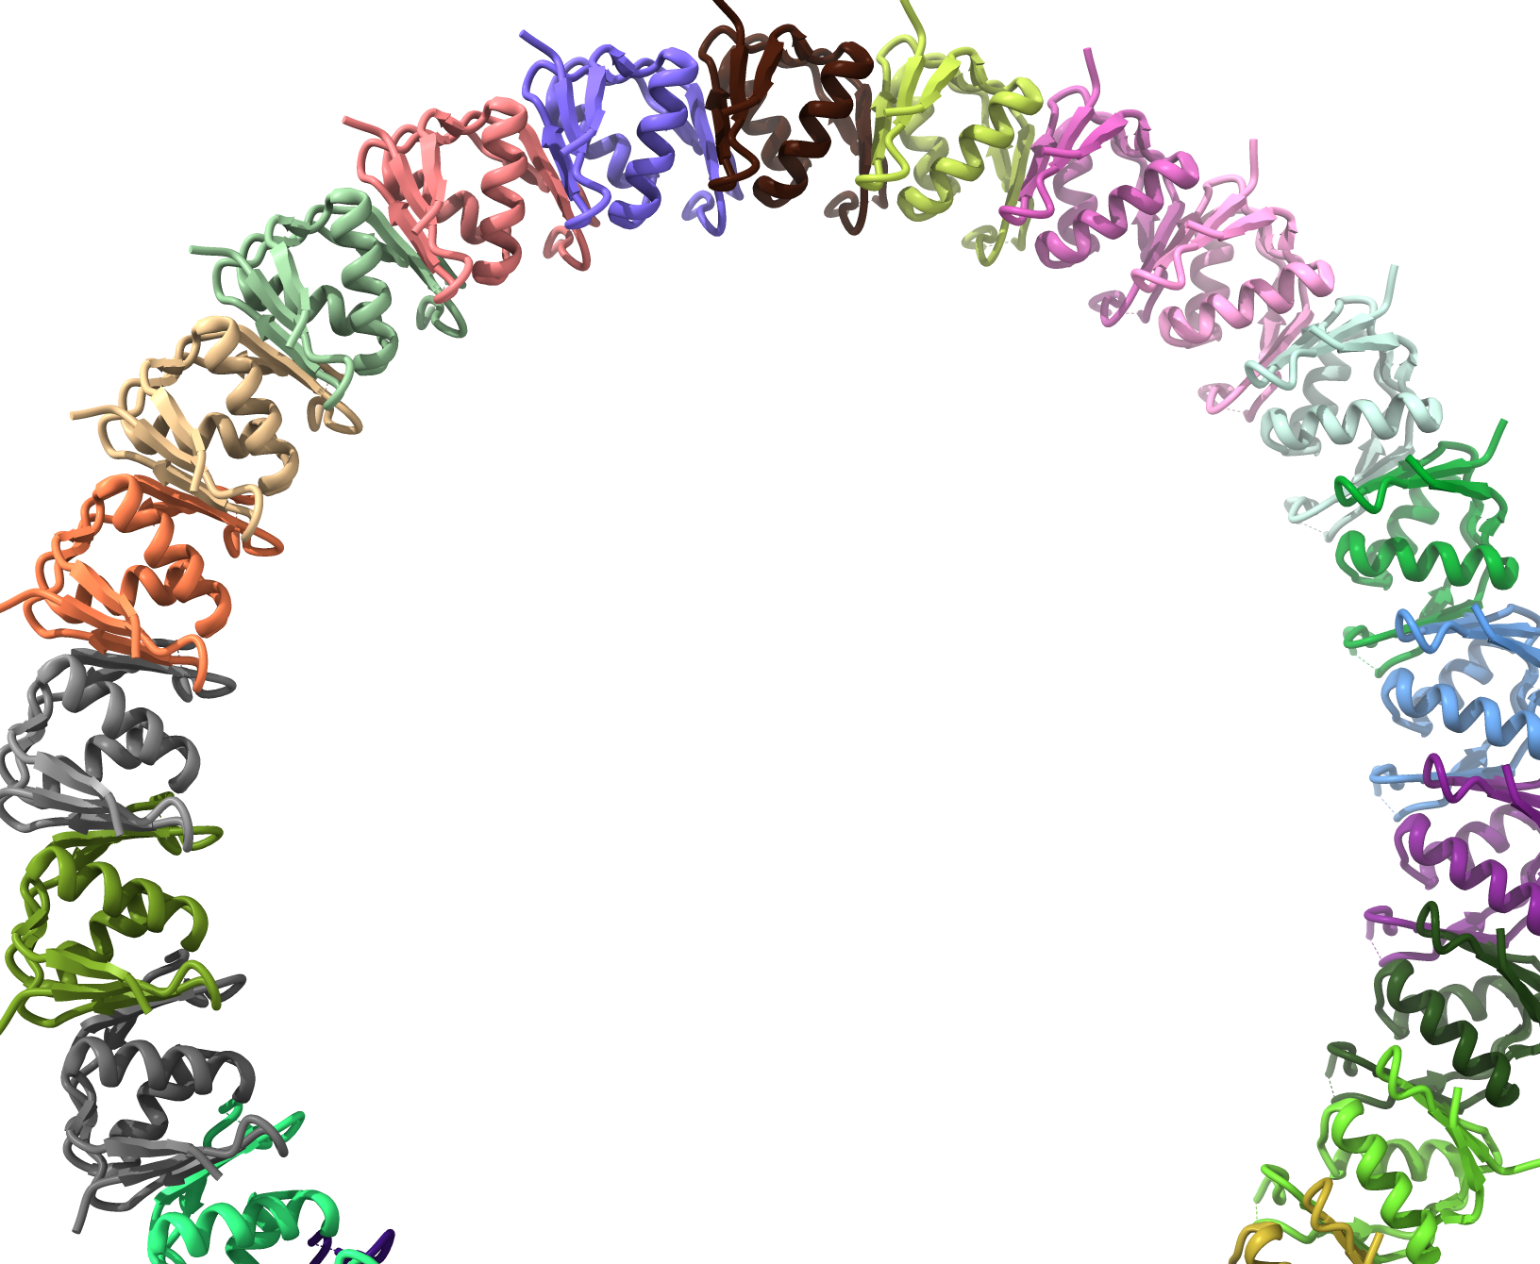
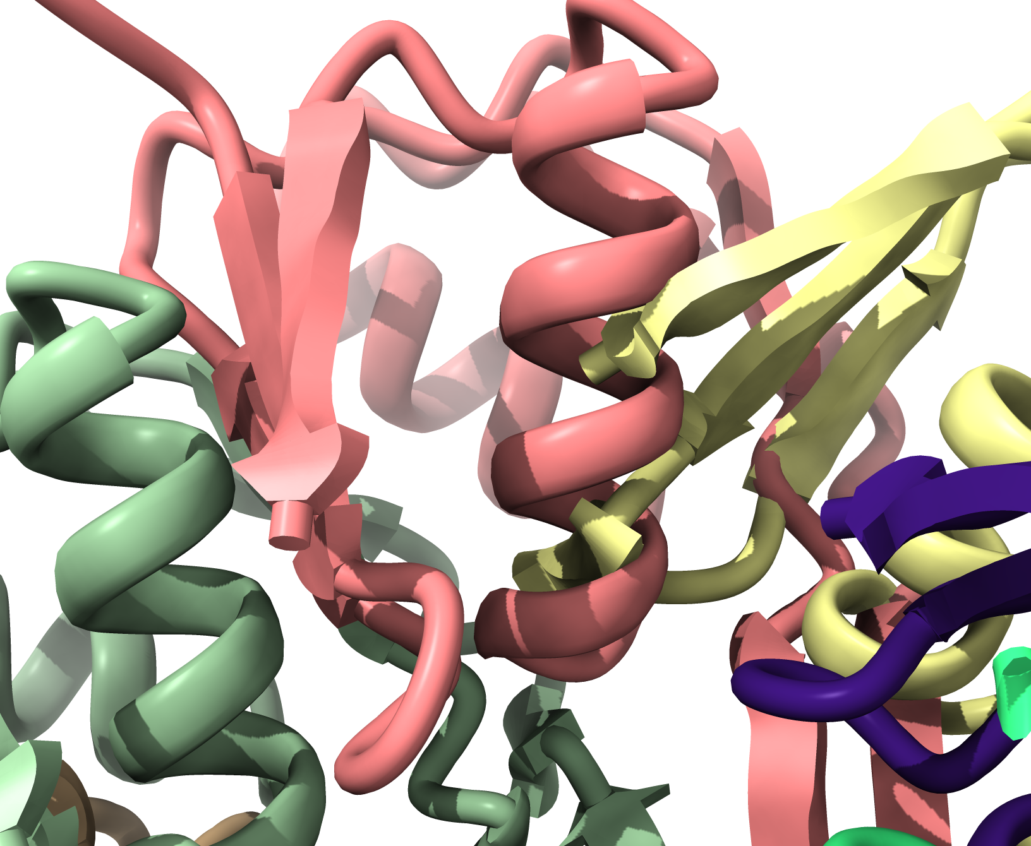
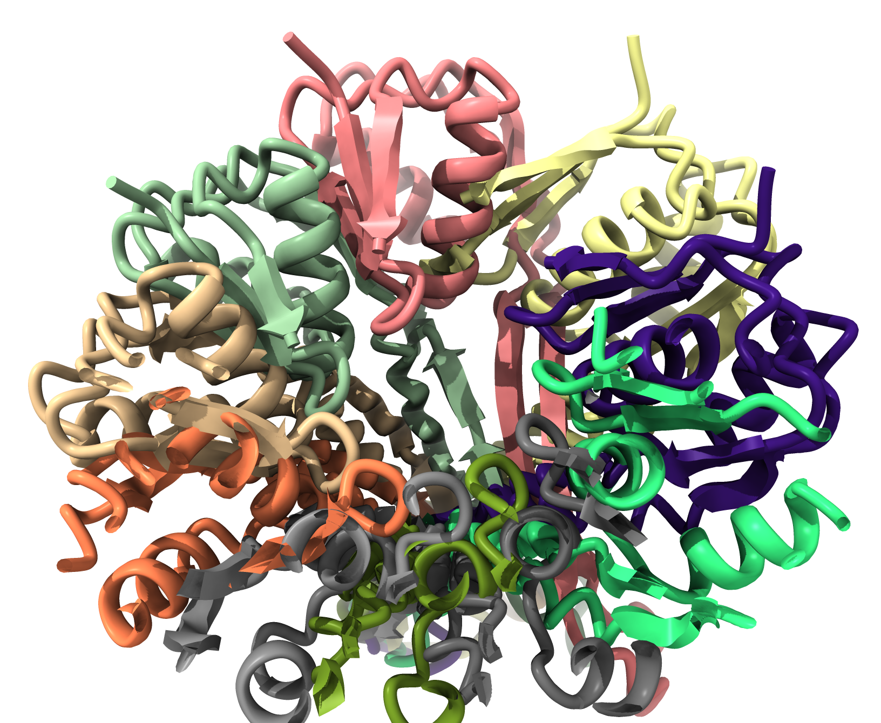
Local accuracy better than global accuracy
PDB entry 7bgl
(domain 3 of chain a)
AlphaFold
(multimer prediction)
Data from 7bgl, Johnson, S. et al. (2021). Nat Microbiol 6, 712–721
Notes:
Example of poor long-distance accuracy but ok local accuracy by AlphaFold. Prediction of domain 3, chain a of PDB entry 7bgl as a multimer (10-mer used, actual size is 26-mer). Multimer prediction has extensive overlap of chains. However the monomeric units are pretty close.

Slide 11
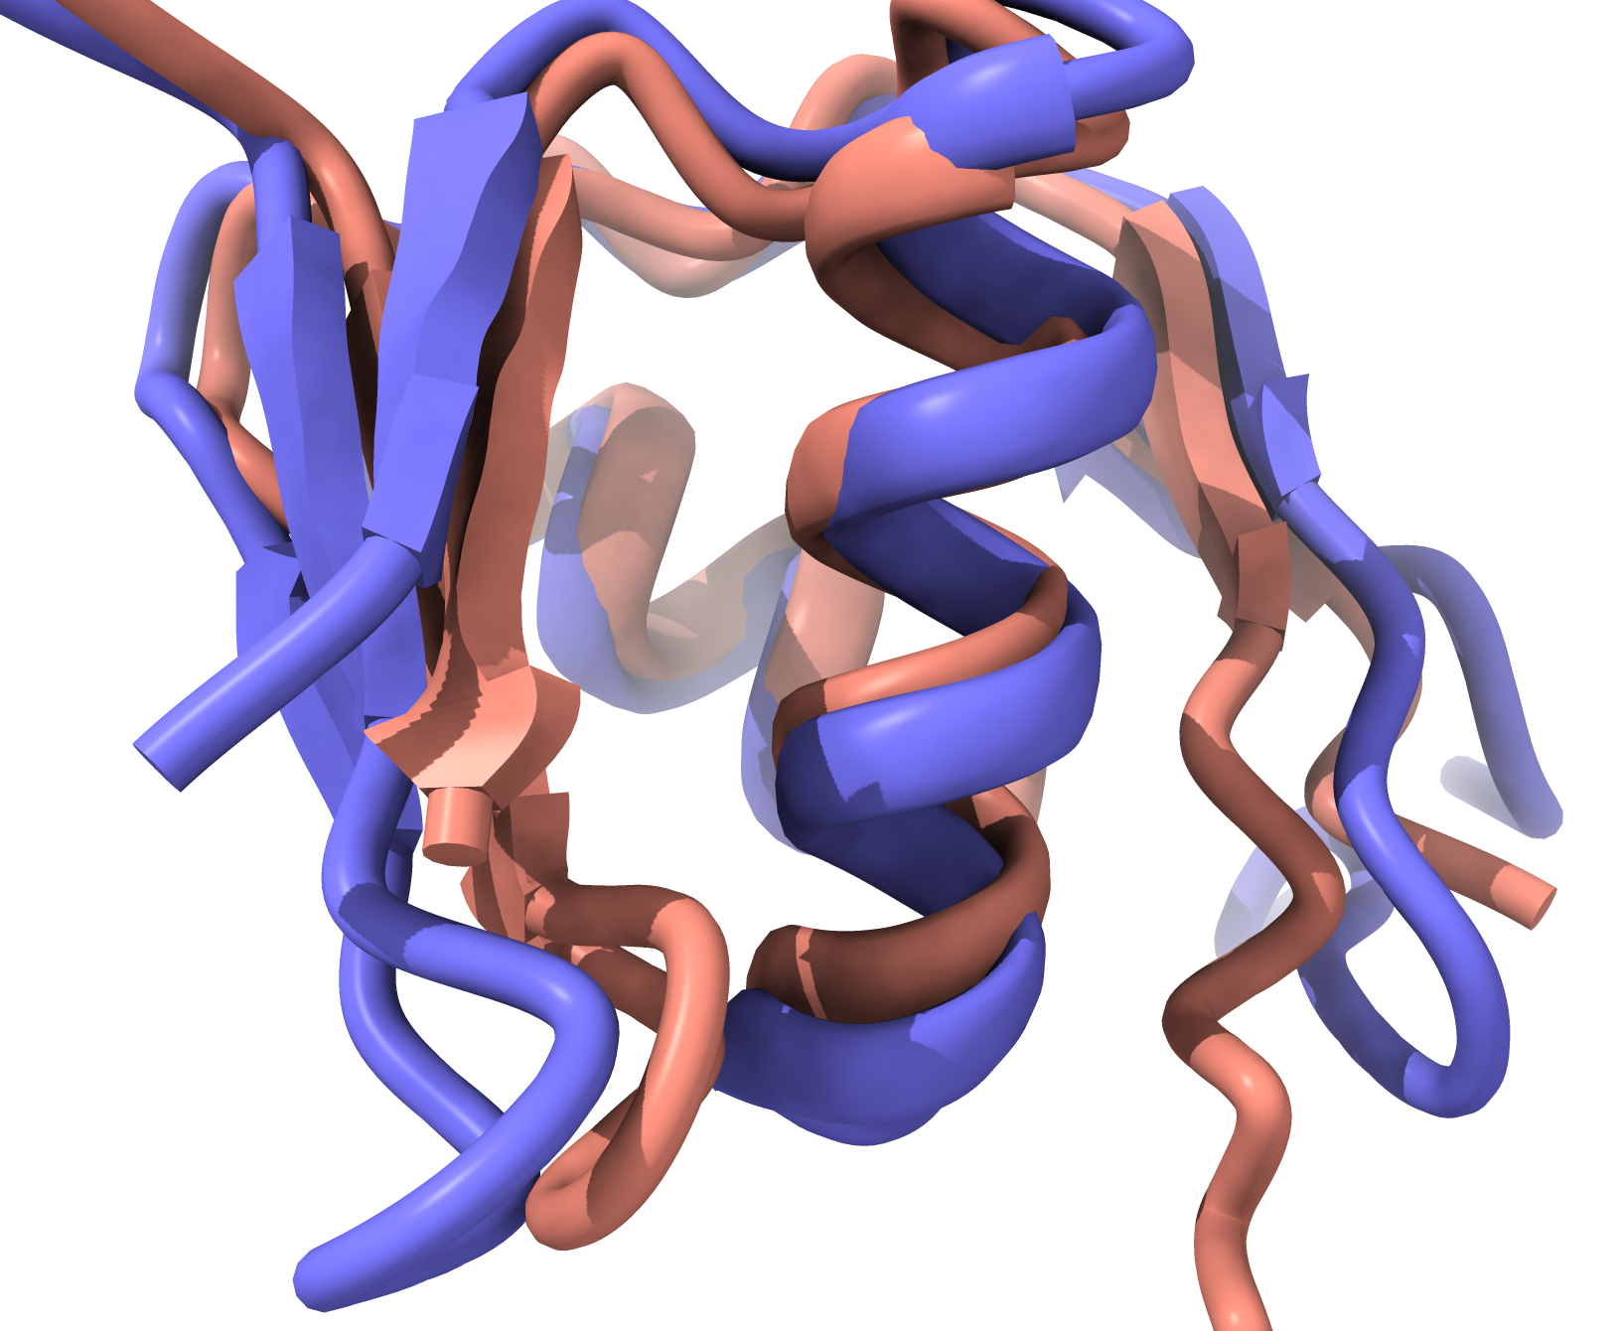
Local accuracy better than global accuracy
PDB entry 7bgl
(domain 3 of chain a)
AlphaFold
(multimer prediction)
→AlphaFold models are great hypotheses
Notes:
Example of poor long-distance accuracy but ok local accuracy by AlphaFold. Prediction of domain 3, chain a of PDB entry 7bgl as a multimer (10-mer used, actual size is 26-mer). Multimer prediction has extensive overlap of chains. However the monomeric units are pretty close.

Slide 12
What can we expect from AlphaFold models?
They are great hypotheses for protein structures
Parts of AlphaFold models are accurate
Parts are completely wrong
The confidence measure is helpful but may not fully reflect accuracy
Notes:
Summary of what we can expect from an AlphaFold model

Slide 13
AlphaFold models …
are great hypotheses for protein structures
jump-start structure determination by X-ray and CryoEM
(and NMR, cryo-ET, neutron…)
can be iteratively improved with a density map
allow a new work-flow for structure determination
Notes:
Jump-starting structure determination with predicted models…

Slide 14
AlphaFold models are great for jump-starting structure determination
Confidence measure (plDDT) allows pruning of worst parts of models
High-confidence parts are often accurate
Better than a homology model: no insertions and deletions in the sequence
Notes:
Why AF models are good for jump-starting structure determination

Slide 15
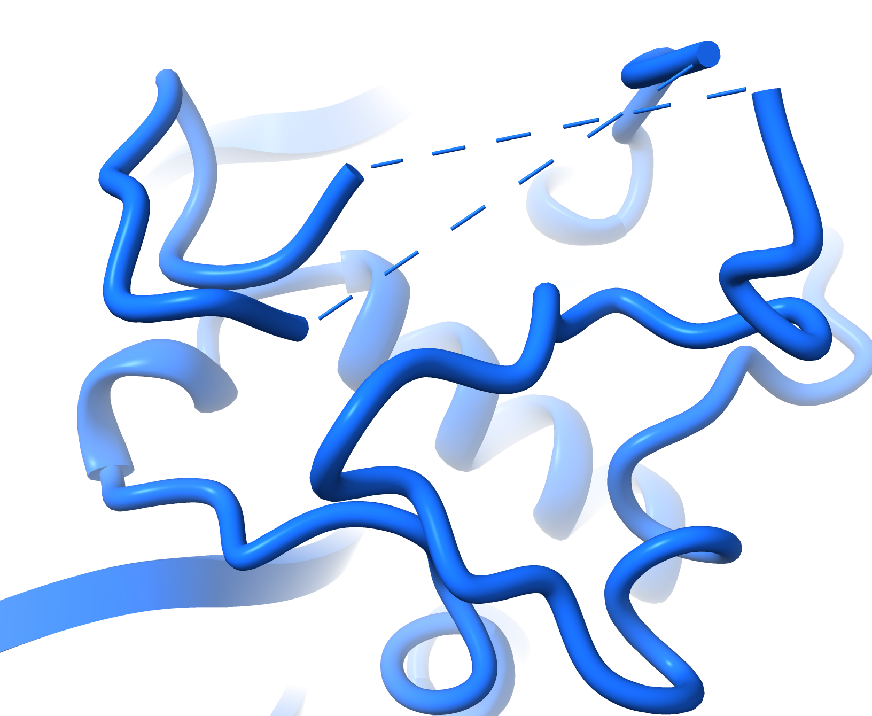
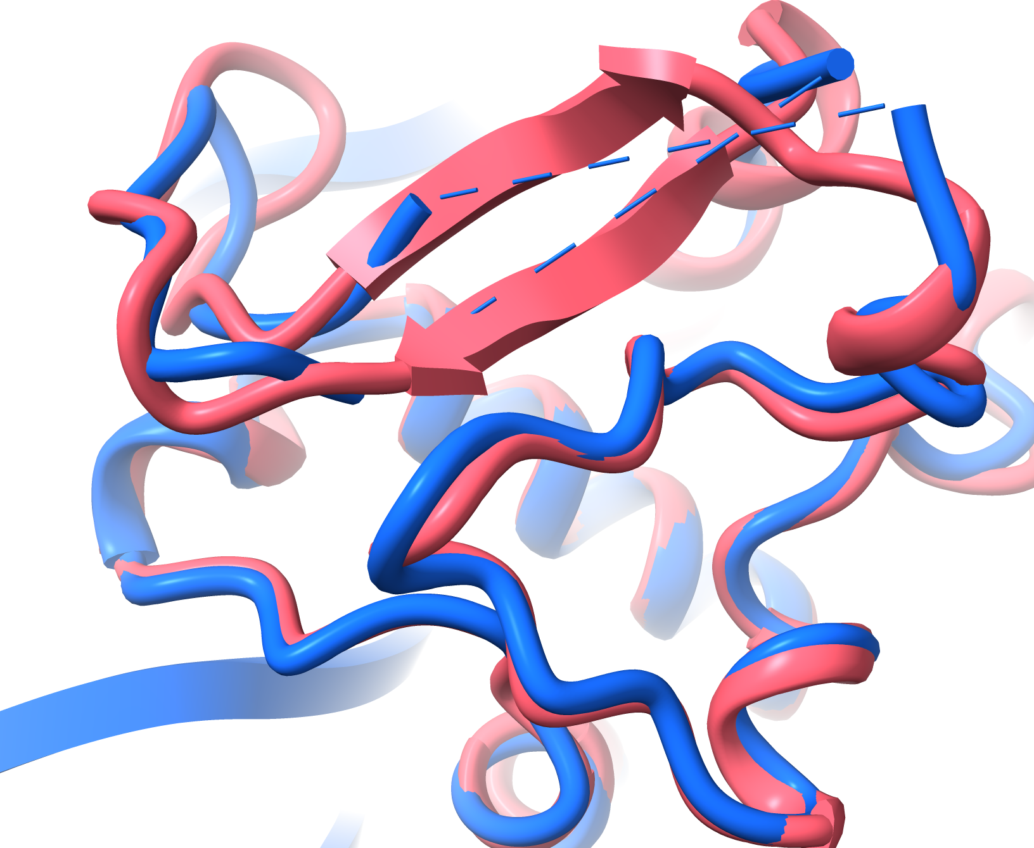
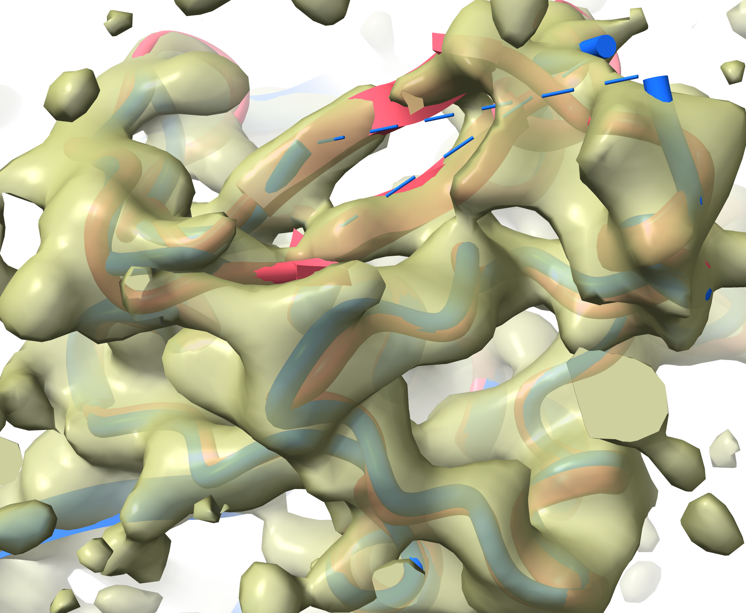
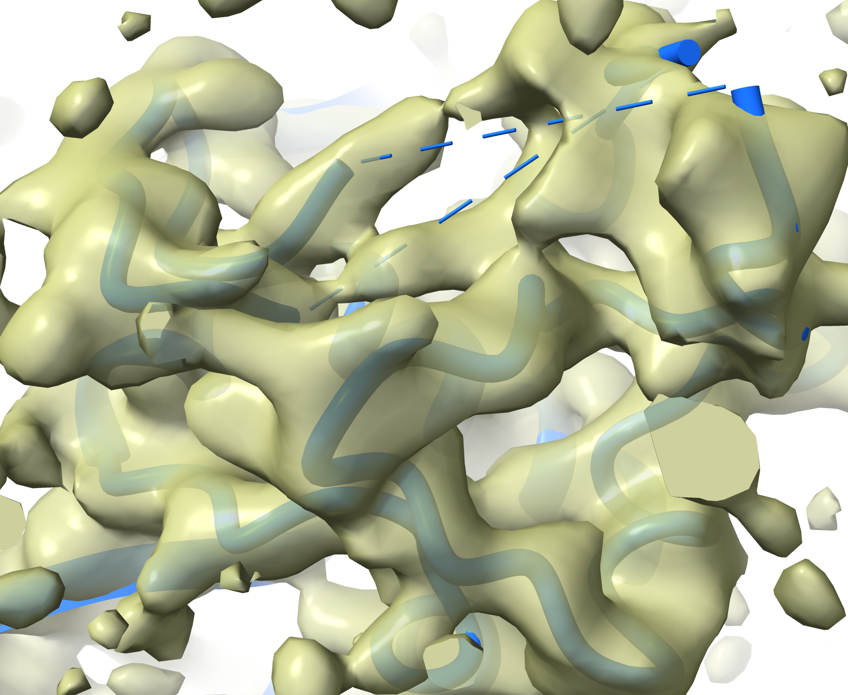
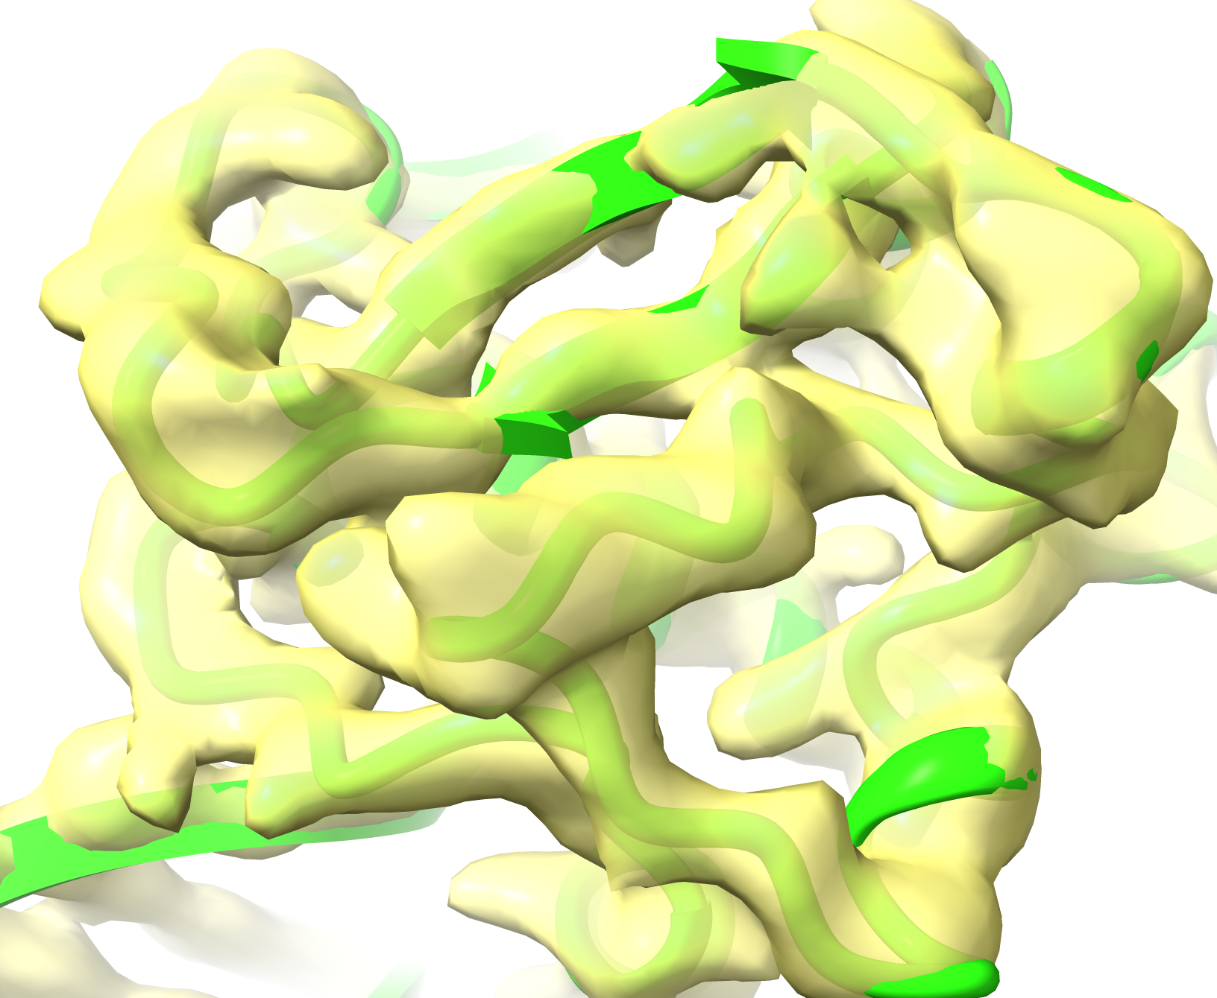
Example: Finishing a difficult crystal structure
Repressor – DNA complex, solved with 2.6 Å SeMet SAD data and refined against 3.1 Å native data
118
147
139
Before AlphaFold, R/Rfree = 0.27/0.29
AlphaFold model:
A hypothesis about this structure
128
After AlphaFold,
R/Rfree = 0.21/0.24
(it was a good hypothesis)
Jamie Wallen, Western Carolina University
Notes:
Using an AF model to fill in gaps in a crystallographic model (where the density was poor)

Slide 16
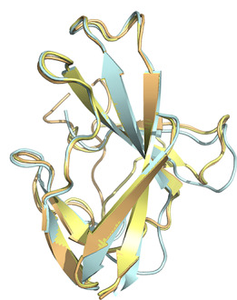
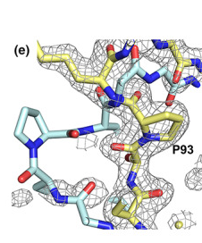
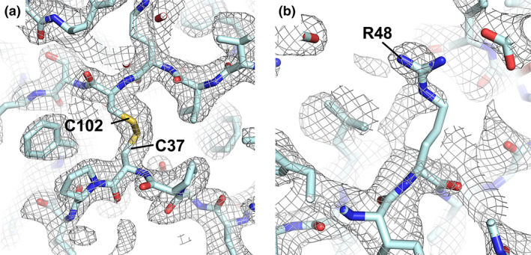
Molecular replacement
Molecular Replacement
(2 Å)
7jtl (2 chains)
Parts of main chain required rebuilding
Accurate parts
Many side-chains in wrong positions
AlphaFold
Flower TG, Hurley JH. (2021) Crystallographic molecular replacement using an in silico‐generated search model of SARS‐CoV‐2 ORF8. Protein Science 30:728–734
Notes:
Using an AF model in molecular replacement

Slide 17
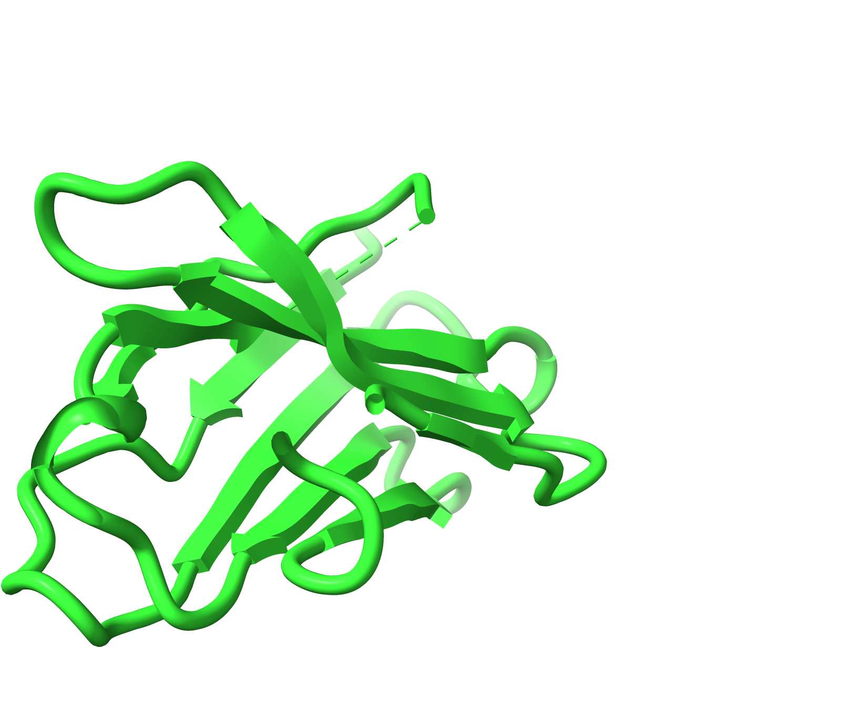
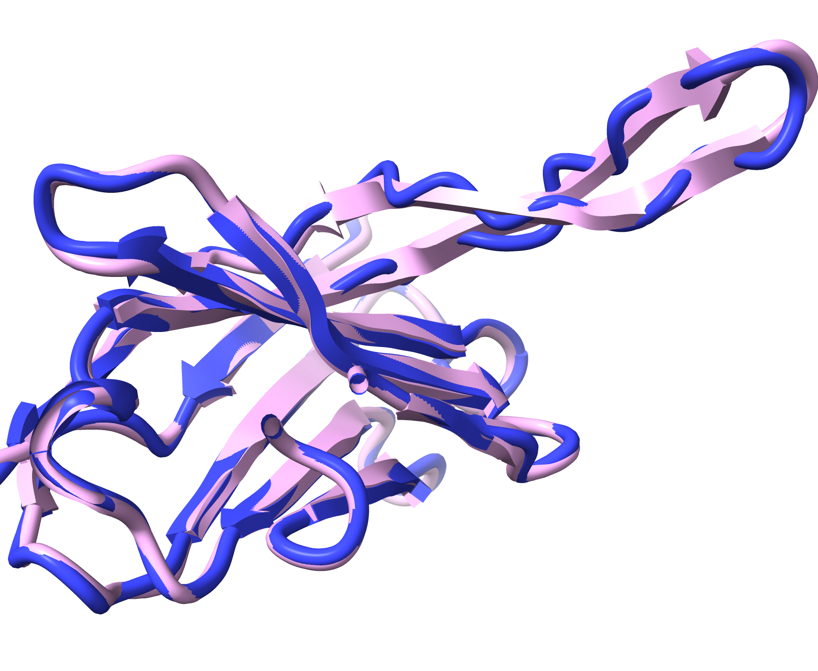
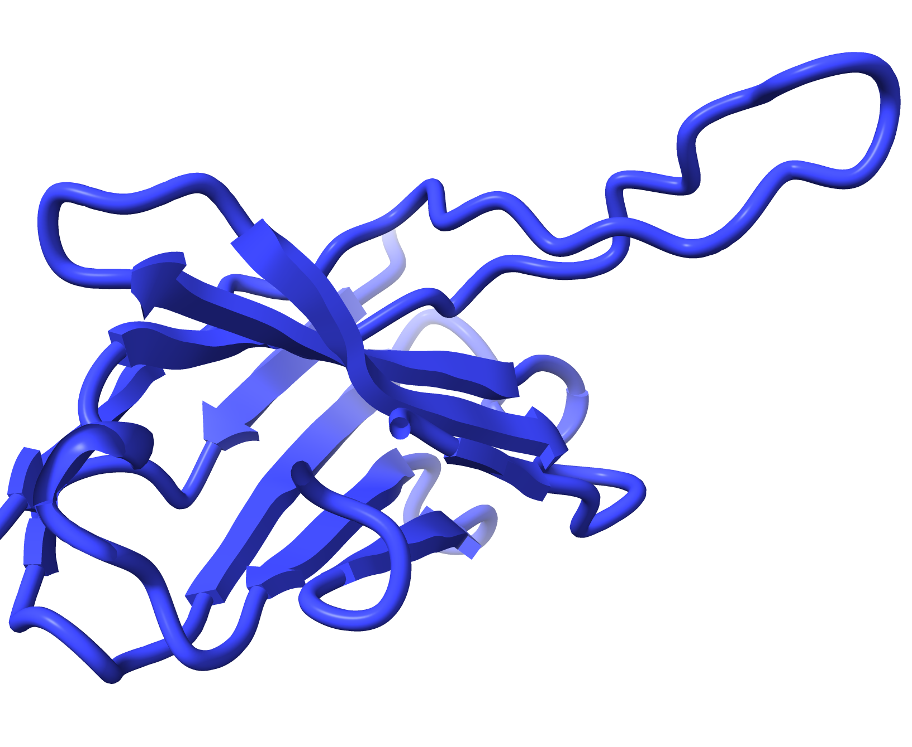
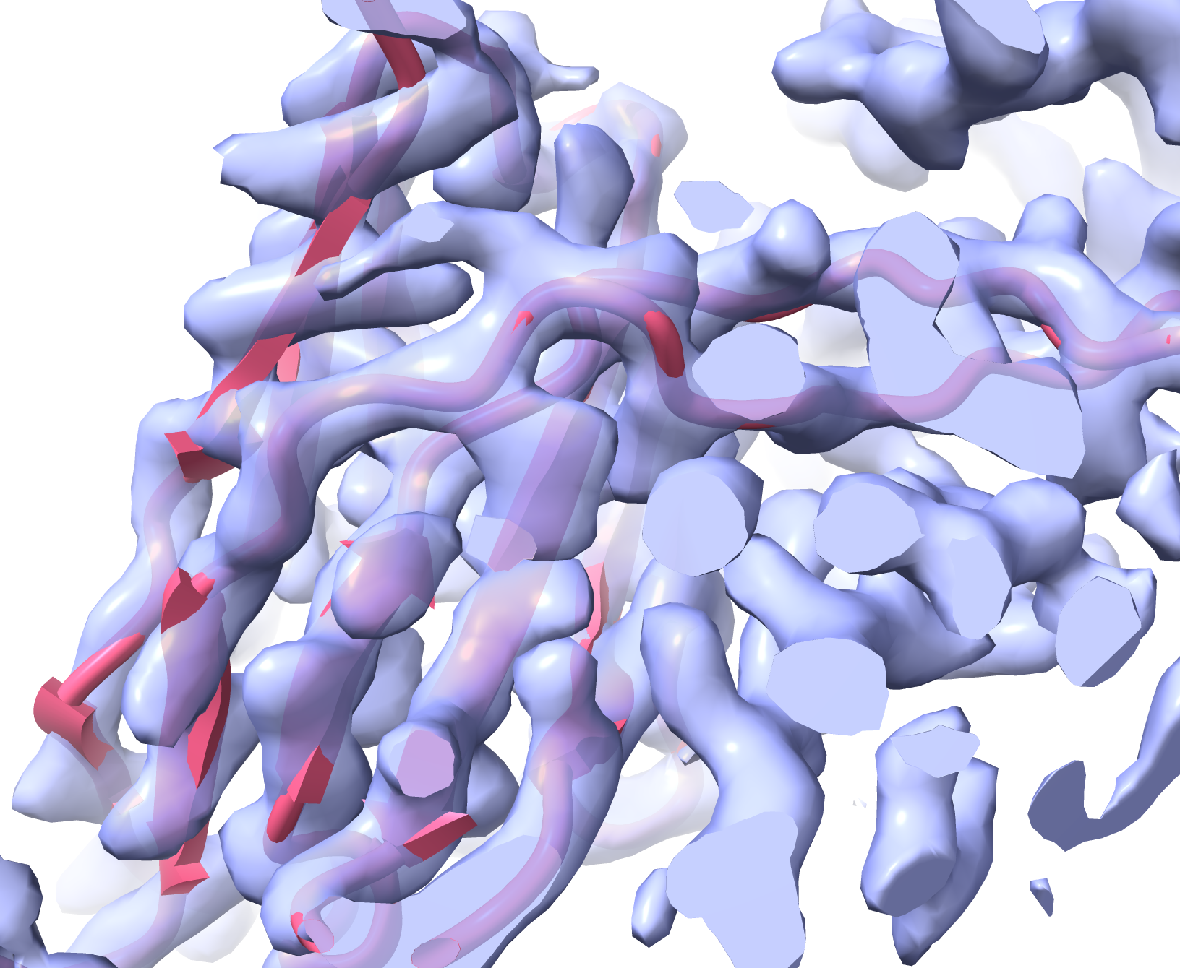
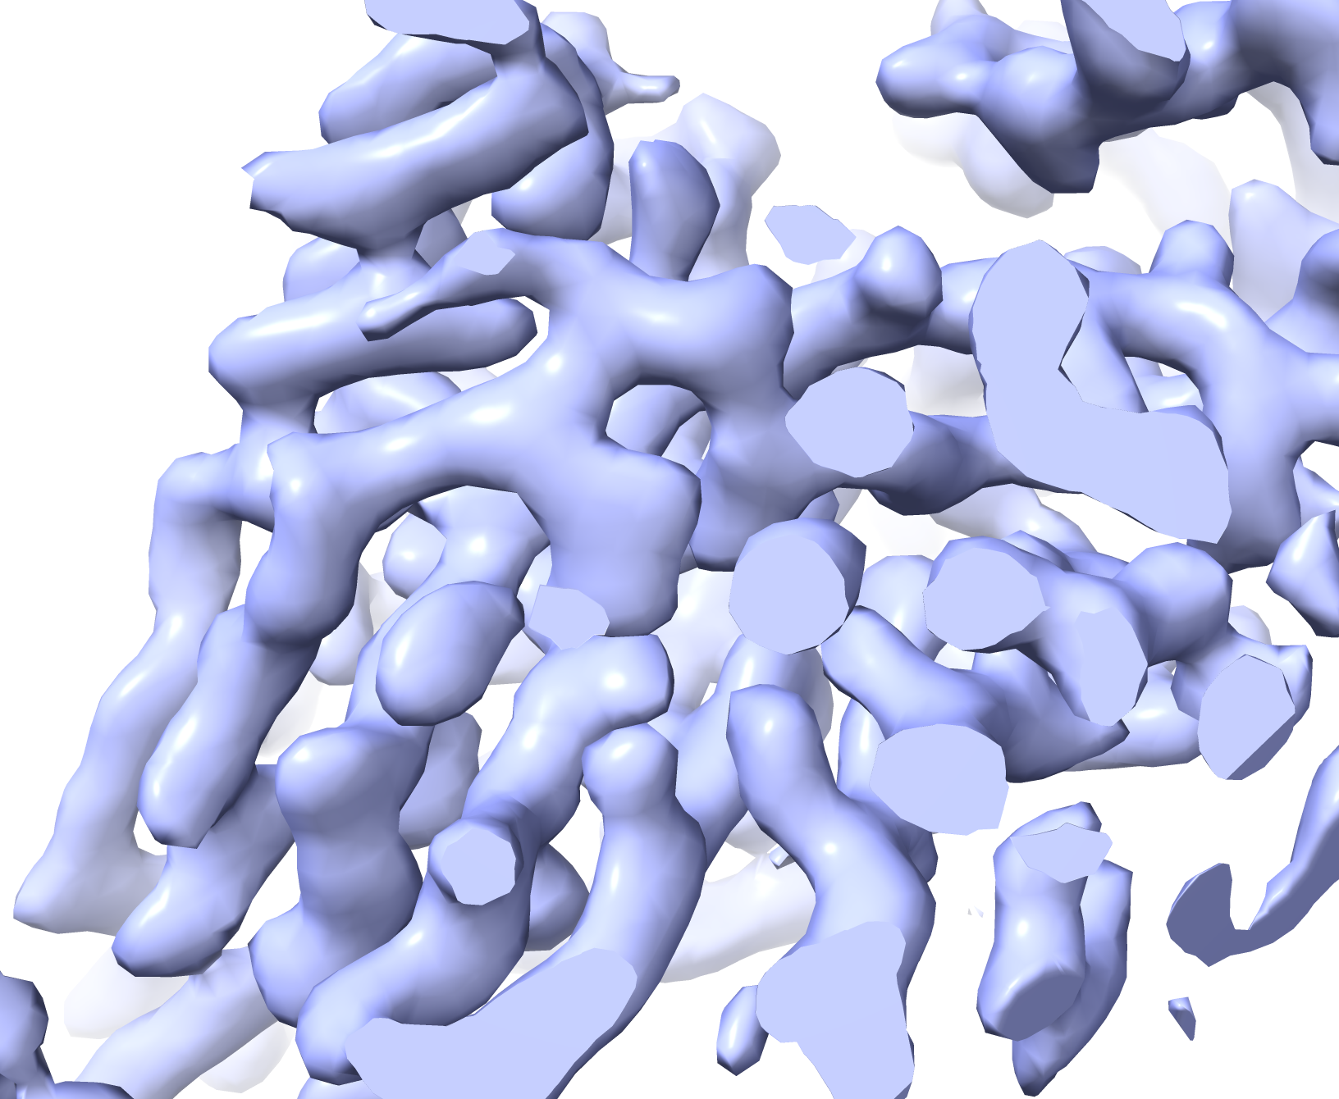
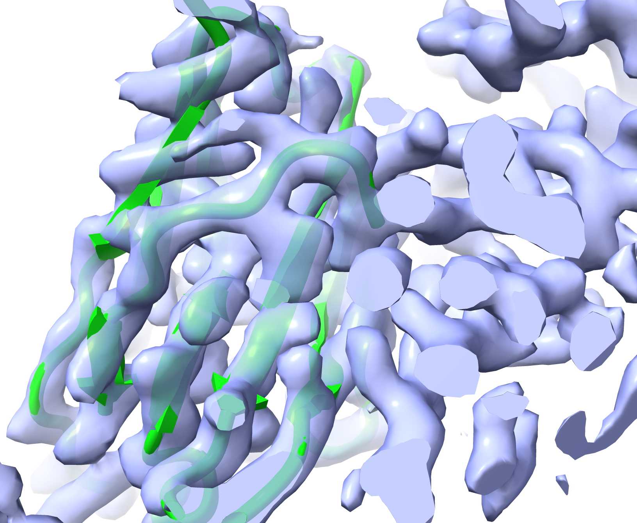
Cryo-EM (7mjs 3 Å, EMDB 23883)
7mjs
7mjs
Trace loop
AlphaFold
Dock in map
Rebuilt
AlphaFold model
Dock in map
Trim low-confidence regions
Trimmed AlphaFold model
Residues 100-120
Low sequence coverage, low confidence, low accuracy
Notes:
Using an AF model in cryo-EM

Slide 18
AlphaFold models …
are great hypotheses for protein structures
jump-start structure determination by X-ray and CryoEM
can be iteratively improved with a density map
allow a new work-flow for structure determination
Notes:
Iterative improvement of predicted models

Slide 19
Iterative AlphaFold prediction and rebuilding
7mjs
Rebuilt
AlphaFold model
Rebuilt model as a template …
Rebuilt
model
… can we get a better AlphaFold model?
Data from 7mjs, Cater, R.J., et al. (2021). Nature 595, 315–319
Notes:
Can we improve an AF model using a rebuilt model as a template?

Slide 20
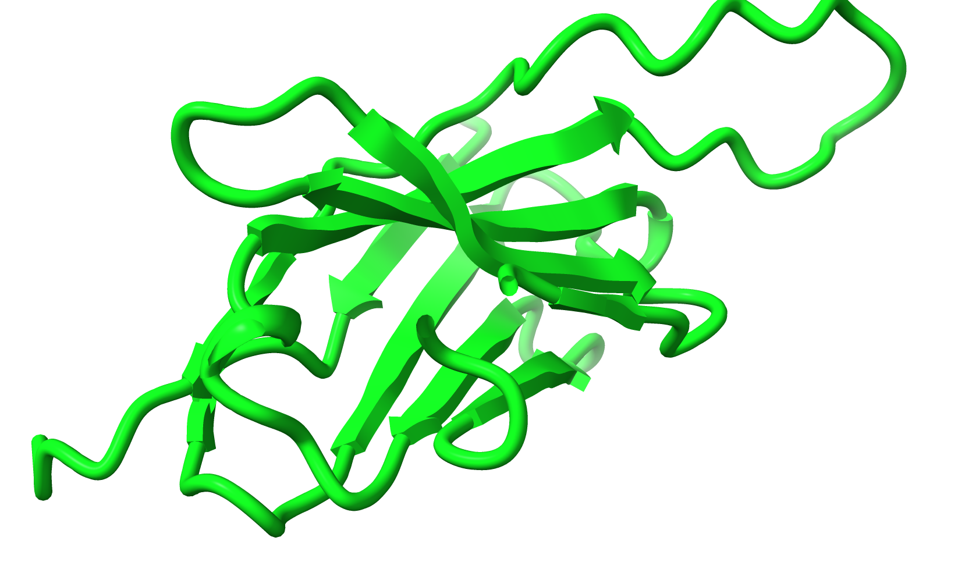
Initial AlphaFold prediction …
Sequence
Multiple sequence alignment
21 million parameters
3D prediction
EVQLVESGGGLVQPGGSLRLSCAASGFNIYSSSIHWVRQAPGKGLEWVAYI
............................F....M........Q........
..................K.........Y....L.......A.........
..............A.............................V......
....................A..............................
............................L....V....E............
.........A...................................Q.....
The prediction is poor in the loop region
Data from 7mjs, Cater, R.J., et al. (2021). Nature 595, 315–319
Notes:
How standard AF prediction works (review)

Slide 21
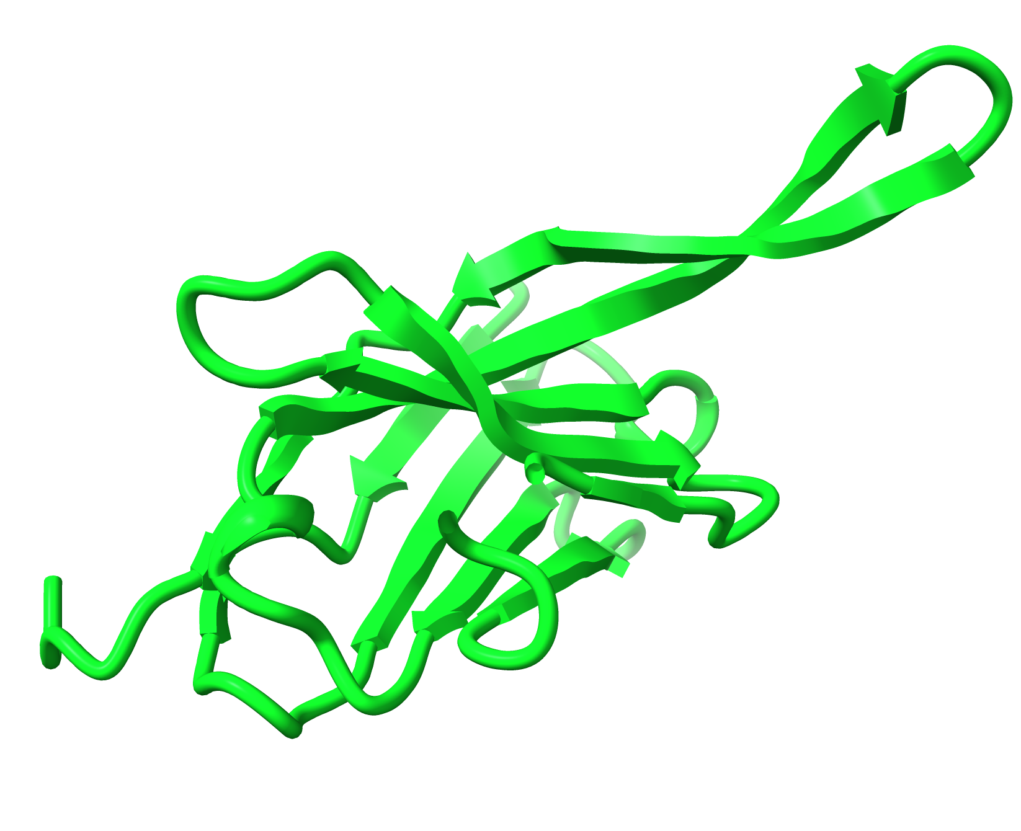
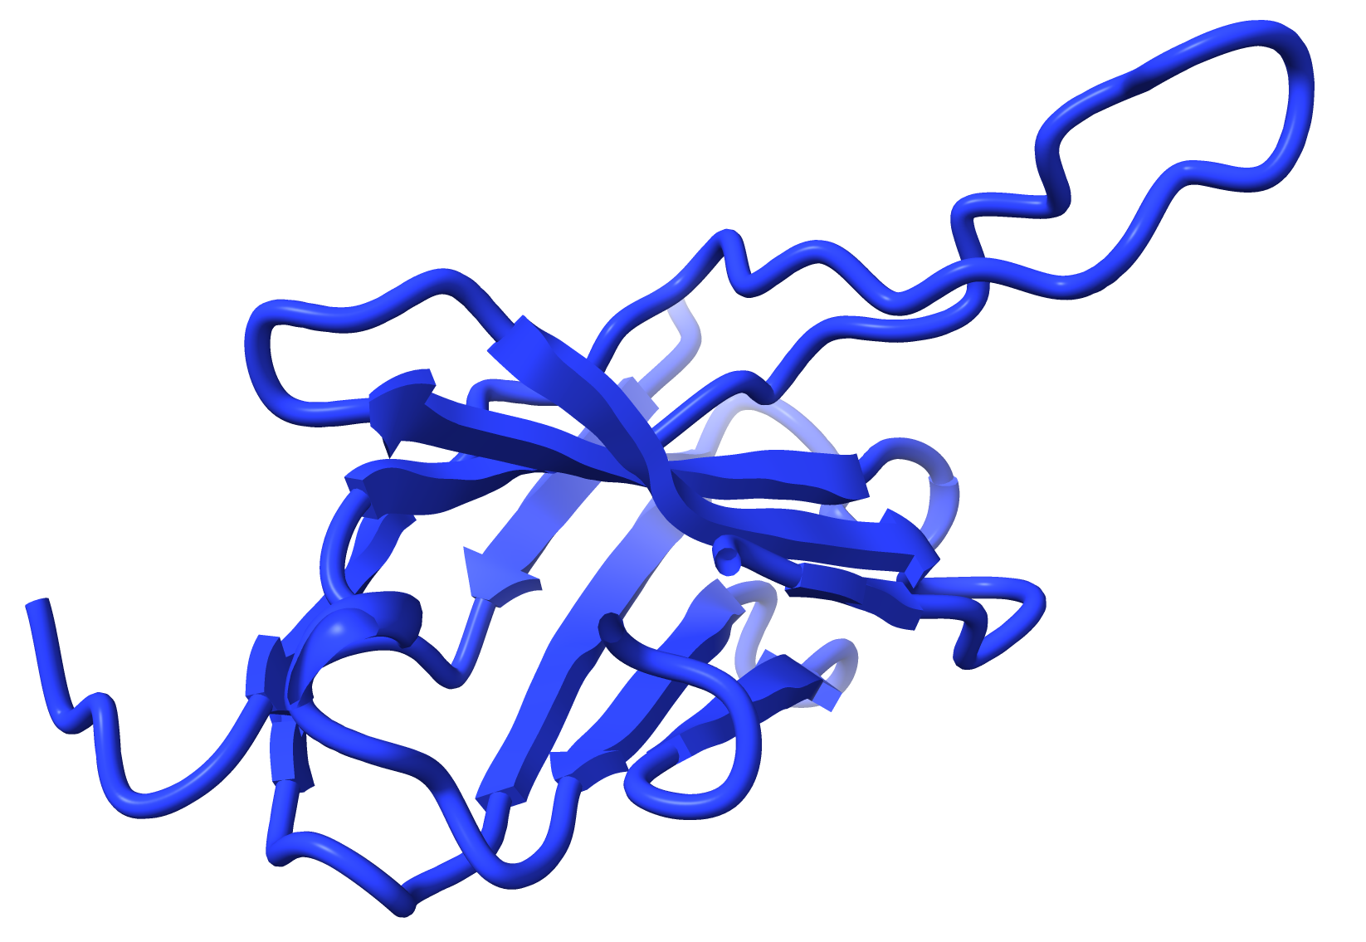
AlphaFold prediction with a template
Sequence
Multiple sequence alignment
21 million parameters
3D prediction
EVQLVESGGGLVQPGGSLRLSCAASGFNIYSSSIHWVRQAPGKGLEWVAYI
............................F....M........Q........
..................K.........Y....L.......A.........
..............A.............................V......
....................A..............................
............................L....V....E............
.........A...................................Q.....
Template
Backbone angles
Focus attention on residues that are close
Yes, the template improves prediction
The new prediction is even better than the template
Data from 7mjs, Cater, R.J., et al. (2021). Nature 595, 315–319
Notes:
Why using a rebuilt model as a template might and does improve AF prediction

Slide 22
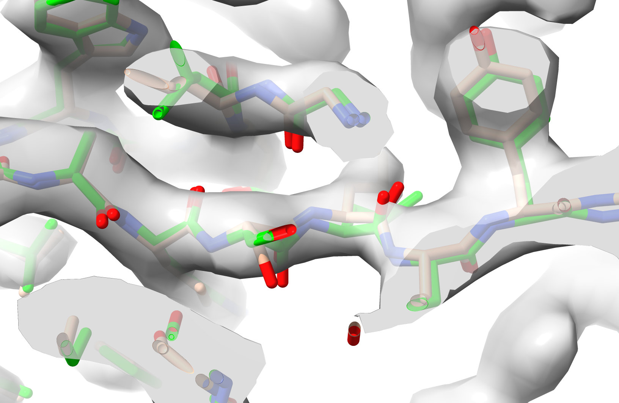
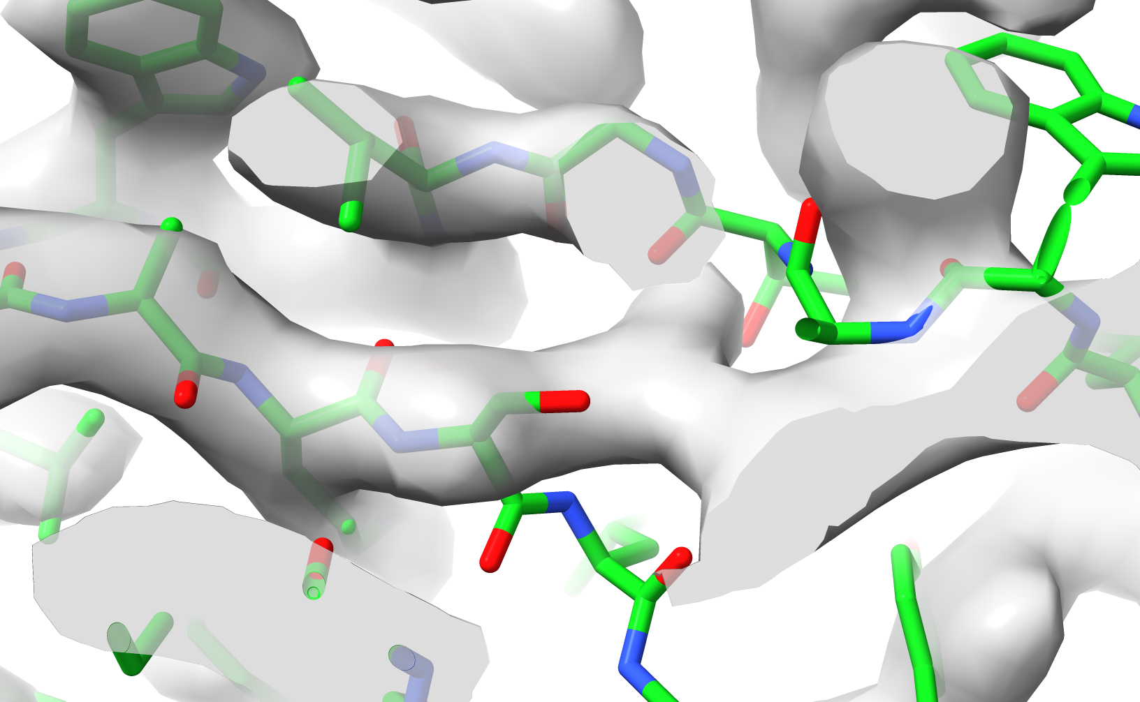
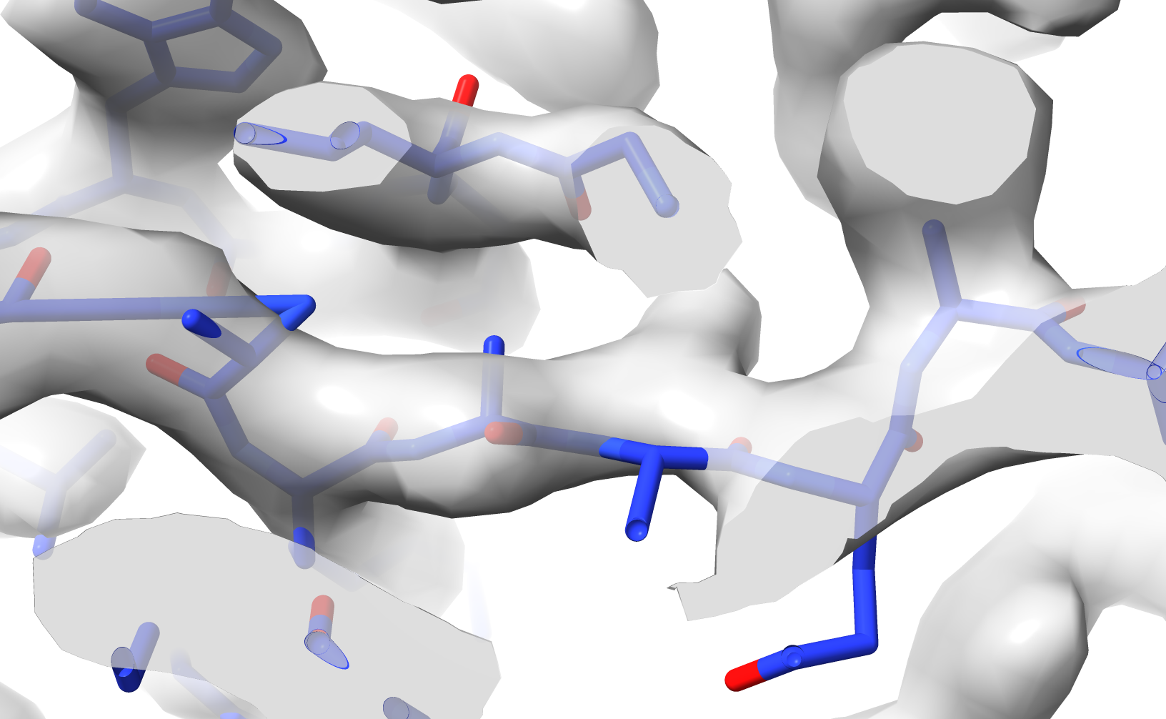
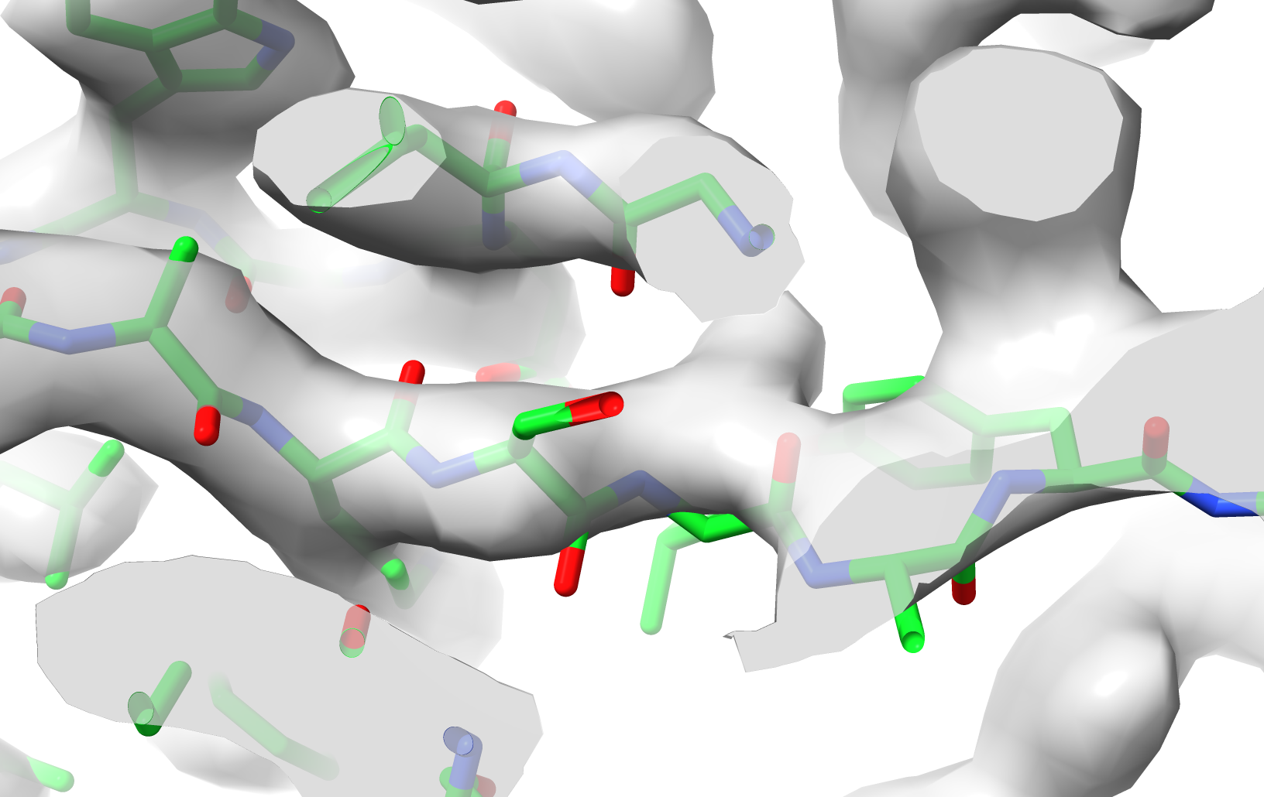
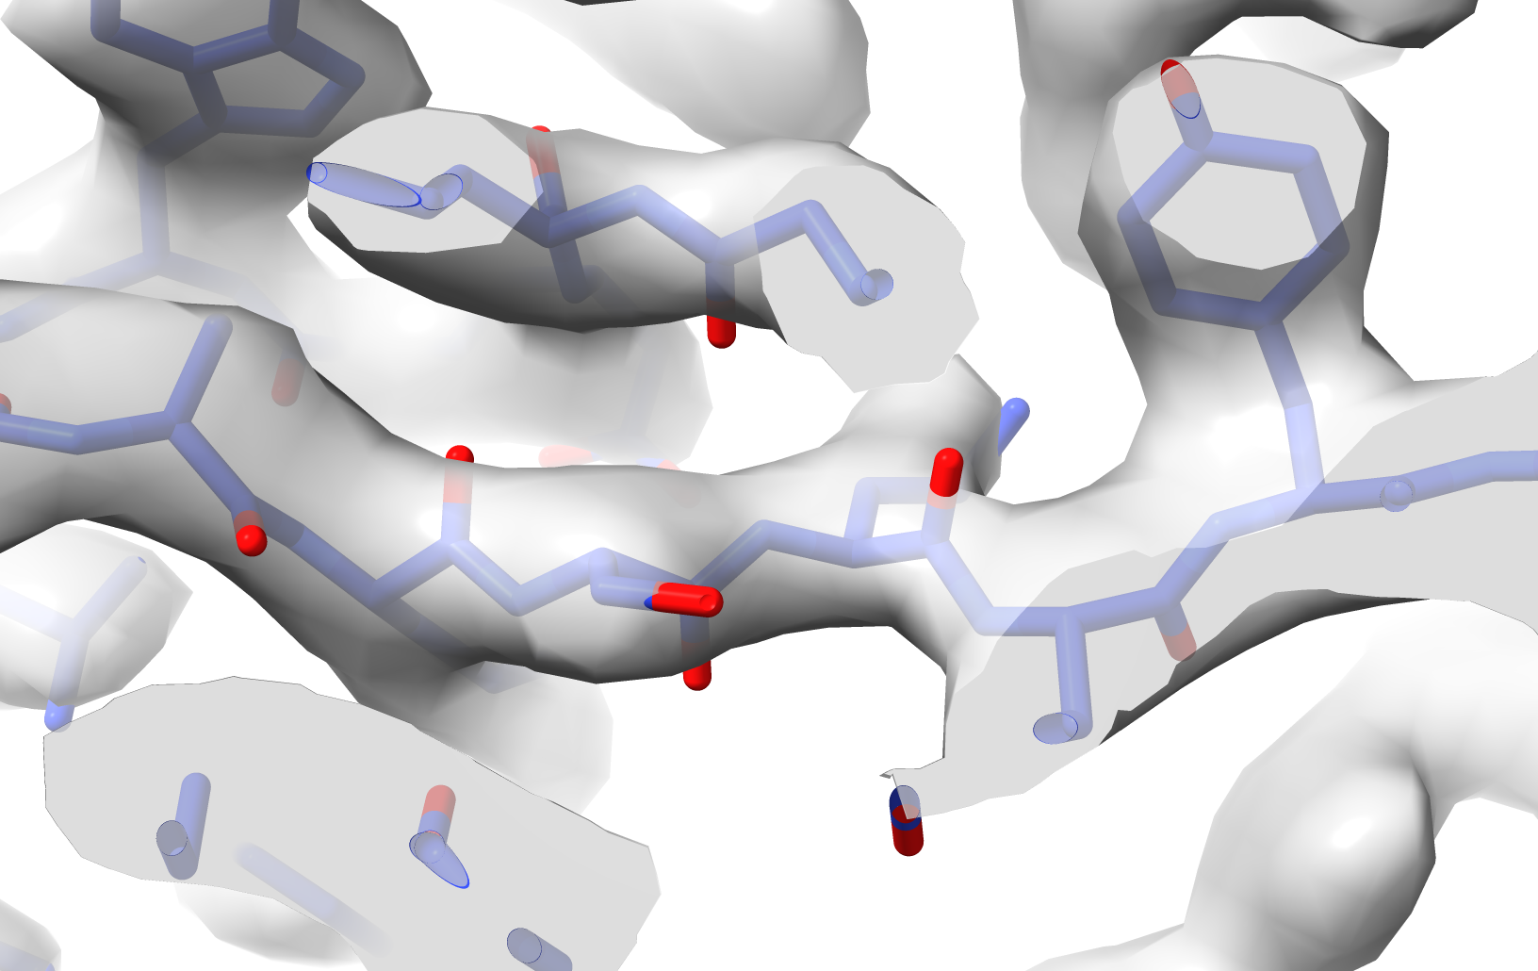
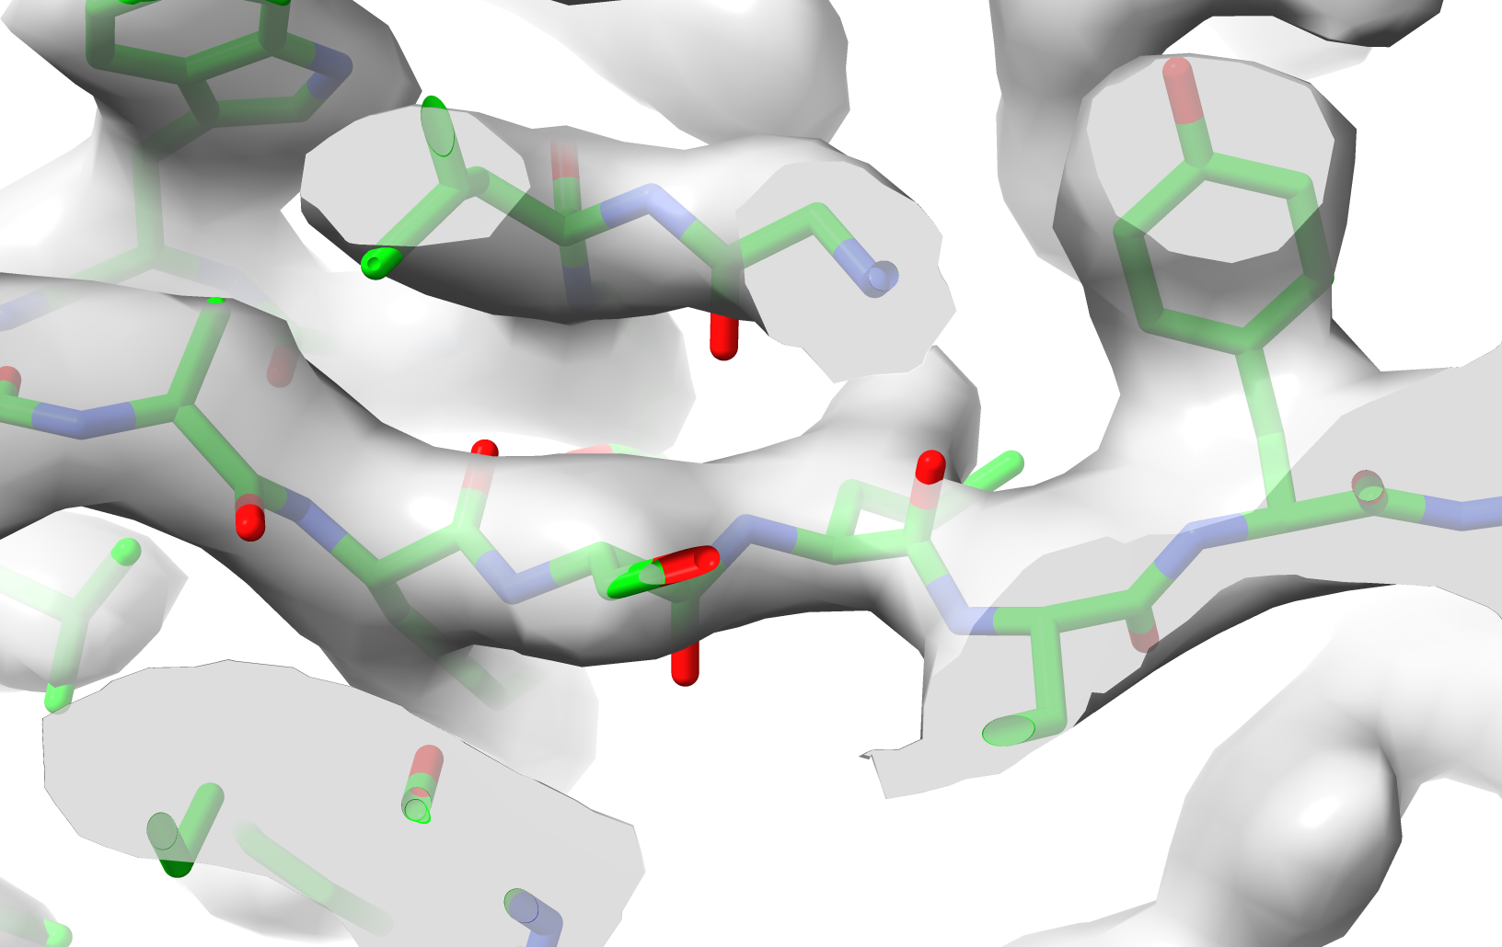

Iterative AlphaFold prediction and rebuilding
AlphaFold cycle 4
AlphaFold cycle 4
7mjs
Rebuilt cycle 1
Initial Alphafold prediction
AlphaFold
cycle 3
Rebuilt cycle 2
AlphaFold
with template
Note this AlphaFold model is superimposed, not refined
Data from 7mjs, Cater, R.J., et al. (2021). Nature 595, 315–319
Notes:
Details of improvement of AF prediction by including rebuilt models as templates

Slide 23
Iterative AlphaFold prediction and rebuilding
Rebuild AlphaFold model with density map
Rebuilt model improves next AlphaFold prediction
Iterate to improve model
Terwilliger et al. (2022). Improving AlphaFold modeling using implicit information from experimental density maps. BioRxiv 2022.01.07.475350
Notes:
Summary of iterative AlphaFold prediction and rebuilding

Slide 24
AlphaFold models …
are great hypotheses for protein structures
jump-start structure determination by X-ray and CryoEM
can be iteratively improved with a density map
allow a new work-flow for structure determination
Notes:
New work flows for structure determination by X-ray and cryo-EM

Slide 25
Workflow for getting the best AlphaFold model
    }
Sequence
AlphaFold Colab
AlphaFold prediction
Multiple sequence alignment
AlphaFold
Dock-and-rebuild
Rebuild with density map
Templates from PDB
ISOLDE
Fix errors
Templates you have created
Rebuilt model
Notes:
Summary of how to get the best AlphaFold model by iterative rebuilding and prediction. Stopping point is “AlphaFold prediction”

Slide 26
Workflow for cryo-EM
    }
Dock-and-rebuild
Model for each chain with full exact sequence
Density map
Rebuild AlphaFold predictions
AlphaFold prediction for each chain
ISOLDE, real-space refine
Fix errors, refine
AlphaFold Colab
AlphaFold with refined model for each chain
Refined model for each chain
Notes:
Summary of workflow for cryo-EM. Stopping point is “Refined model for each chain”

Slide 27
Workflow for crystallography
    }
MR model
X-ray data
Phaser
AutoBuild
Molecular replacement
Automated rebuilding
AlphaFold prediction for each chain
Autobuilt model
Density map
AlphaFold Colab
AlphaFold with supplied template on each chain
AlphaFold prediction
Dock-and-rebuild
Rebuild AlphaFold predictions
Refined model for each chain
ISOLDE,
Real-space refine
Rebuilt model for each chain with full exact sequence
Fix errors, refine
Notes:
Summary of workflow for crystallography

Slide 28
AlphaFold models …
are great hypotheses for protein structures
jump-start structure determination by X-ray and CryoEM
can be iteratively improved with a density map
allow a new work-flow for structure determination
Notes:
Summary of talk

Slide 29




The Phenix Project
Lawrence Berkeley Laboratory
New Mexico Consortium
Los Alamos National Laboratory
Paul Adams, Pavel Afonine, Dorothee Liebschner, Nigel Moriarty, Billy Poon, Christopher Schlicksup, Oleg Sobolev
Tom Terwilliger, Li-Wei Hung
Baylor College of Medicine
University of Cambridge
Matt Baker, Corey Hyrc
Randy Read, Airlie McCoy,
Tristan Croll, Claudia Millán Nebot, Rob Oeffner, Duncan Stockwell
Duke University
Jane & David Richardson, Chris Williams, Vincent Chen
An NIH/NIGMS funded
Program Project
Liebschner et al., Macromolecular structure determination using X-rays, neutrons and electrons: recent developments in Phenix. Acta Cryst. 2019 D75:861-877
Notes:
Credits

