Slide 1



SBGrid Weekly Webinar Series
Tuesdays and Fridays at 12:00pm ET
Full webinar lineup on our website - sbgrid.org
Connect with us online
@SBGrid @SBGrid SBGridTV
Events are posted on SBGrid Google Calendar (to join visit http://sbgrid.org/calendar)
This talk is available at:
http://www.phenix-online.org/presentations/Phenix_SBGrid_Terwilliger_2020-03-31c.pptx

Slide 2
Systems Check

Slide 3
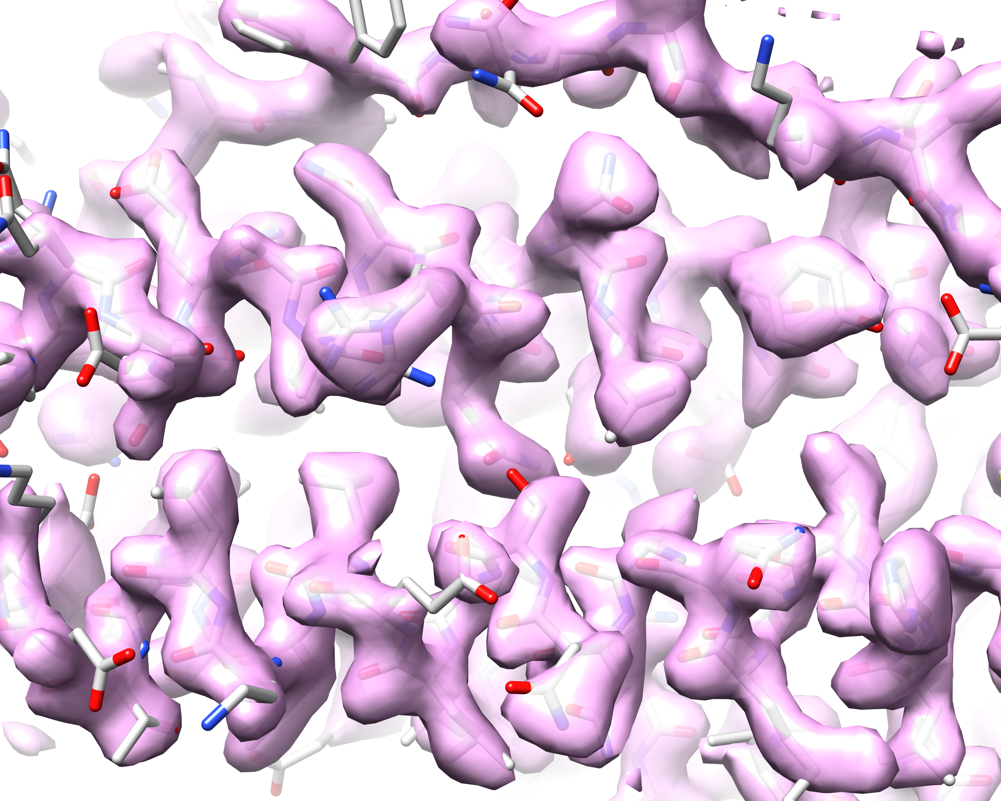




Density modification and model building with cryo-EM maps
SBGrid Weekly Webinar Series
March 31, 2020
Tom Terwilliger, New Mexico Consortium
Randy Read, Cambridge University
Steve Ludke, Baylor College of Medicine
Pavel Afonine, Paul Adams, Dorothee Liebschner, Lawrence Berkeley National Laboratory
This talk is available at:
http://www.phenix-online.org/presentations/Phenix_SBGrid_Terwilliger_2020-03-31c.pptx

Slide 4
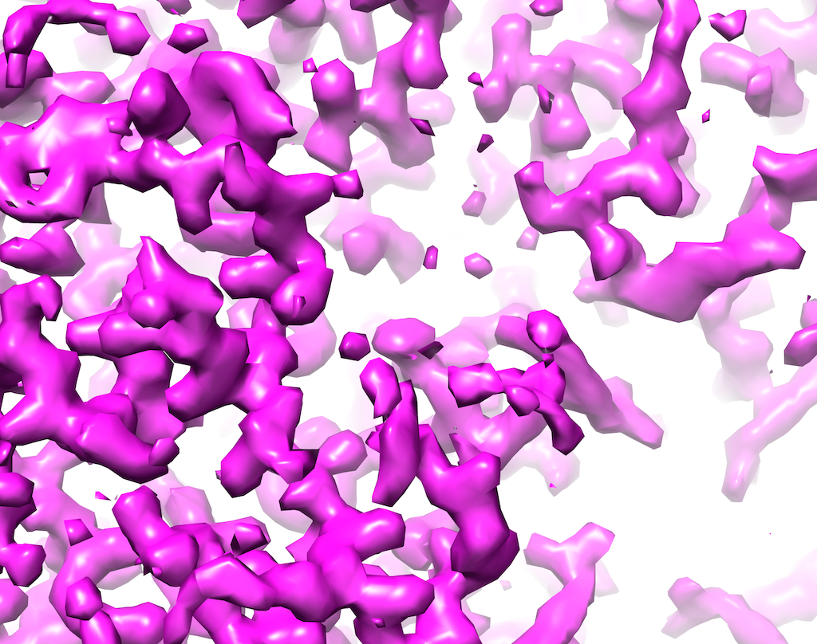
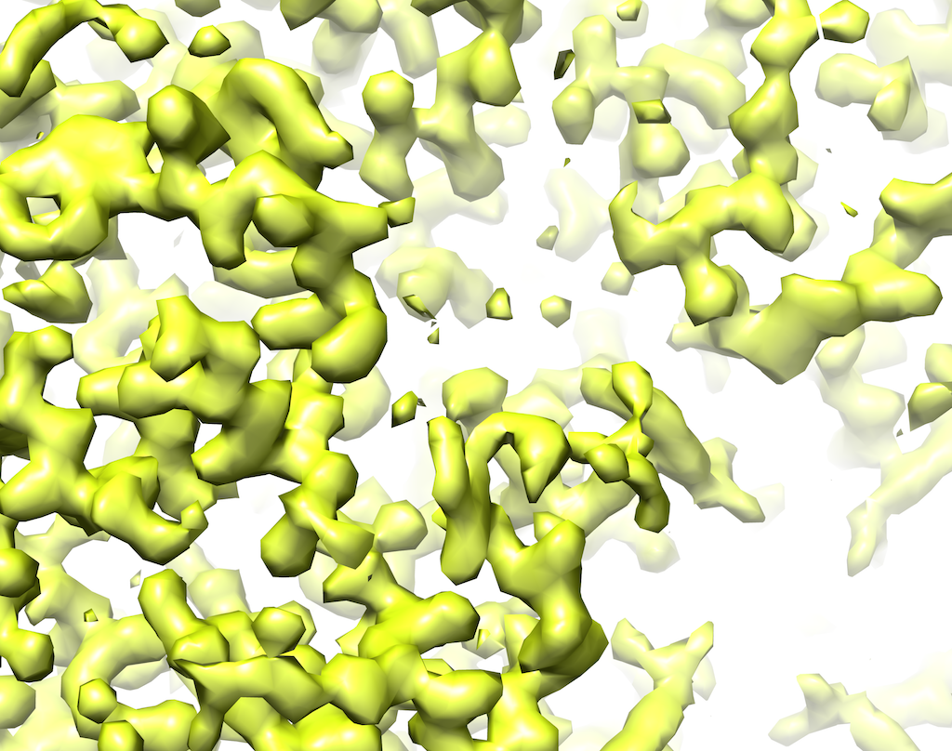
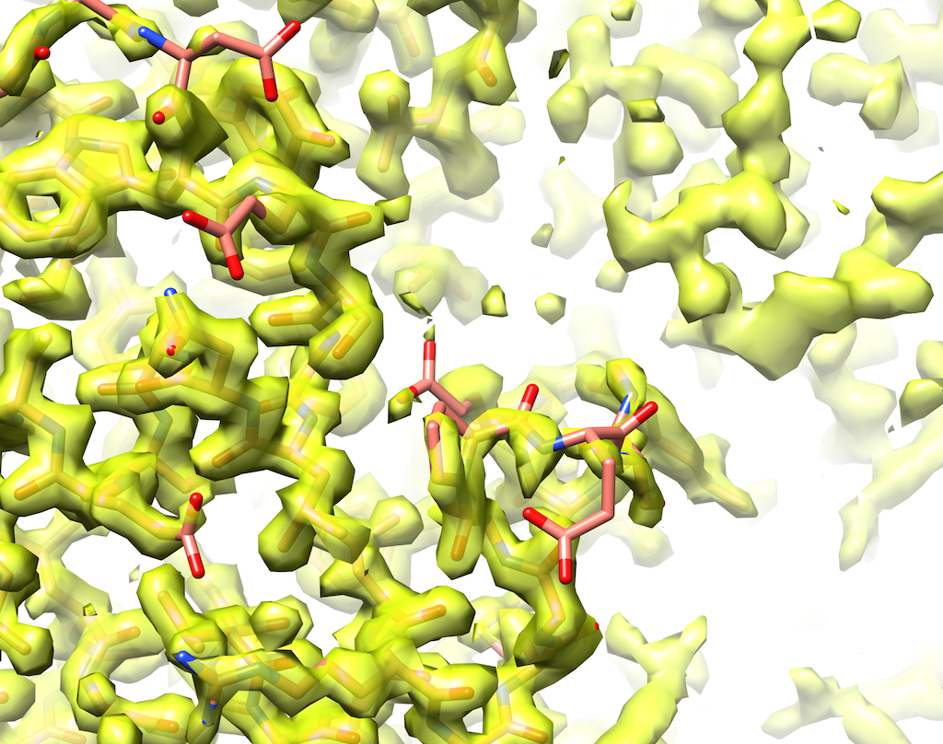
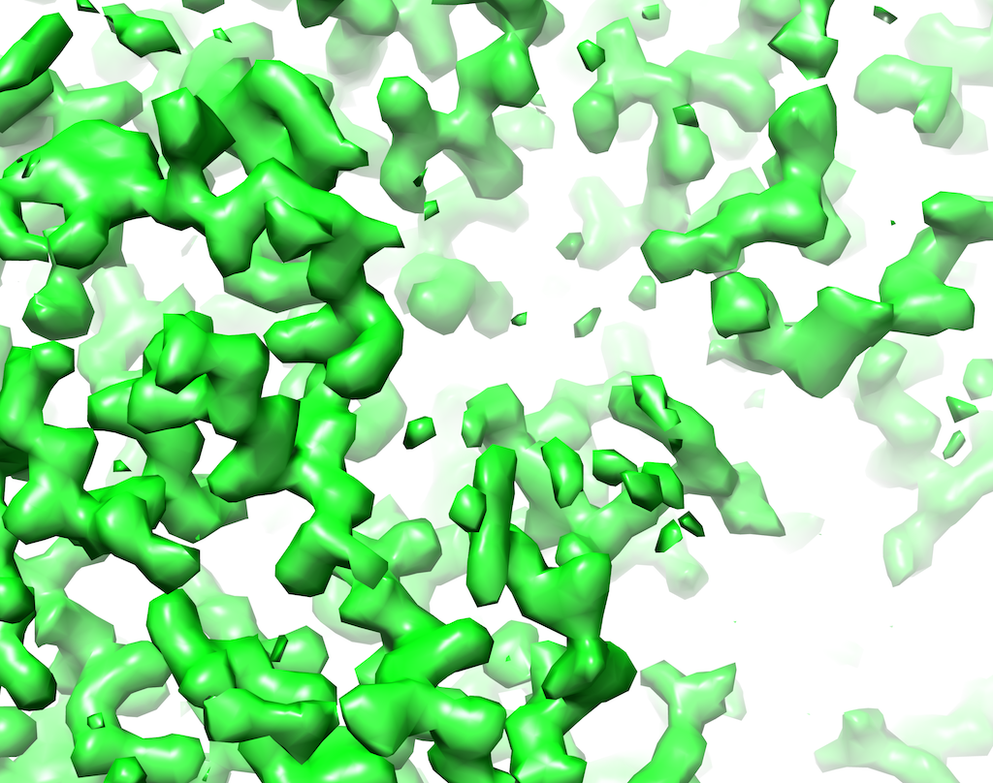

Density modification and model-building
Density-modified map
Model
2 half-maps
Notes:
These are 1.8 A resolution half-maps from apoferritin. EMD-20026

Slide 5
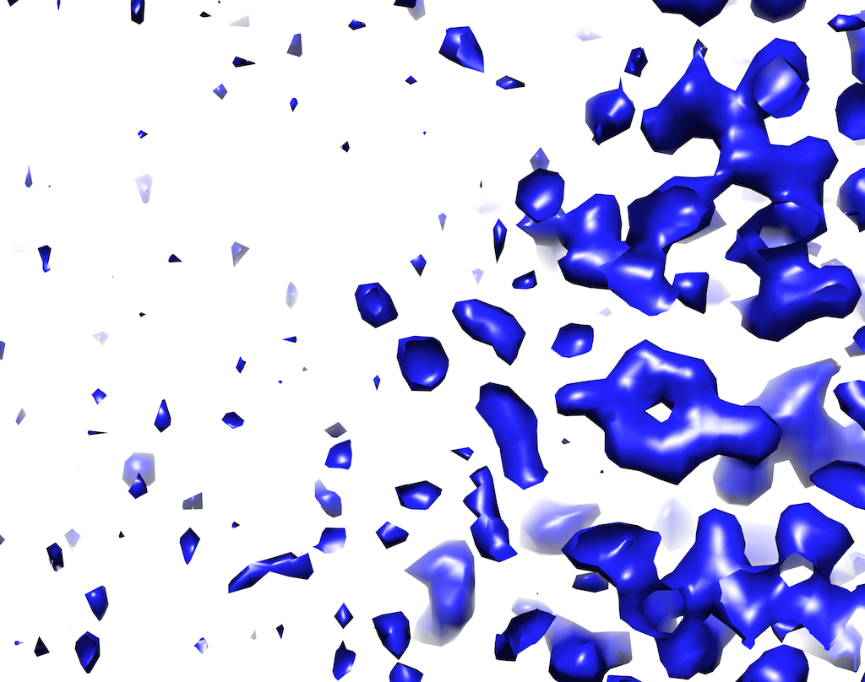
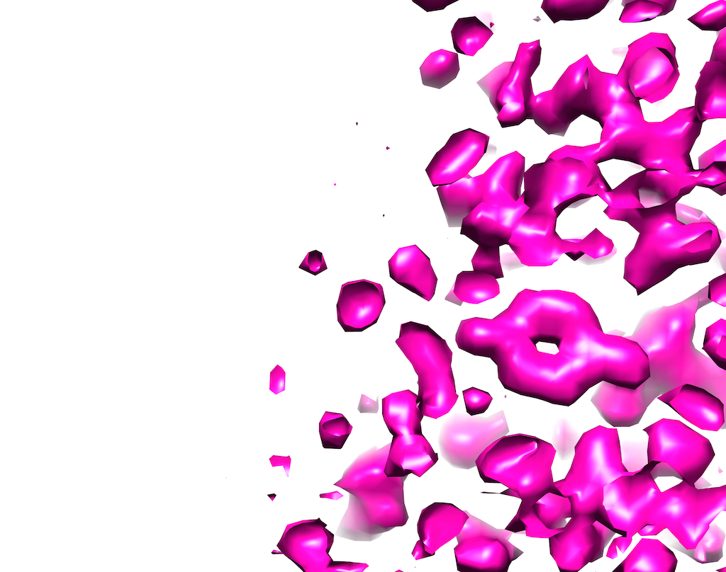
Density modification with cryo-EM maps
Using expectations about one part of a map to improve another part of the map
Original map
Density-modified
Solvent should be flat
Distribution of density values (histograms) should match typical protein
Notes:
The original map is implausible because it has a noisy solvent and density profile is unlike that of typical protein.
The density-modified map is more plausible with flat solvent and density histograms similar those of typical protein

Slide 6
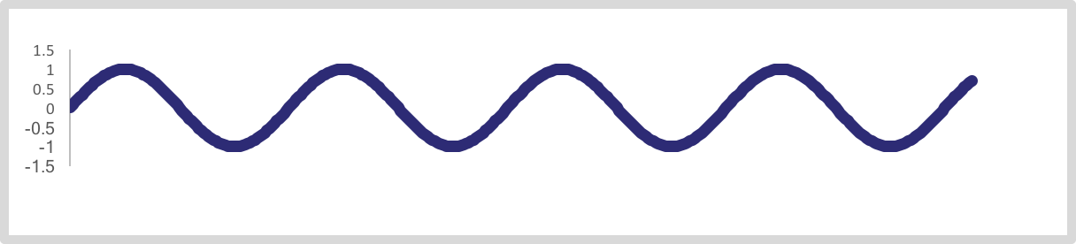
How density modification works
Maps are calculated from Fourier terms…
Fourier terms
Map
An error in one Fourier term leads to correlated errors throughout the map
A change in one Fourier term affects all points in the map
Fixing a Fourier term based on one part of the map can improve another part of the map
Change one Fourier term
Notes:
Errors in one part of the map are correlated with errors elsewhere in the map (note ripples in the little map are everywhere).

Slide 7
Map phasing step in density modification
Fourier terms that improve the map in one place improve it everywhere
One Fourier term at a time, find value that yields most plausible map (all other terms fixed)
Flatter solvent
Better histograms
New Fourier terms improve entire map
(“map-phasing”)
Notes:
Key here is that information is transferred from one part of the map to another.
This is possible because the errors in one part of the map are correlated with errors elsewhere.

Slide 8
Density modification with cryo-EM maps
Sharpen/average to create full map
Identify macromolecule and solvent regions
Target histograms for macromolecule and solvent
Two half-maps
Fourier terms for two original half-maps
Map-phasing estimates of Fourier terms
(one set for each half-map)
Calculate weighted average of two original and two map-phasing sets of Fourier terms
6. Density-modified map
Notes:
Flow chart of density modification. Operations in real-space are in blue and those in reciprocal-space are in green.

Slide 9
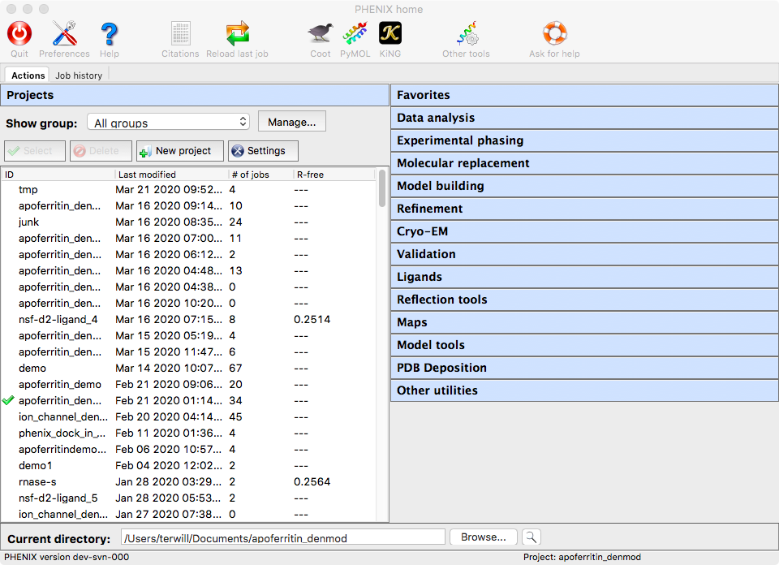
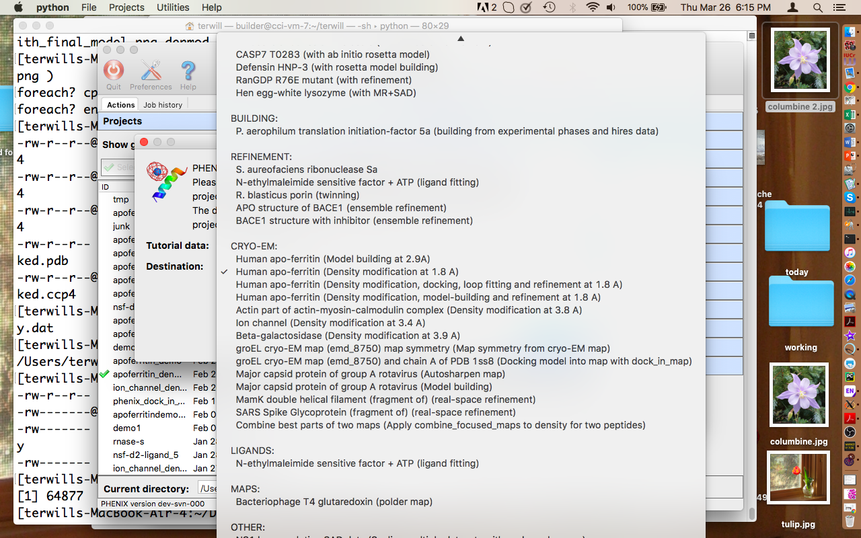
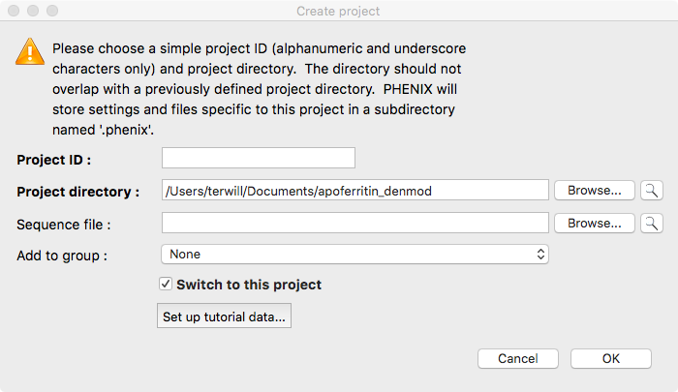
Density modification and model-building tutorial

Slide 10
Density modification in Phenix

Slide 11
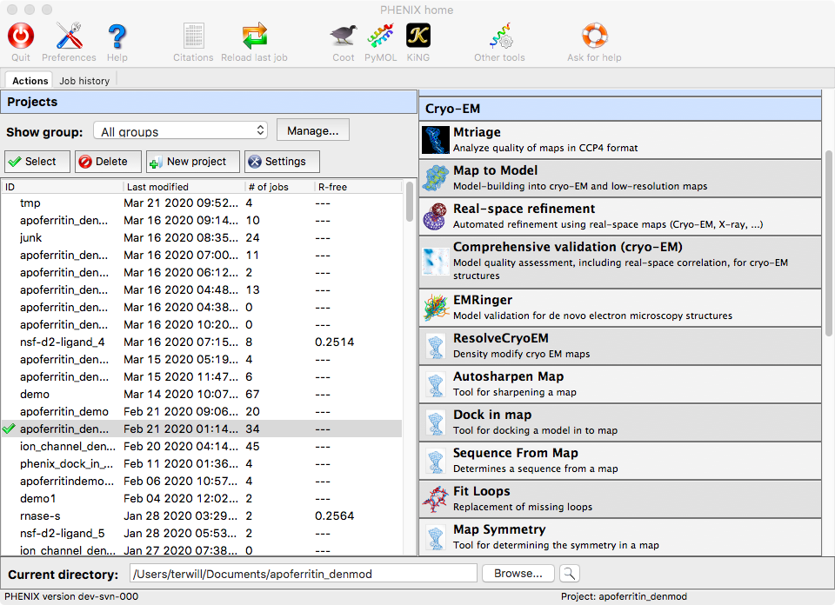

Slide 12
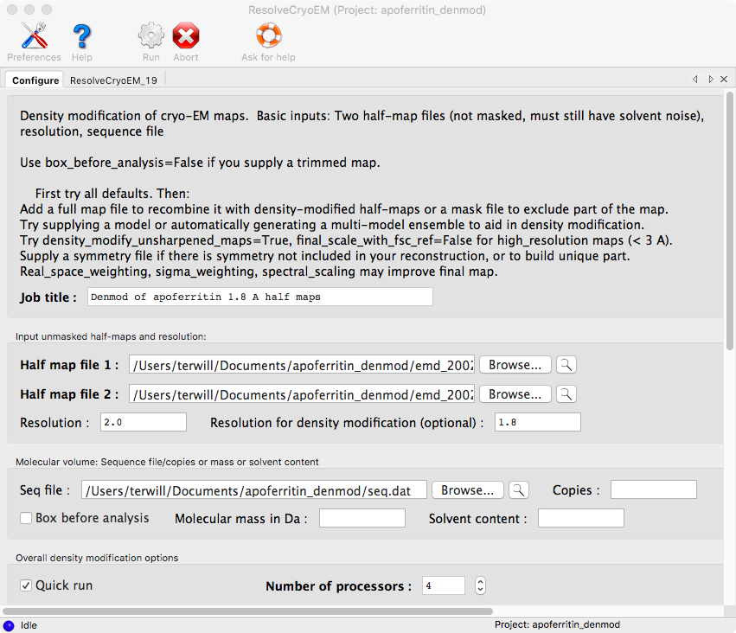

Slide 14
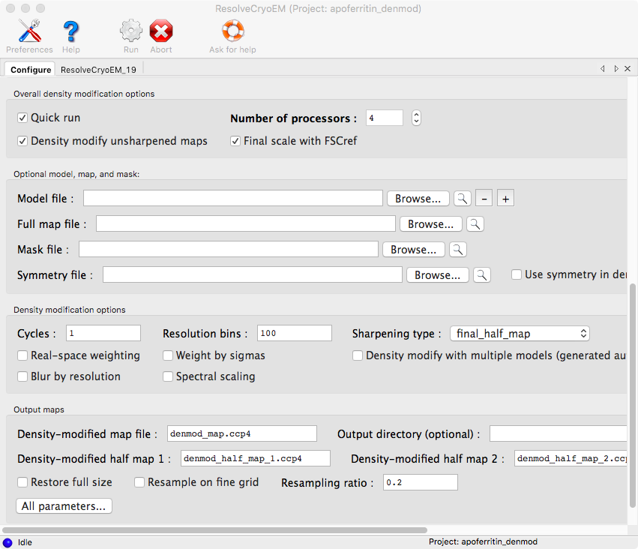

Slide 15
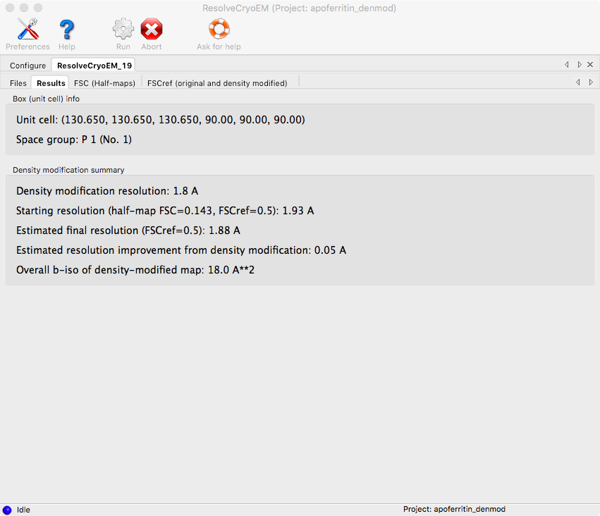

Slide 16
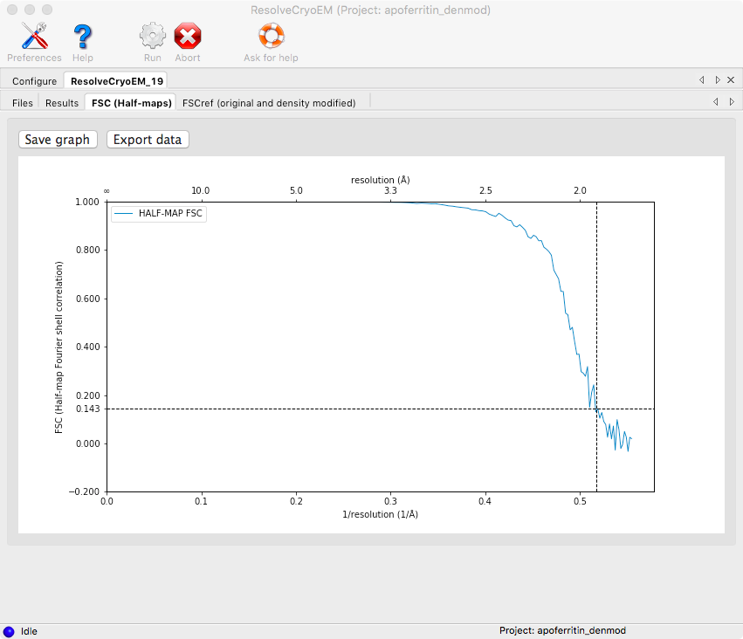

Slide 17
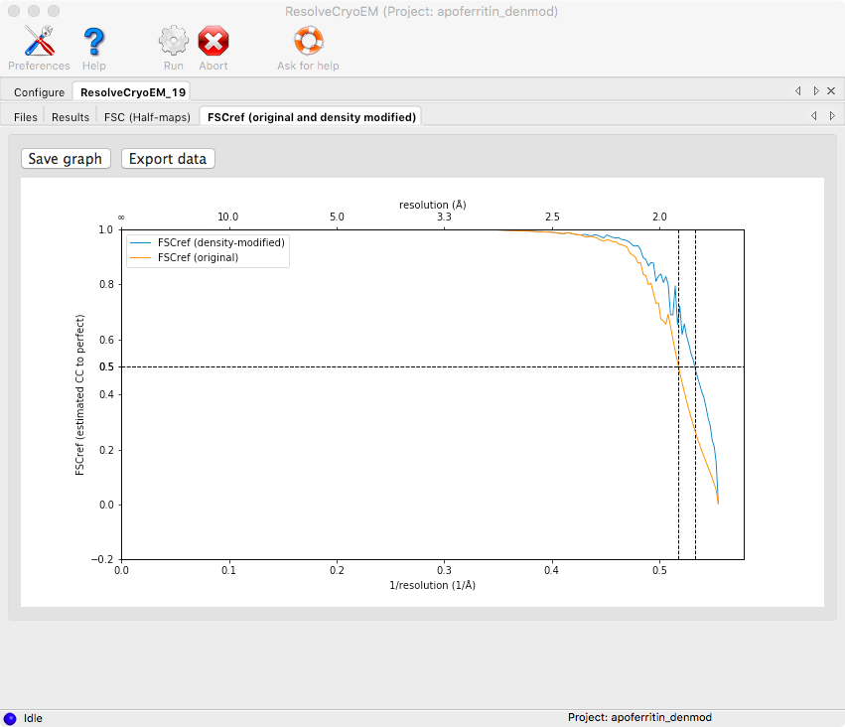

Slide 18
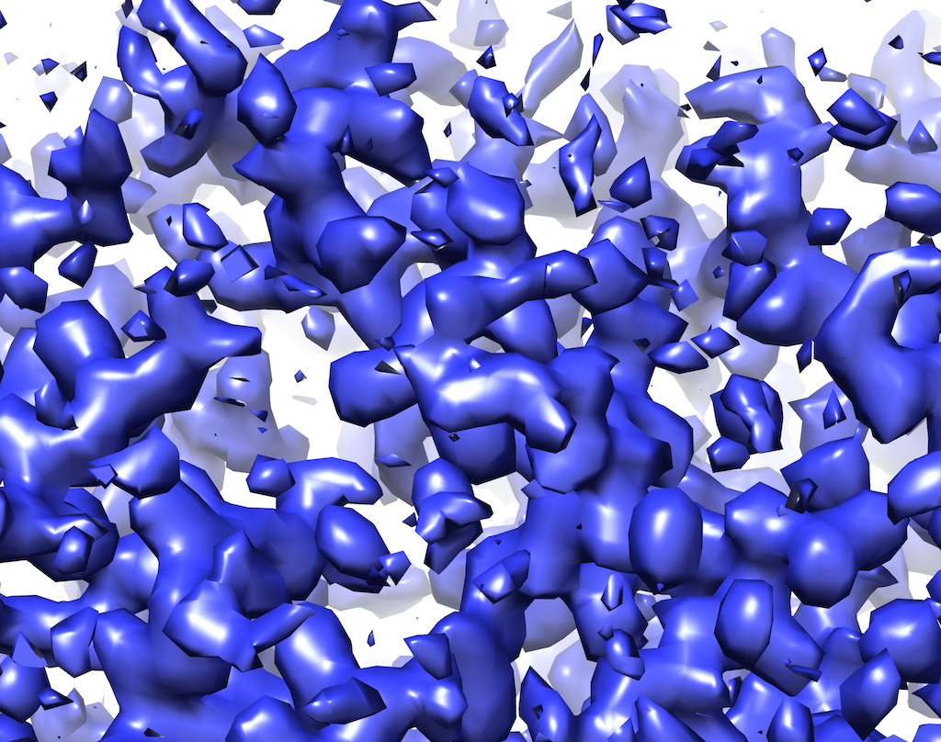
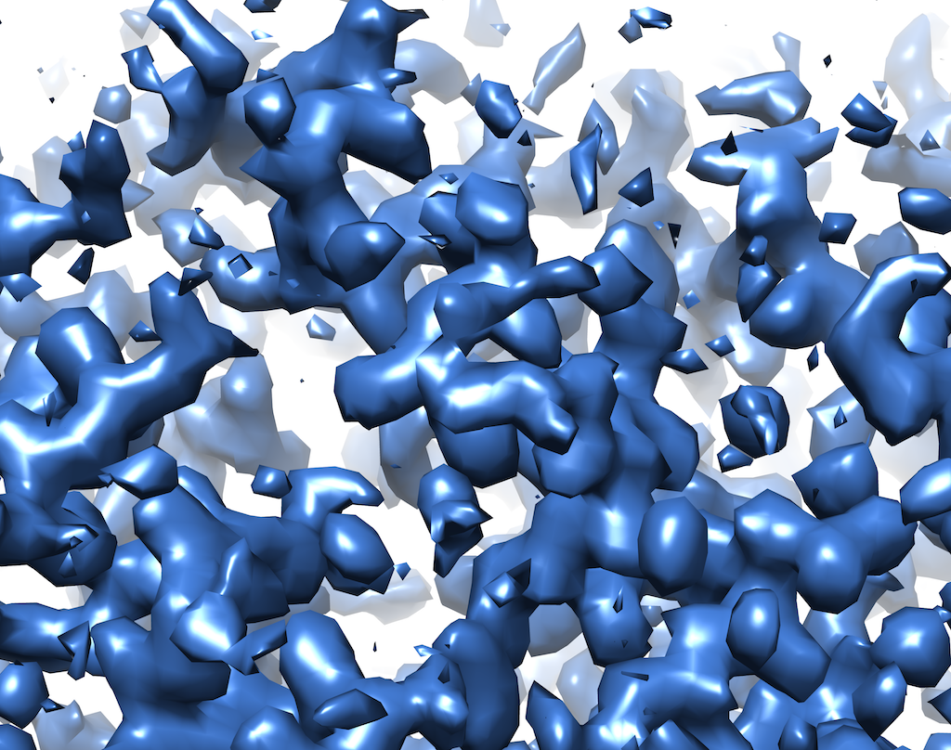
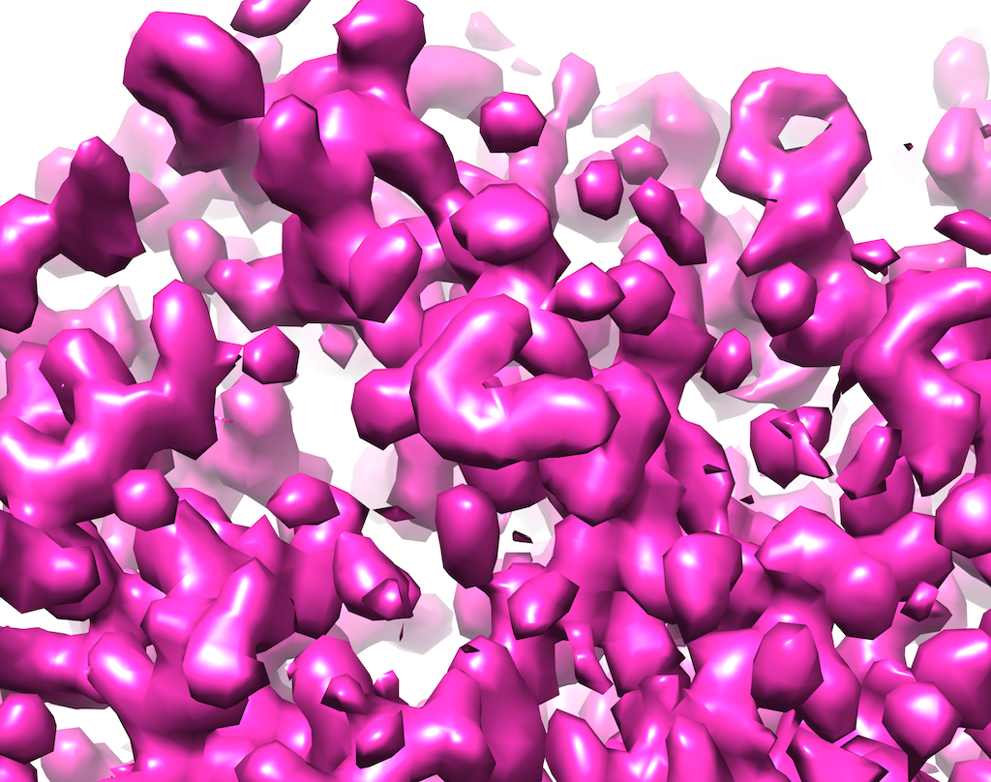
Density modification of apoferritin half-maps
Average of half-maps
(resolution-matched to density-modified map)
Density-modified map
Notes:
Average of half-maps is resolution-matched to density modified map. Contours enclose equal volumes.

Slide 19
Model-building using density-modified map

Slide 20
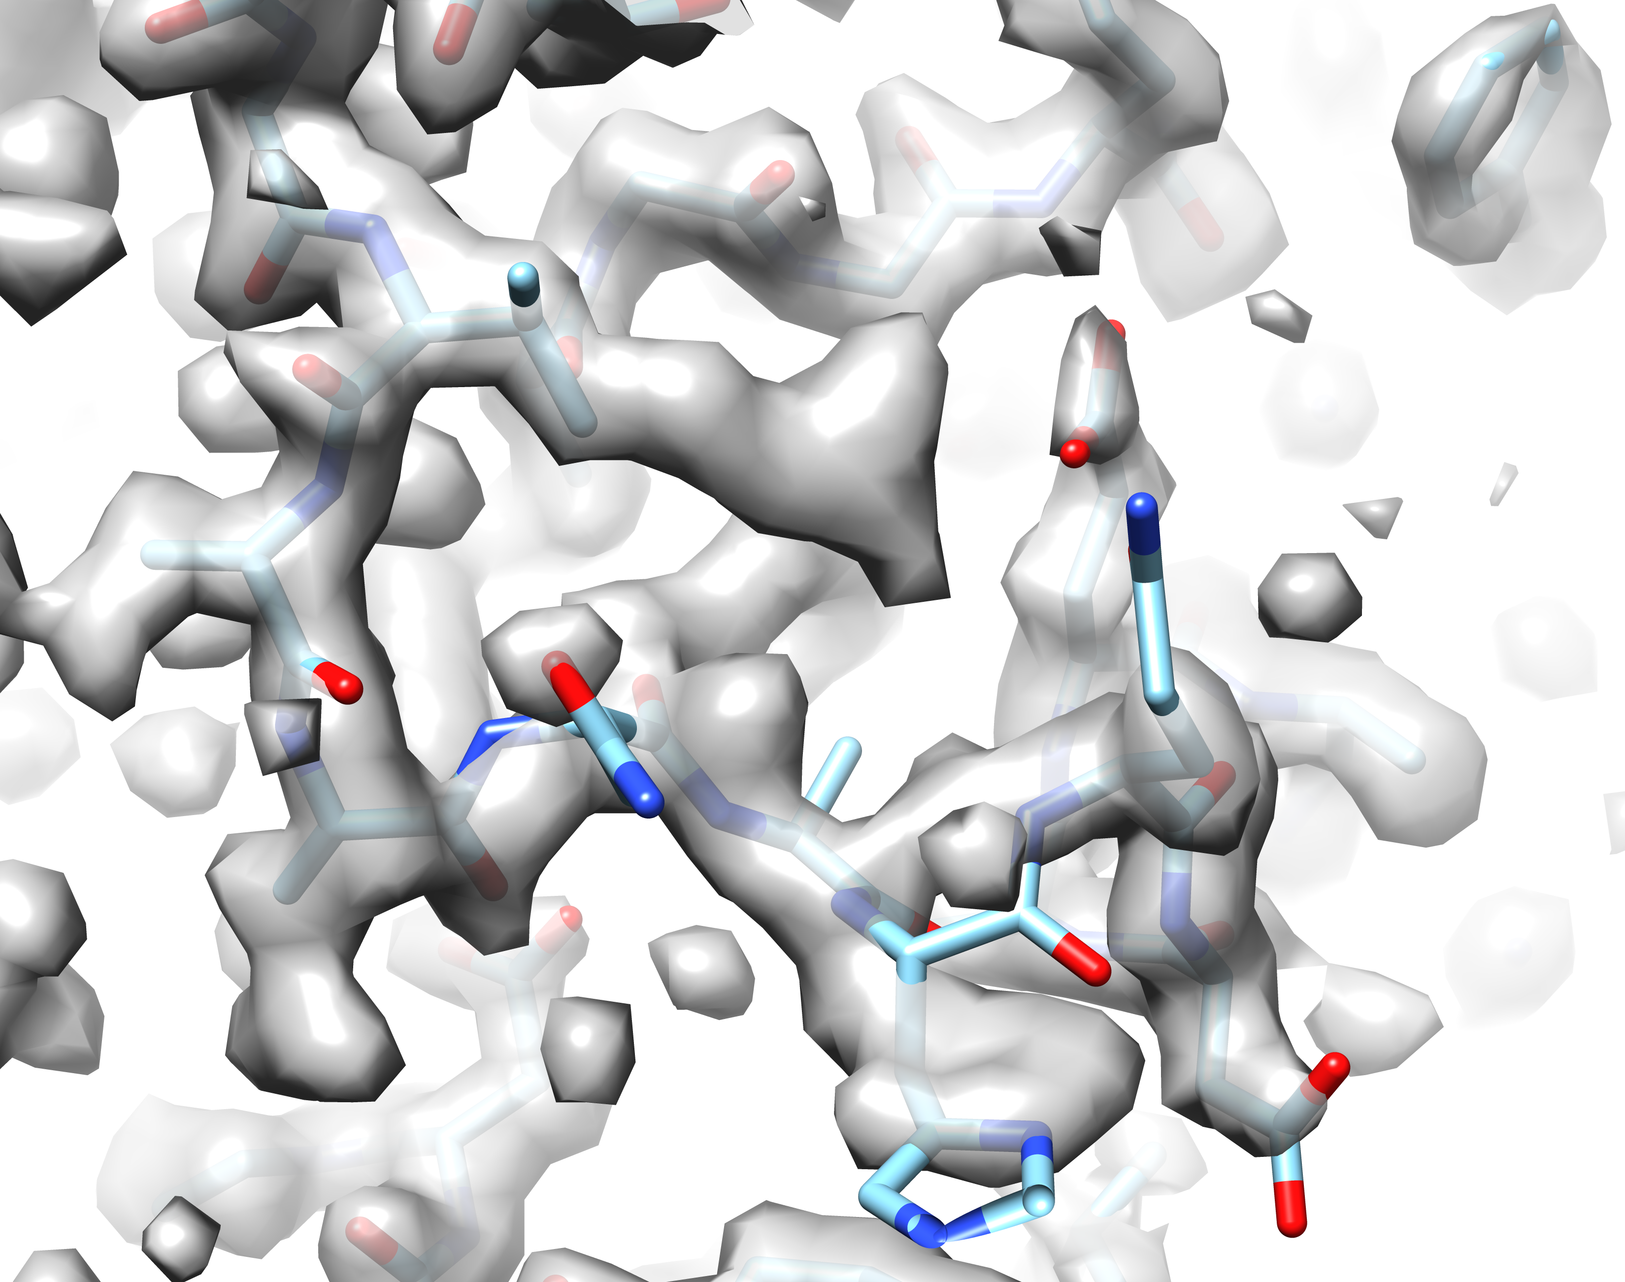
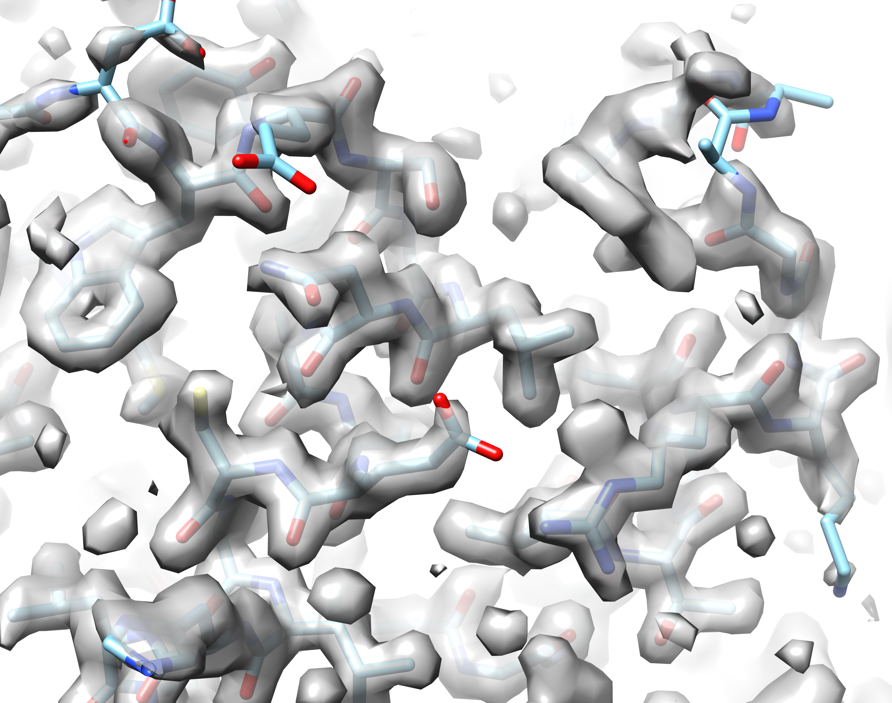
Model-building using density-modified map
Initial model-building with some mis-traced segments
(residues 6-9 and 154-162)
Notes:
How to fix these problems:
Need to fix mis-tracing and mis-aligment of sequence
First cut out the bad parts
Then re-sequence the good parts using the known sequence and the density
Then fit the loops knowing how many residues go in the loops (both ends of the loops are now known)
Let’s start by cutting out a small box of density around the model so things will go quickly.

Slide 21
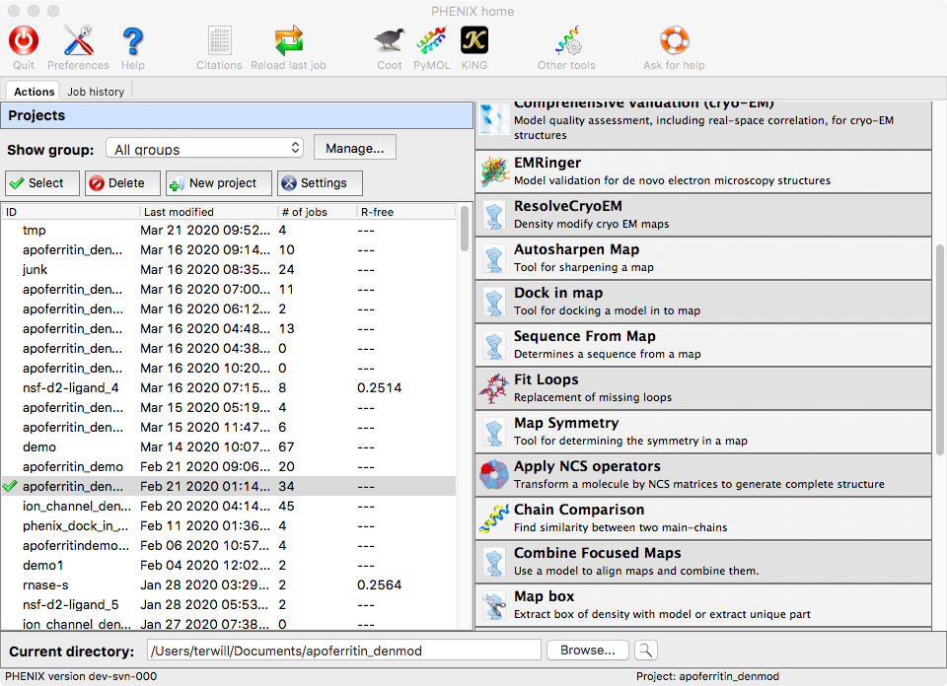
Boxing map around model with map_box

Slide 22
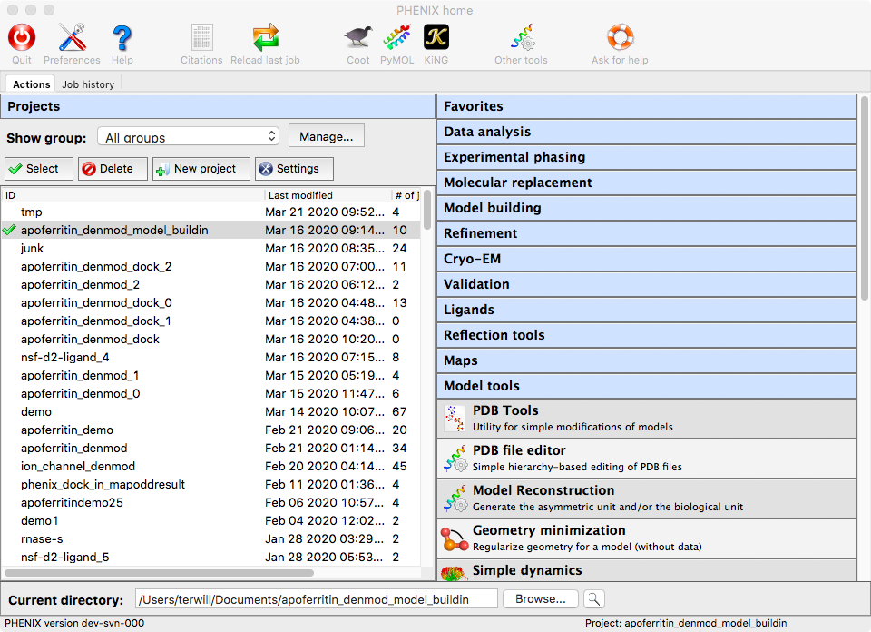
Fixing a model with pdb_tools and sequence_from_map
Remove residues 6-9 with PDB Tools

Slide 23
Fixing a model with pdb_tools and sequence_from_map
Re-sequence and fill in gap with sequence_from_map

Slide 24
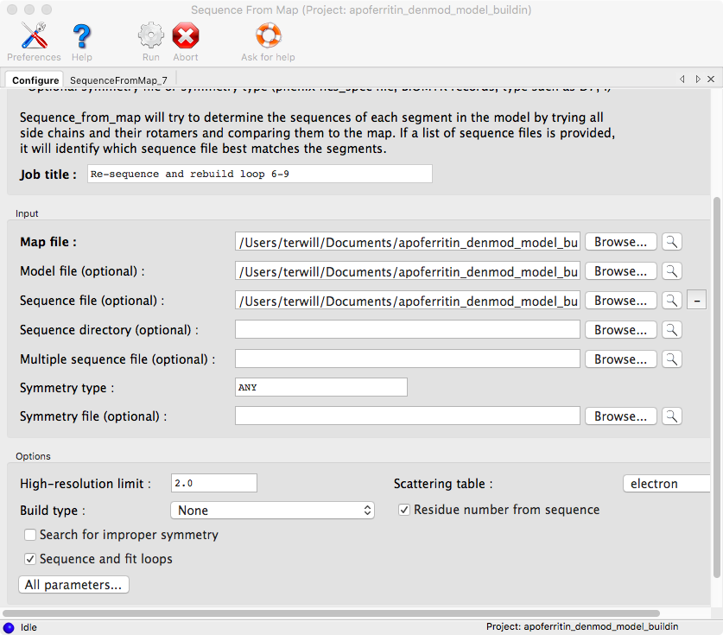
Fixing a model with pdb_tools and sequence_from_map
Re-sequence and fill in gap with sequence_from_map

Slide 25
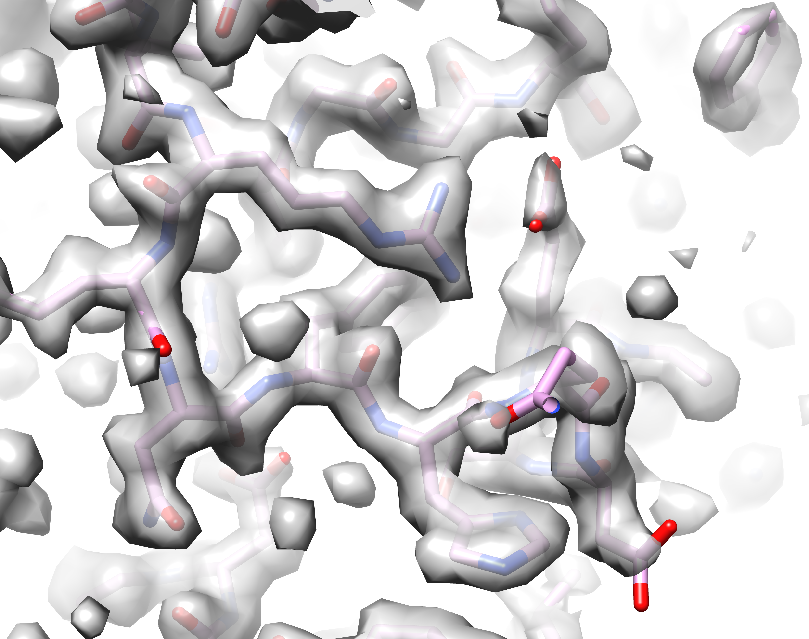
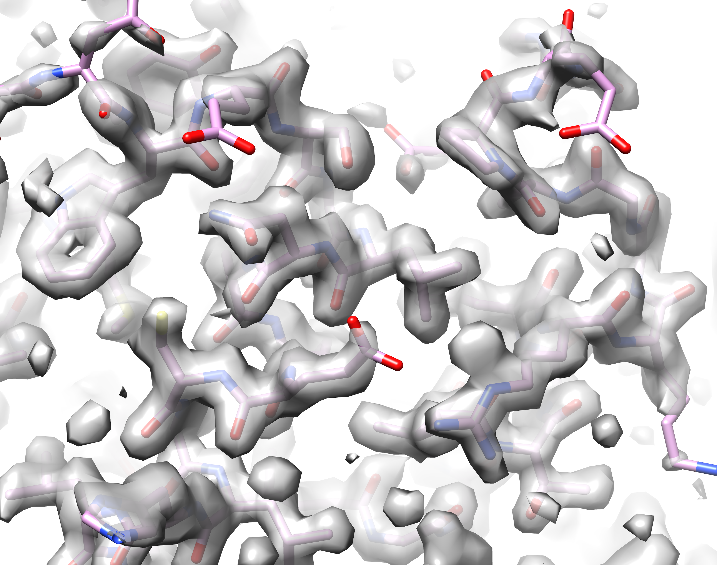
Model-building using density-modified map
Model-building after fixing mis-traced segments
(residues 6-9 and 154-162)
Initial model-building with some mis-traced segments
(residues 6-9 and 154-162)

Slide 26
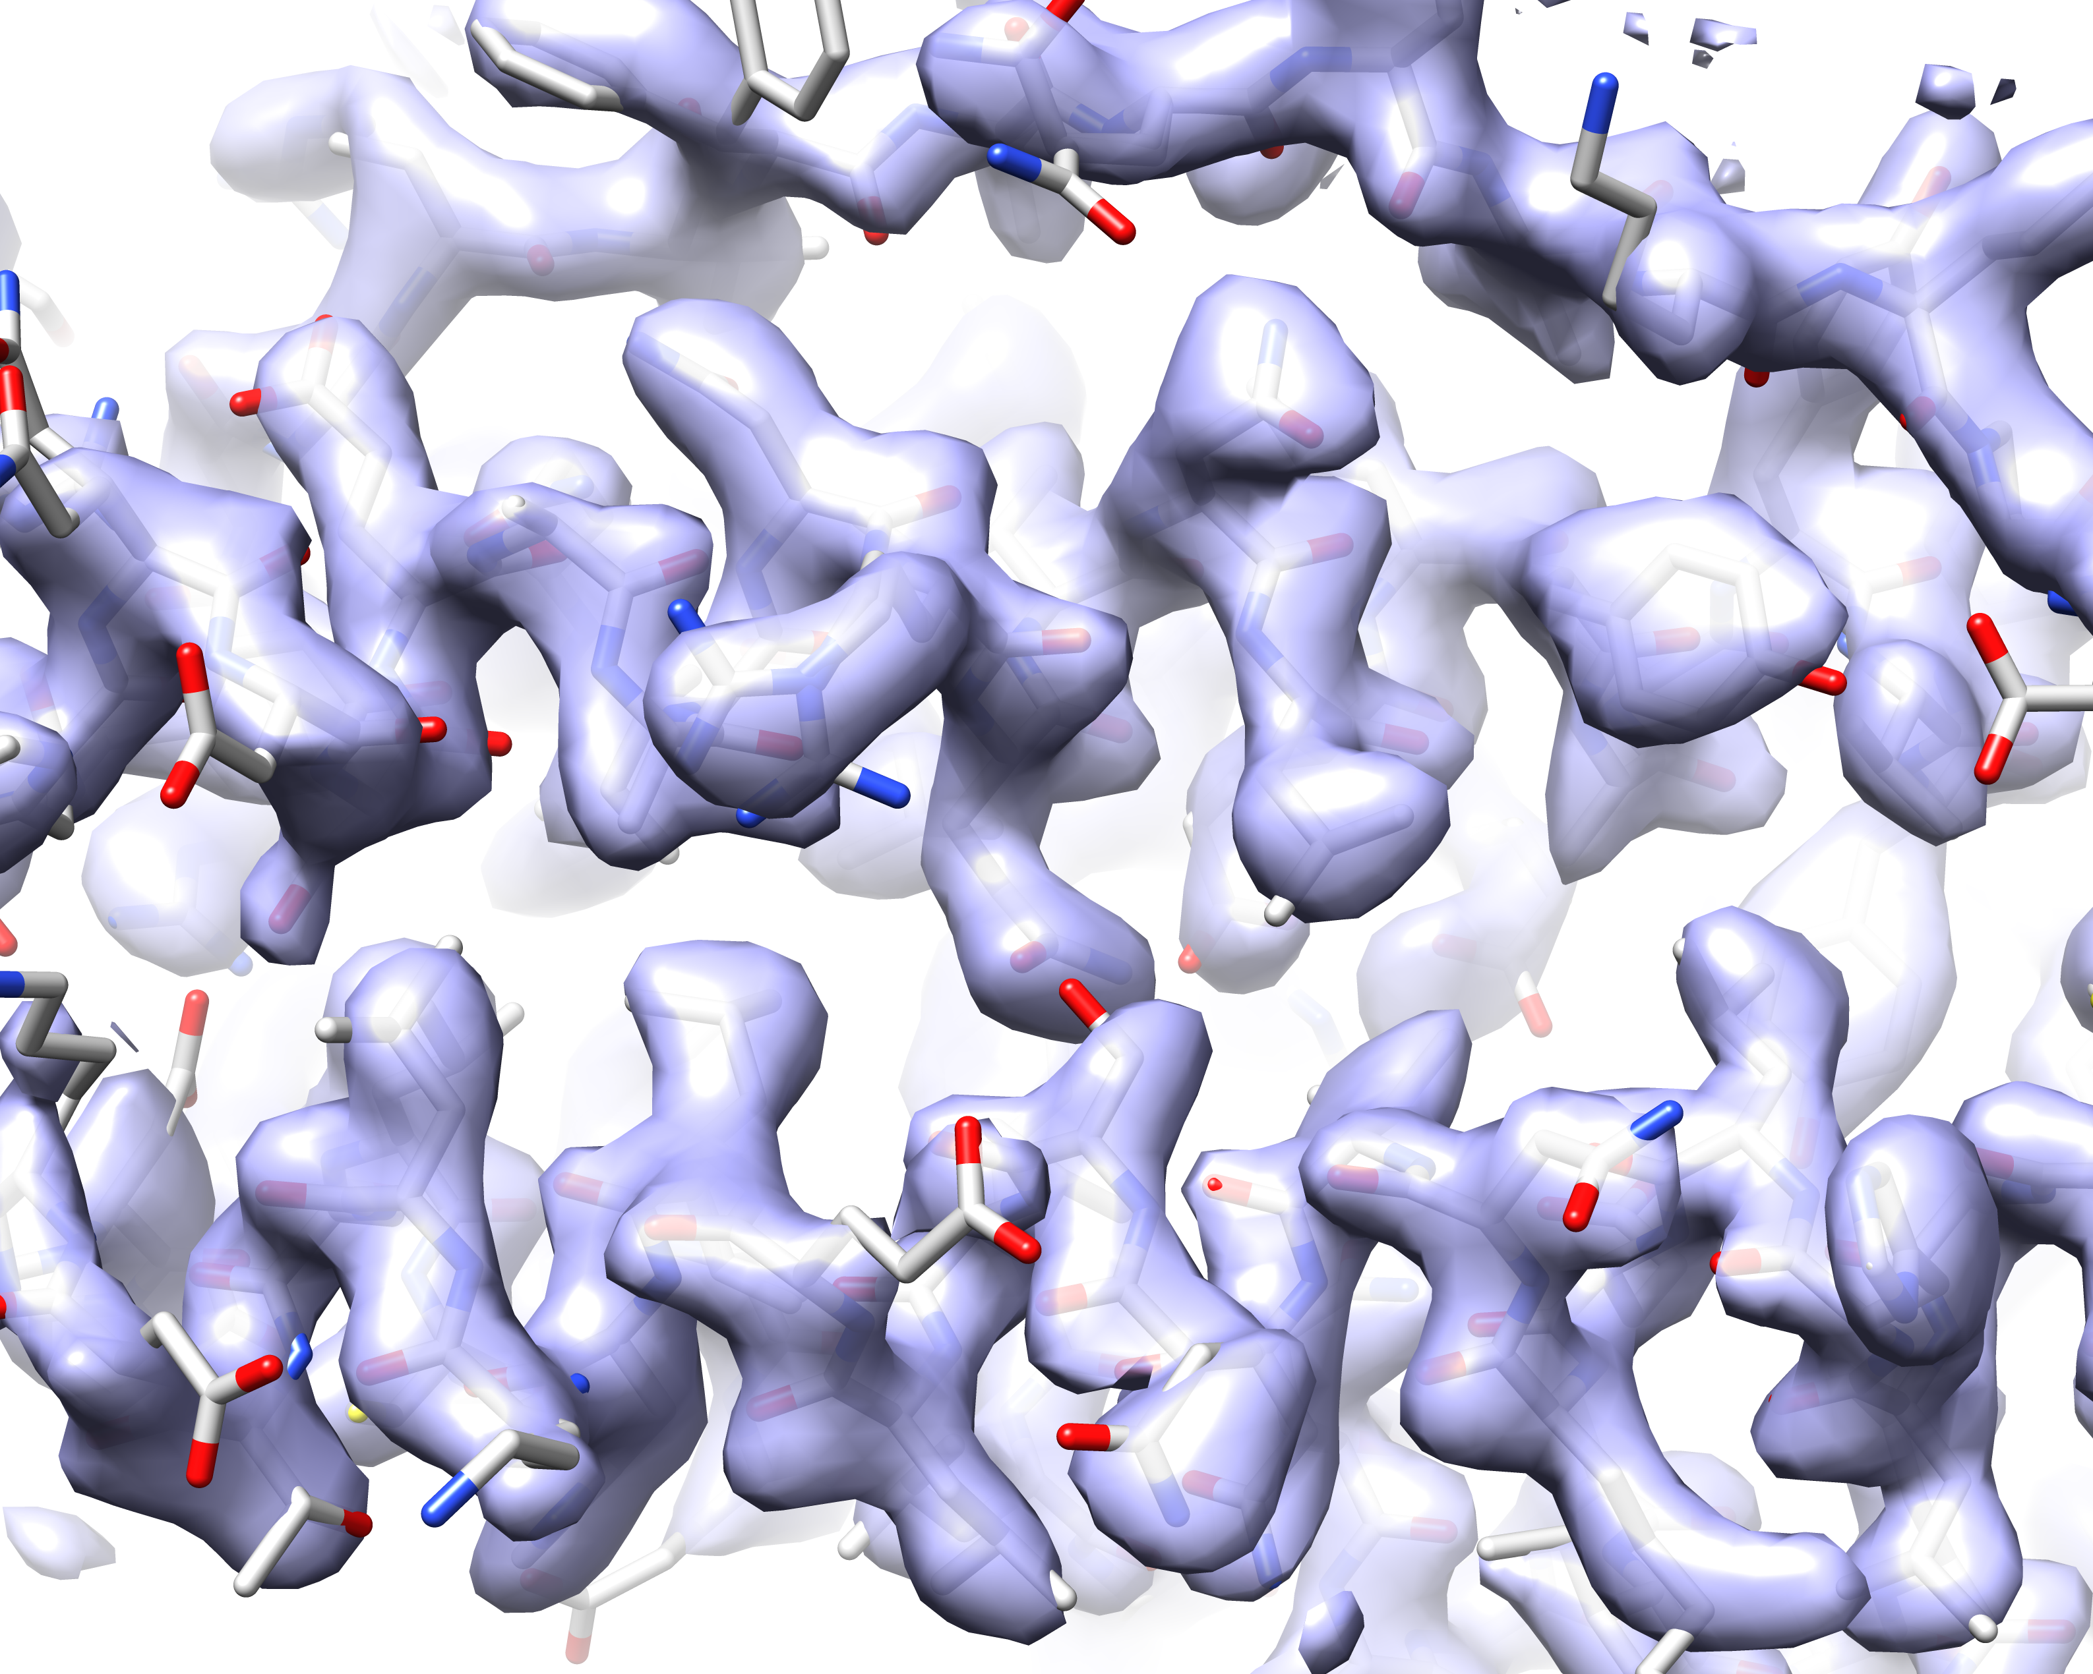
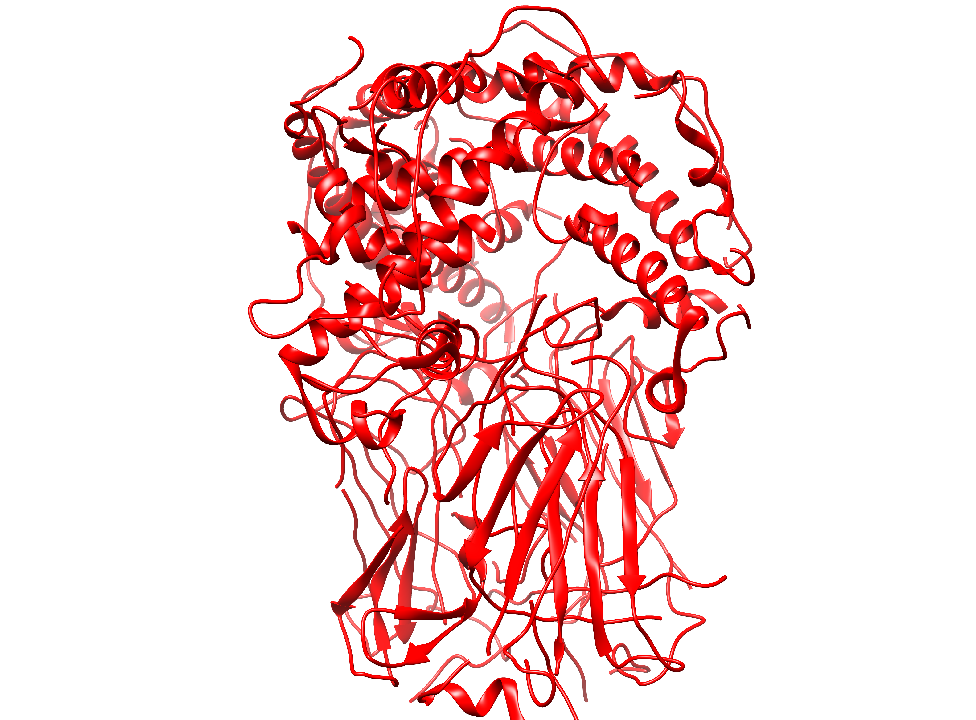
Density modification and model-building
What to try and what to keep in mind
Density modification on your half-maps (resolve_cryo_em)
Look for 0.05-0.3 Å estimated improvement in resolution
Works best with half-maps that have uniform noise
Model-building (map_to_model, protein/RNA/DNA)
Fix your model by cutting out mis-fit segments and rebuilding with sequence_from_map
Tutorial data, walk-through and scripts supplied with latest versions of Phenix
This talk is available at:
http://www.phenix-online.org/presentations/Phenix_SBGrid_Terwilliger_2020-03-31c.pptx

Slide 27
SBGrid Weekly Webinar Series
Tuesdays and Fridays at 12:00pm ET
Full webinar lineup on our website - sbgrid.org
Connect with us online
@SBGrid @SBGrid SBGridTV
Events are posted on SBGrid Google Calendar (to join visit http://sbgrid.org/calendar)
This talk is available at:
http://www.phenix-online.org/presentations/Phenix_SBGrid_Terwilliger_2020-03-31c.pptx

