Slide 1





Model-building using cryo-EM maps
2017 Model Challenge Assessment Meeting
Oct 7, 2017
Tom Terwilliger, Li-Wei Hung
Los Alamos National Laboratory
Pavel Afonine, Oleg Sobolev, Paul Adams
Lawrence Berkeley National Laboratory
Randy Read
University of Cambridge

Slide 2
Model-building using cryo-EM maps
Finding the unique part of a map
Automatic map sharpening
Model building and refinement
Automated interpretation of cryo-EM maps
Notes:
Goal: automated map interpretation. Many cryo-EM structures have internal symmetry that may have been used in generating the map. Need to work with a compact asymmetric unit of the map that hopefully represents the molecule.

Slide 3
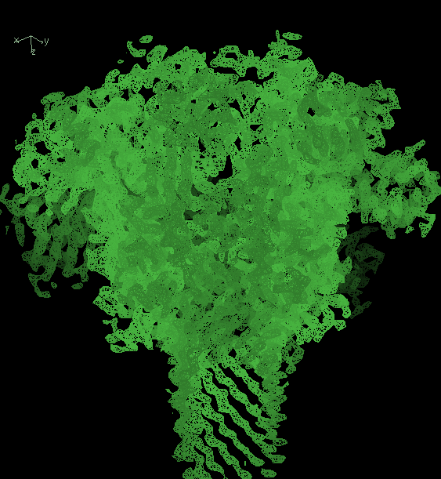
Anthrax toxin protective antigen pore at 2.9 Å
7-fold symmetry
Jiang et al., 2015
“where is one chain?”
Notes:
We know the 7-fold symmetry from the reconstruction
We don’t know what the compact molecule is
We don’t know the optimal sharpening of the map

Slide 4
Automatic map segmentation
Use symmetry of the map
(e.g., user specifies “D7” or automatically identified)
Identify contiguous regions representing asymmetric unit of the map
Choose symmetry-copies that make compact molecule
Notes:
( X-ray map is M542A mutant and has bound D-galactopyranosyl-1-on; cryo-EM 2-phenylethyl 1-thio-beta-D-galactopyranoside)

Slide 5
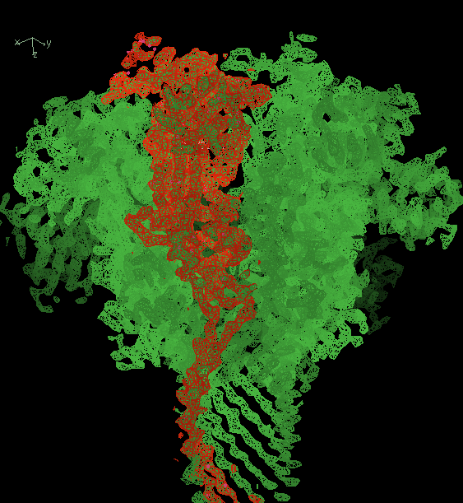
Anthrax toxin protective antigen pore at 2.9 Å
7-fold symmetry
Jiang et al., 2015
phenix.segment_and_split_map
Notes:
Red is 7 regions comprising one molecule. Note: current version automatically identifies NCS. User can specify C7 D7 helical parameters, or “ANY” (searches for all up to specified rotational symmetry, except helical symmetry)
NOTE: this is the weakest link in the system at present: cannot always get au right and if you don’t the connectivity will not be correct. For a real map it’s not as if you can just cut out the molecule correctly. We add symmetry-related regions all around the compact one, build everything, then figure out afterwards what part connects to make a molecule.

Slide 6
Model-building using cryo-EM maps
Finding the unique part of a map
Automatic map sharpening
Model building and refinement
Automated interpretation of cryo-EM maps
Notes:
Goal: automated map interpretation. Many cryo-EM structures have internal symmetry that may have been used in generating the map. Need to work with a compact asymmetric unit of the map that hopefully represents the molecule.

Slide 7
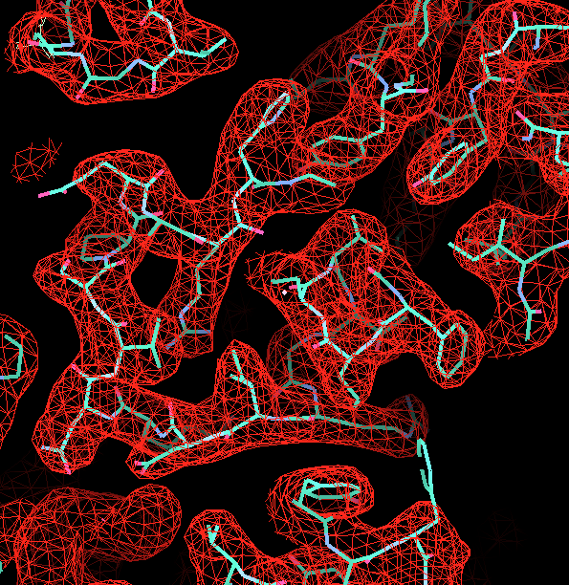
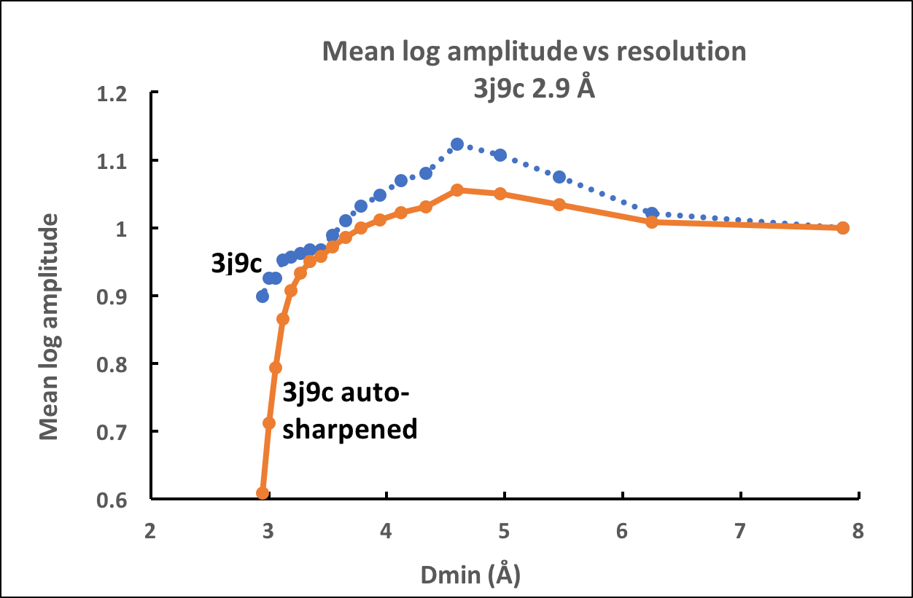
Automatic map sharpening
Finding the optimal resolution dependence of a map
Notes:
We apply 3 changes to amplitude vs resolution: (0) anisotropy correction (1) blur or sharpen data from d_min to inf. (2) severely blur data near d_min to high_res (as resolution cutoff).
B-iso will be ISOTROPIC BLUR/SHARPENING FACTOR LOWERING OR RAISING amplitudes at higher resolution

Slide 8
Automatic map sharpening
Finding the optimal resolution dependence of a map
“high-resolution cutoff”
Notes:
We apply 2 changes to amplitude vs resolution: (1) blur or sharpen data from d_min to inf. (2) severely blur data near d_min to high_res (as resolution cutoff)
B-iso will be ISOTROPIC BLUR/SHARPENING FACTOR LOWERING OR RAISING amplitudes at higher resolution

Slide 9
Automatic map sharpening
Finding the optimal resolution dependence of a map
“B-sharpen”
Notes:
We apply 2 changes to amplitude vs resolution: (1) blur or sharpen data from d_min to inf. (2) severely blur data near d_min to high_res (as resolution cutoff)
B-iso will be ISOTROPIC BLUR/SHARPENING FACTOR LOWERING OR RAISING amplitudes at higher resolution

Slide 10
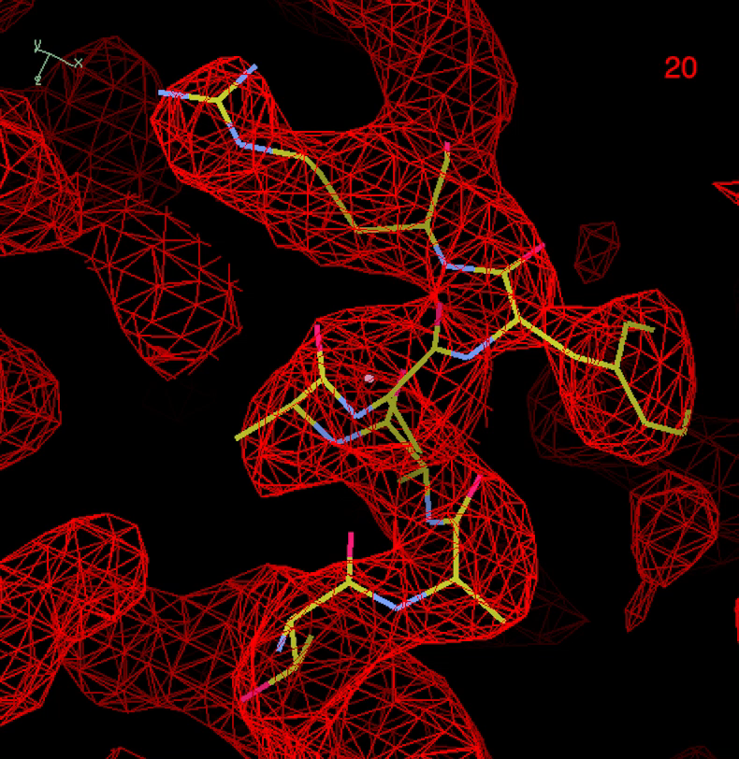
Sharpening map for 3j5p (emd_5778, 3.25 Å)
“B-iso” applied to about 3.25 Å
Smooth falloff at higher resolution
Notes:
Note that exact values of b-iso is not crucial…+/- 30 to 50 A**2 makes just a little difference
NOTE: Fixed resolution for falloff. Can refine it but we do not here.

Slide 11
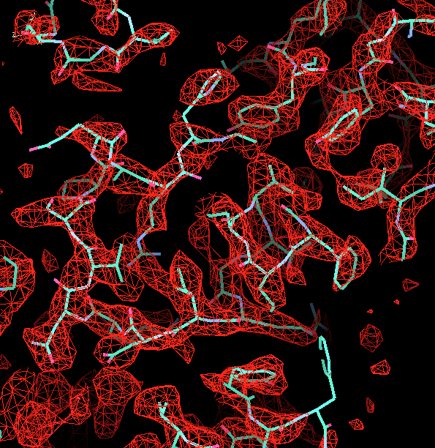
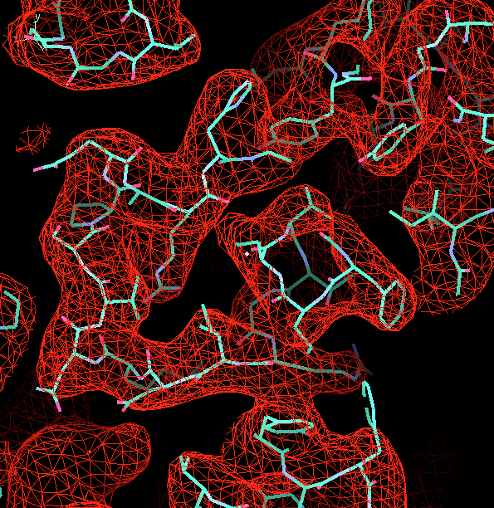
Automatic map sharpening emd_5778
B_iso = -100
(density broken)
B_iso = 60
(clear density)
B_iso = 150
(blurred density)
Notes:
Overall B-iso=60 is optimal for this map. Higher B-> blurred, Lower B-> broken up.
All maps have the same information content (just accentuate different resolution information)
How can we tell the difference among these maps?
Sharpening increases the surface area
Oversharpening breaks up the density
All contours 3 sigma

Slide 12
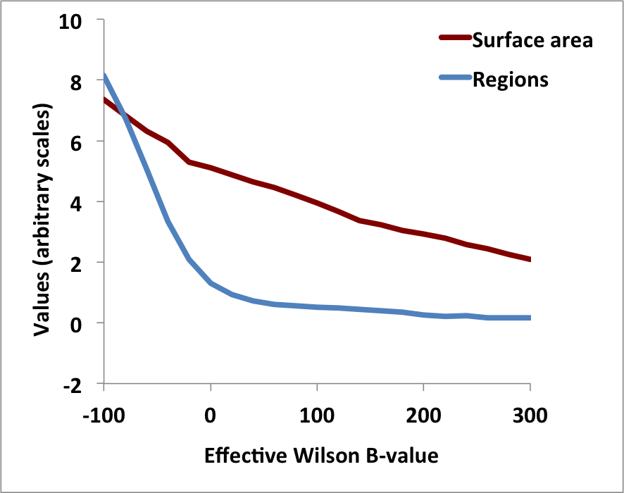
Sharpening based on contiguous regions and surface area
B_iso=-100
B_iso=60
B_iso=150
Notes:
Expect that more sharpening will lead to finer definition of density and therefore higher surface area. Compare the surface area of the B_iso=150 vs 60 or -100.
Wilson B describes fall-off with resolution of power (intensity) in the Fourier transform of the map
SA=surface area of regions enclosing top 30% * 0.2 = 6% of non-solvent volume (grid points outside but adjacent to a point inside one of these regions), normalized to this non-solvent volume (number of grid points in this volume).
Regions = number of regions obtained when threshold is set to yield regions covering 20% of non-solvent volume,

Slide 13
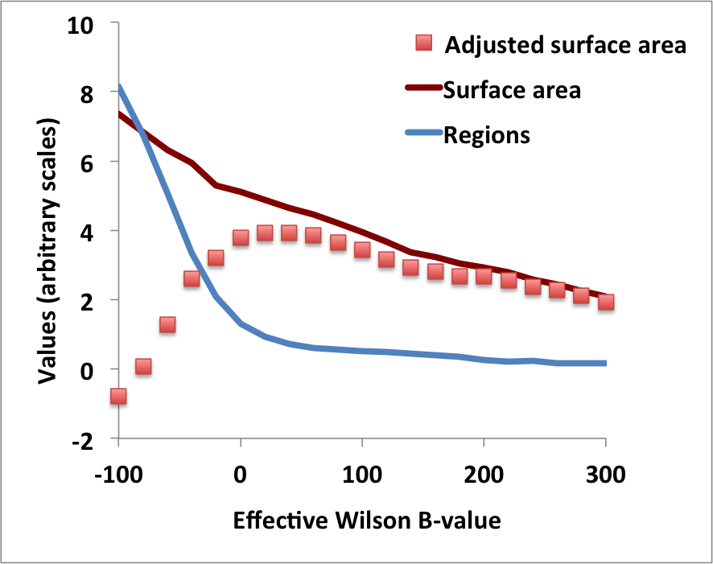
Adjusted surface area: surface area – weight * number of regions
B_iso=-100
B_iso=60
B_iso=150
Notes:
Expect that more sharpening will lead to finer definition of density and therefore higher surface area. Compare the surface area of the B_iso=150 vs 60 or -100.
SA=surface area of regions enclosing top 30% * 0.2 = 6% of non-solvent volume (grid points outside but adjacent to a point inside one of these regions), normalized to this non-solvent volume (number of grid points in this volume).
Regions = number of regions obtained when threshold is set to yield regions covering 20% of non-solvent volume,

Slide 14
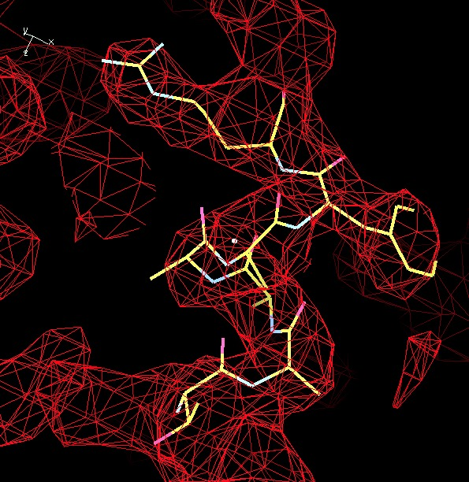
Sharpening map for 3j5p (emd_5778, 3.25 Å)
Auto-sharpened with phenix.auto_sharpen
B_iso=20
obtained

Slide 15
Algorithms for map optimization
(phenix.auto_sharpen)
Examining map features
Kurtosis
Adjusted surface area
Using half-dataset maps
Map-map correlation vs resolution
Using model
Map-model map correlation vs resolution
Local optimization
Apply different optimization to different regions of the map
phenix.auto_sharpen

Slide 16
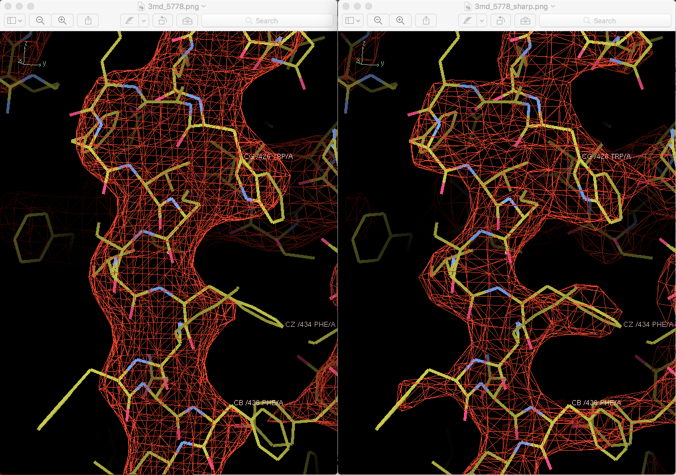
Automatic map sharpening
…application to maps from EMDB
Deposited map
phenix.auto_sharpen
Notes:
Emd_5778 is at a resolution of about 3.3 A The deposited map is highly blurred, but it can be sharpened automatically to show much more detail.
Calculation takes a few seconds.

Slide 17
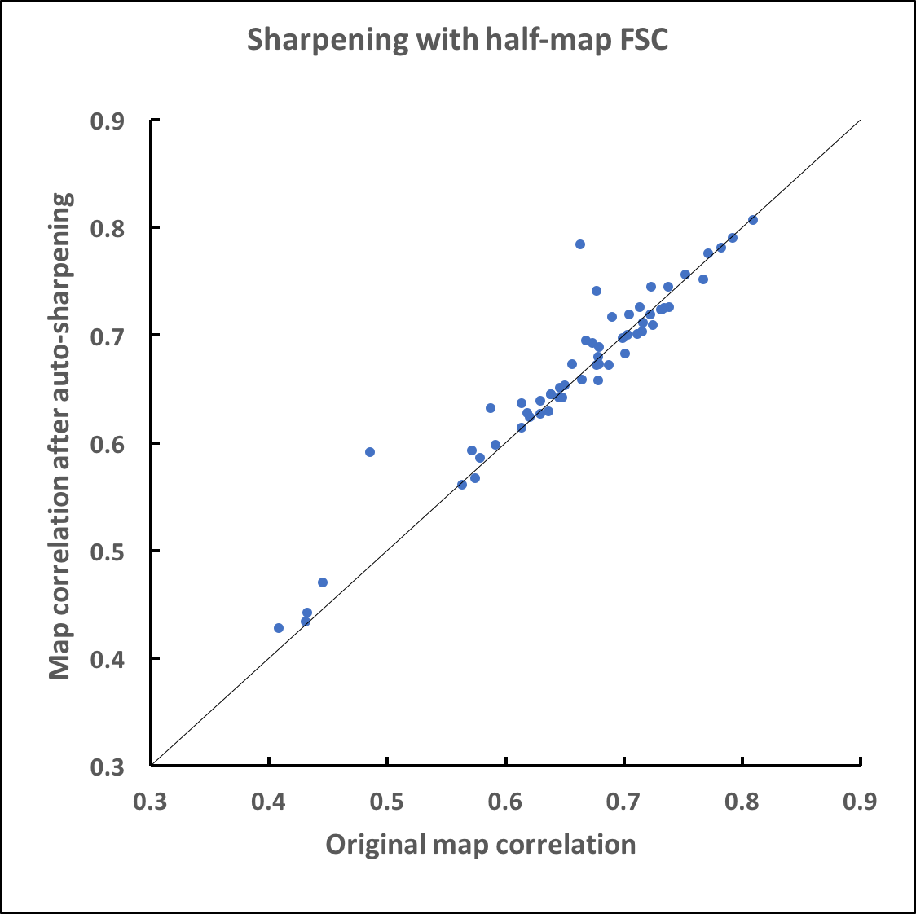
Sharpening with half-maps based on resolution-dependent FSC
(59 datasets with half-maps available)
Mean improvement: +0.008
Notes:
Note that the model F vs d is also used here.(Using actual model). Also note fewer datasets available to compare. Mean improvement with b_iso_to_d_cut using same data is 0.014.

Slide 18
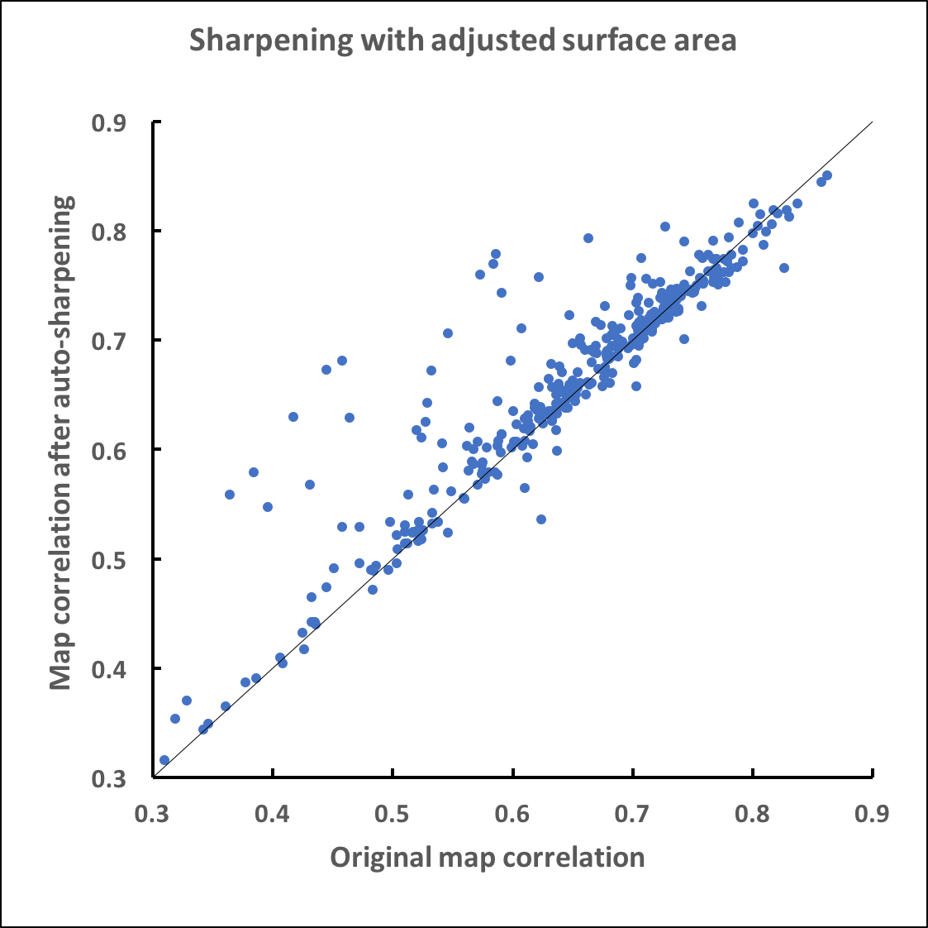
Applying B to high resolution of d_cut
Choice of B based on maximizing adjusted surface area
Mean improvement: +0.016
Notes:
Note that there is fall-off near dmin of k_sharpen

Slide 19
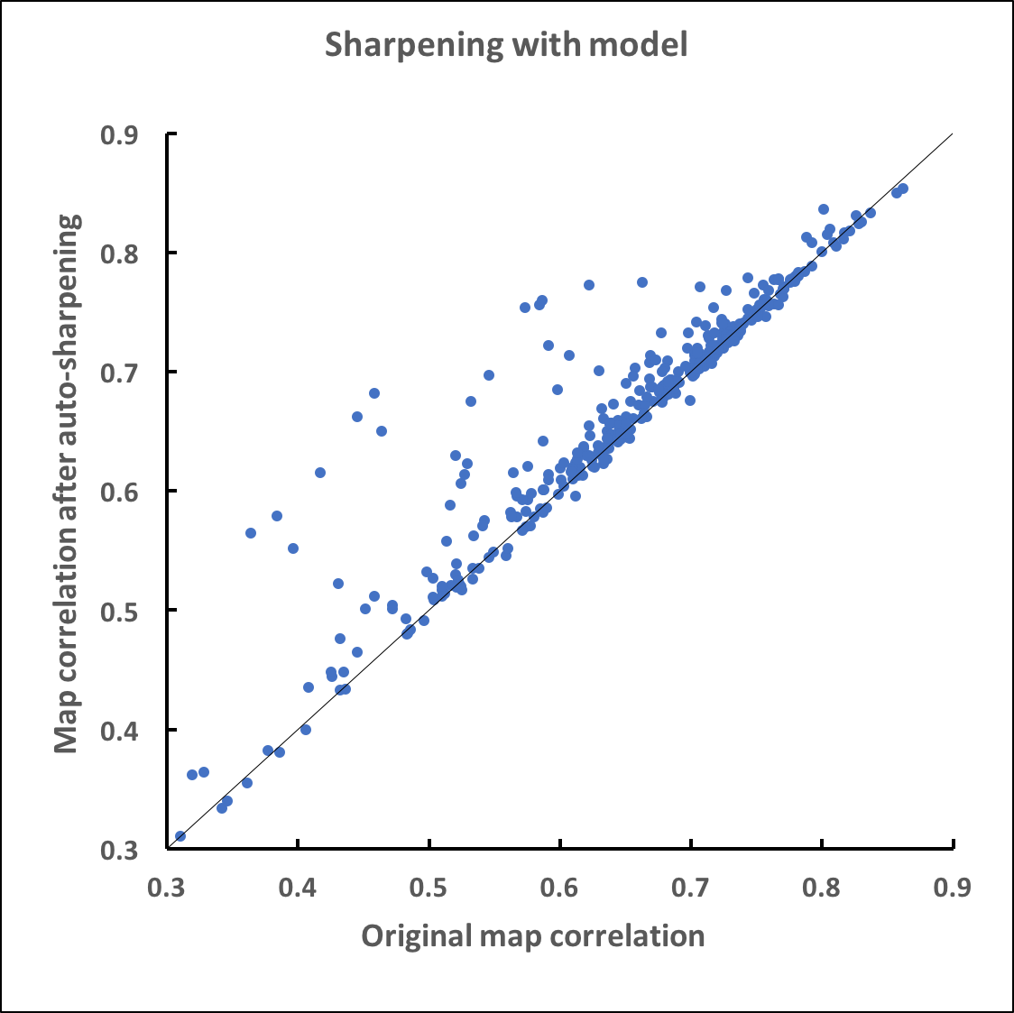
Sharpening with model based on resolution-dependent FSC
Mean improvement: +0.017

Slide 20
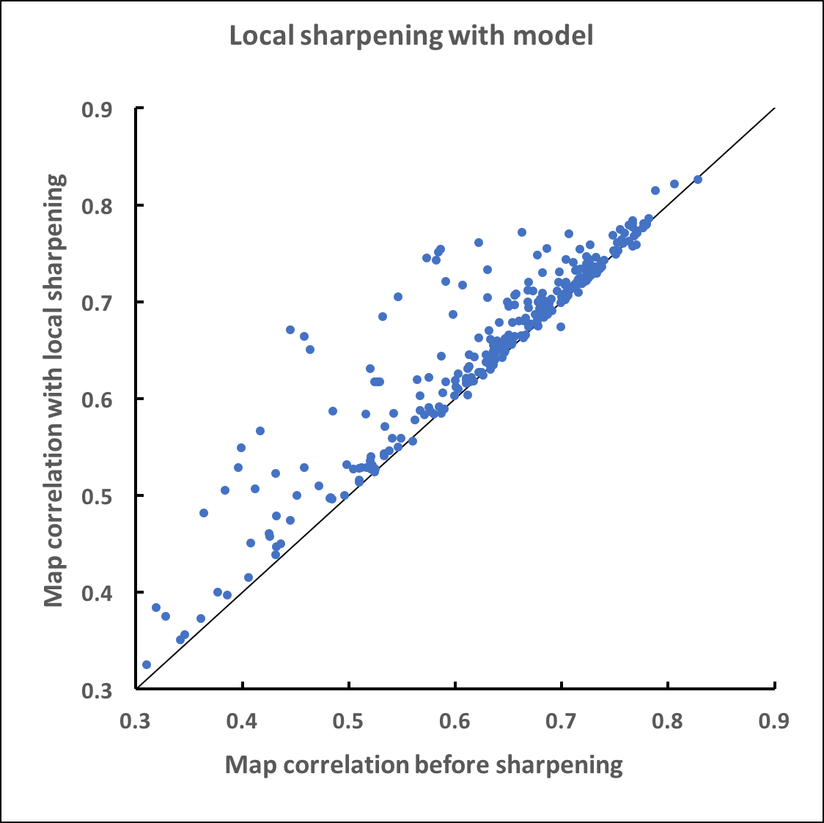
Local sharpening with model based on resolution-dependent FSC
(294 maps included)
Mean difference:
+0.025

Slide 21
Model-building using cryo-EM and crystallographic maps
Finding the unique part of a map
Automatic map sharpening
Model building and refinement
Automated interpretation of cryo-EM maps
Notes:
Goal: automated map interpretation

Slide 22
Model-building strategies
Tracing density for main-chain of proteins (tubes of density obtained by variable blurring of map)
Feature identification (helices, strands, RNA helices)
Building into segmented map; building into entire asymmetric unit of map
Combination of partial models using density correlation as quality metric

Slide 23
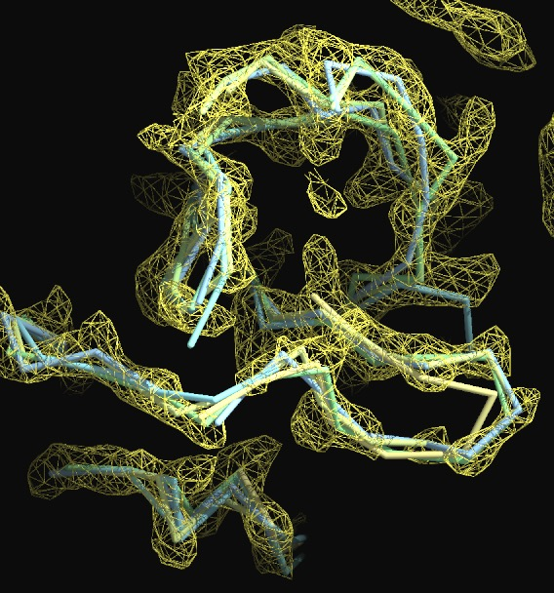
Chain tracing after variable map blurring
(Chain I, yeast mitochondrial ribosome large subunit, 3.2 Å, 3j6b)
Notes:
Chain I of 3j6b

Slide 24
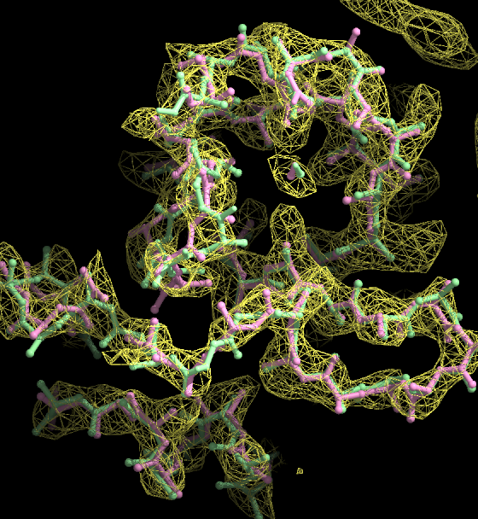
Refinement with secondary-structure restraints (pink)
Deposited model (green)
Notes:
Chain I of 3j6b

Slide 25
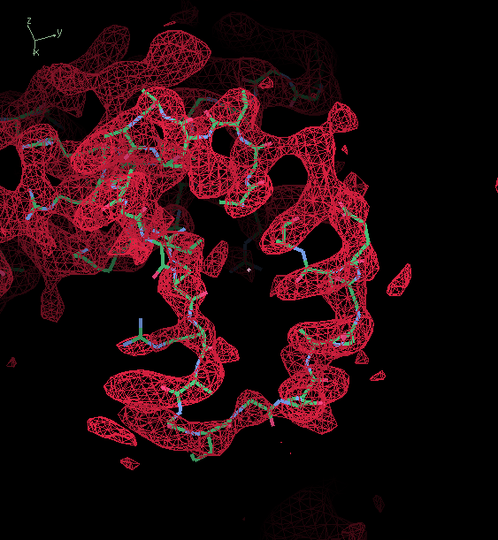
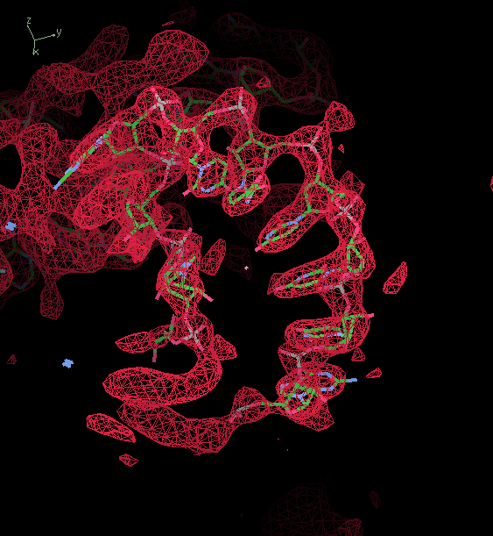
Identifying what is protein and what is RNA using density correlation
…as protein
…as RNA

Slide 26
Model-building using cryo-EM and crystallographic maps
Are X-ray and cryo-EM maps the same?
Finding the unique part of a map
Automatic map sharpening
Model building and refinement
Automated interpretation of cryo-EM maps
Notes:
Goal: automated map interpretation

Slide 27
Strategy for cryo-EM map interpretation phenix.map_to_model map.mrc seq.dat resolution=2.9 nproc=30
All tools available in current nightly builds of Phenix
Create optimal map showing just the molecule
Sharpen or blur the map to maximize clarity
Cut out density for the molecule
Identify compact, connected asymmetric unit of the map
Build model
Protein, RNA, DNA
Tracing of connected density, identification of features, …(add your methods)
Identify sequence alignment
Idealize secondary structure and refine
Assemble Protein/RNA/DNA
Apply molecular symmetry and refine full model
Notes:
All the tools described here are available in current nightly build (not official release) of Phenix.

Slide 28
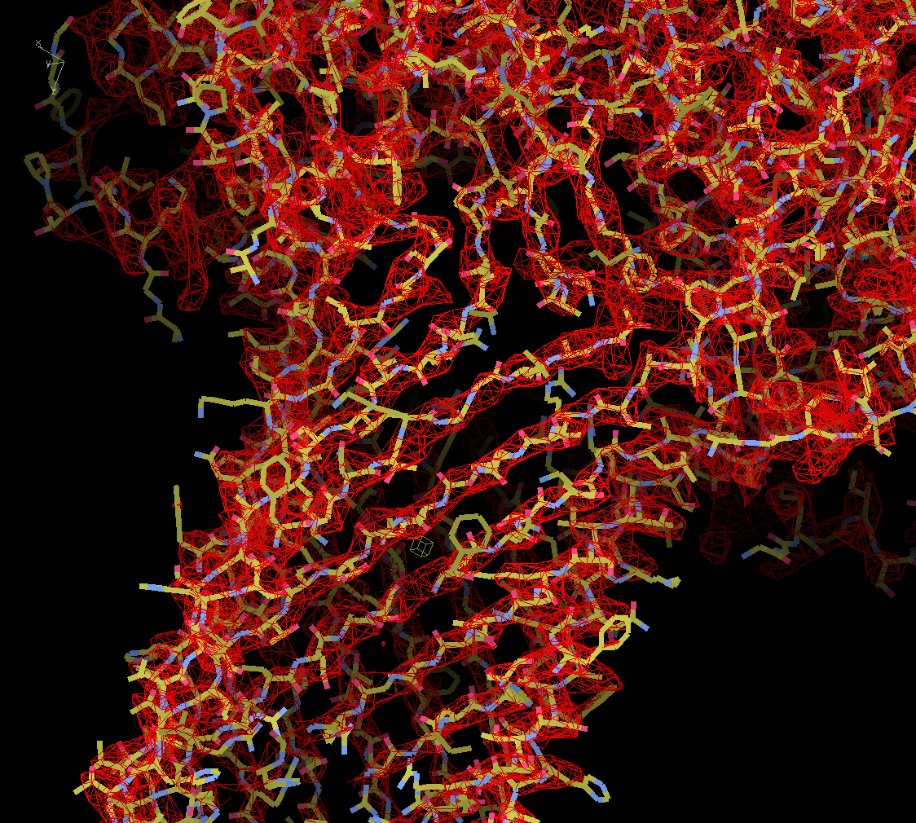
Anthrax toxin protective antigen pore at 2.9 Å
7-fold symmetry
Data from Jiang et al., 2015
phenix.map_to_model

Slide 29
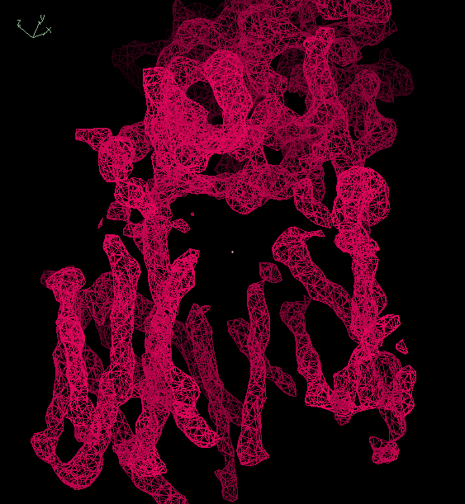
Gamma-secretase at 4.5 Å
(emd_2677)
Notes:
Emd_2677

Slide 30
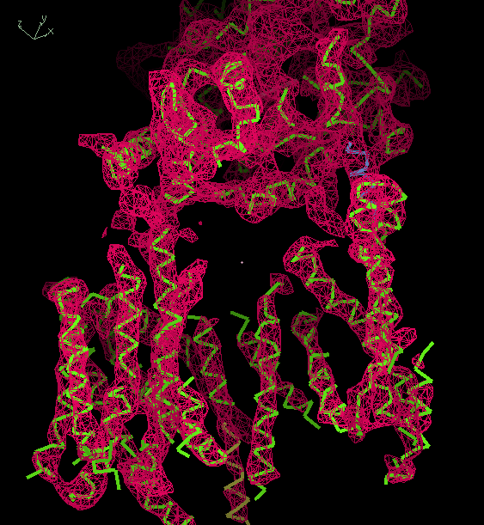
Gamma-secretase at 4.5 Å
(autobuilt model; emd_2677)
Notes:
Emd_2677

Slide 31
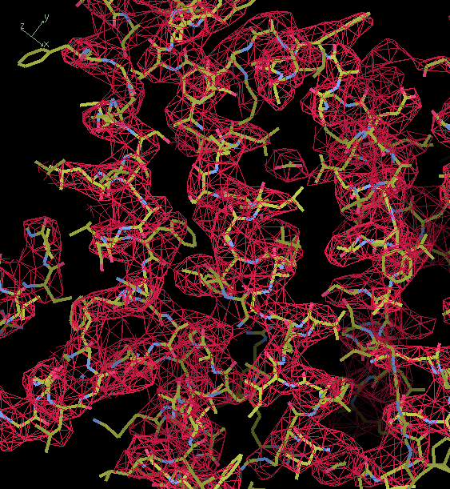
..and another Gamma-secretase structure at 3.4 Å
(autobuilt model; emd_3061)
Notes:
Emd_2677

Slide 32
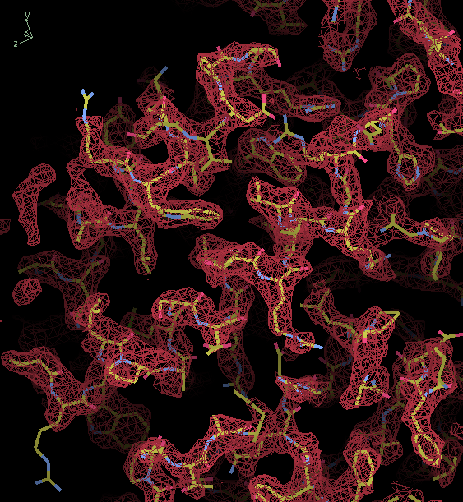
Beta-galactosidase at 2.2 Å
(autobuilt model; emd_2984)

Slide 33
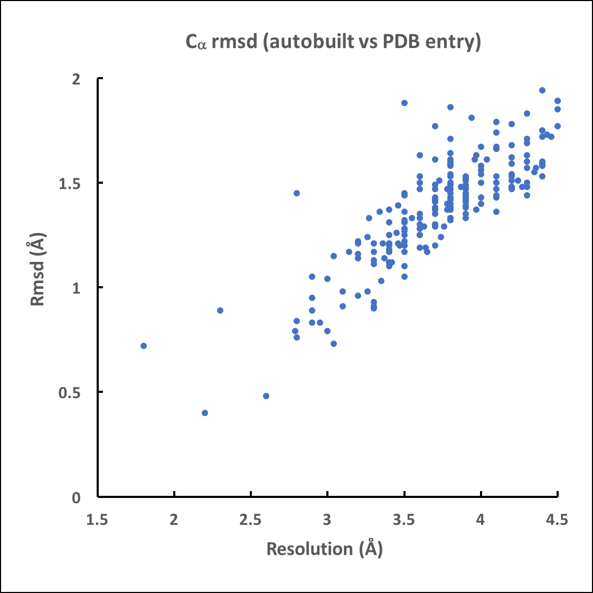
Building 209 unique structures from EMDB/PDB
2.2-4.5 Å
Model accuracy
Notes:
Model used to cut out region of interest from map, model-building into this cut-out map here

Slide 34
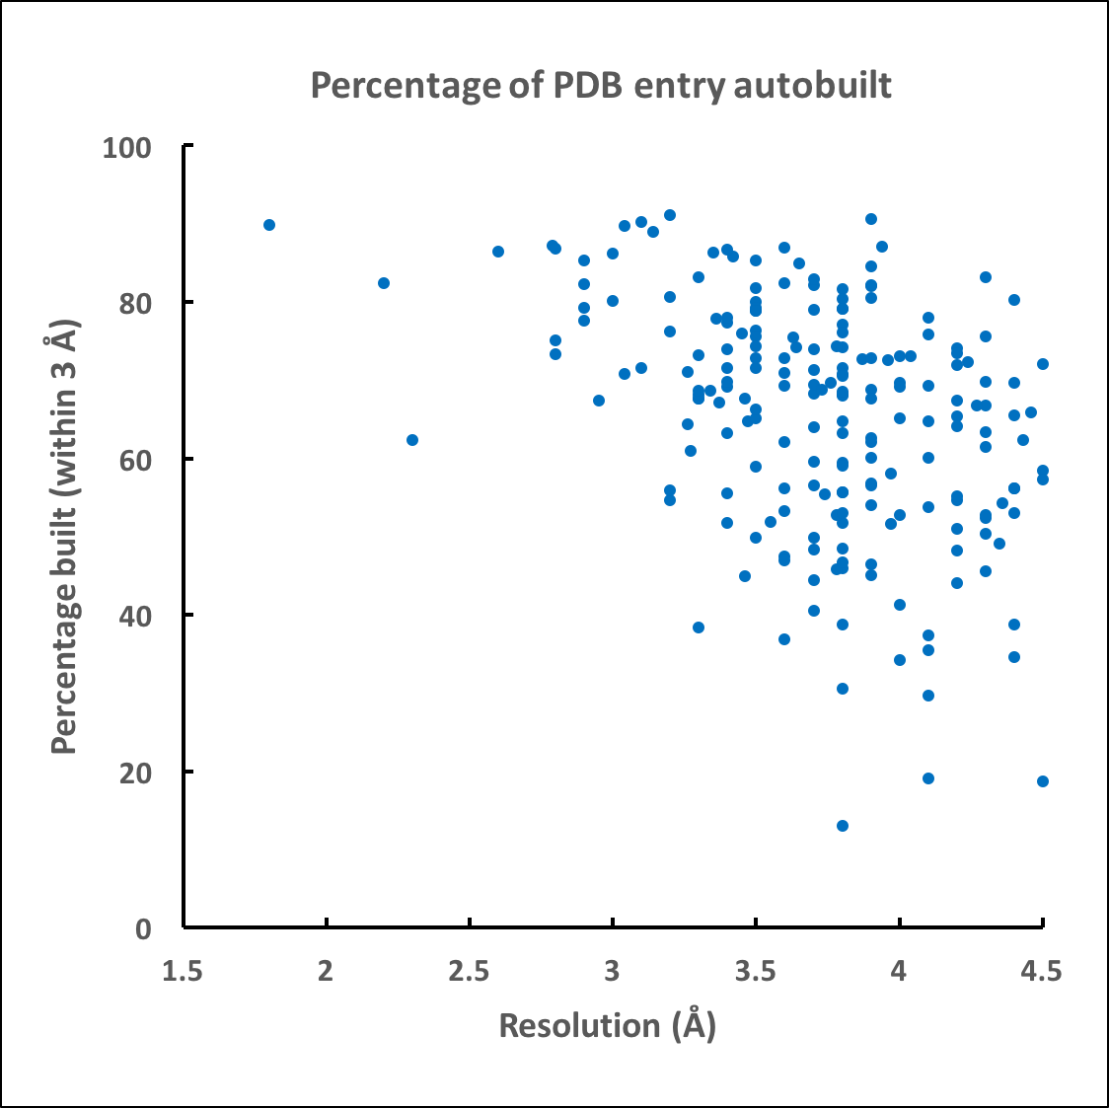
Building 209 unique structures from EMDB/PDB
2.2-4.5 Å
Percentage built correctly

Slide 35
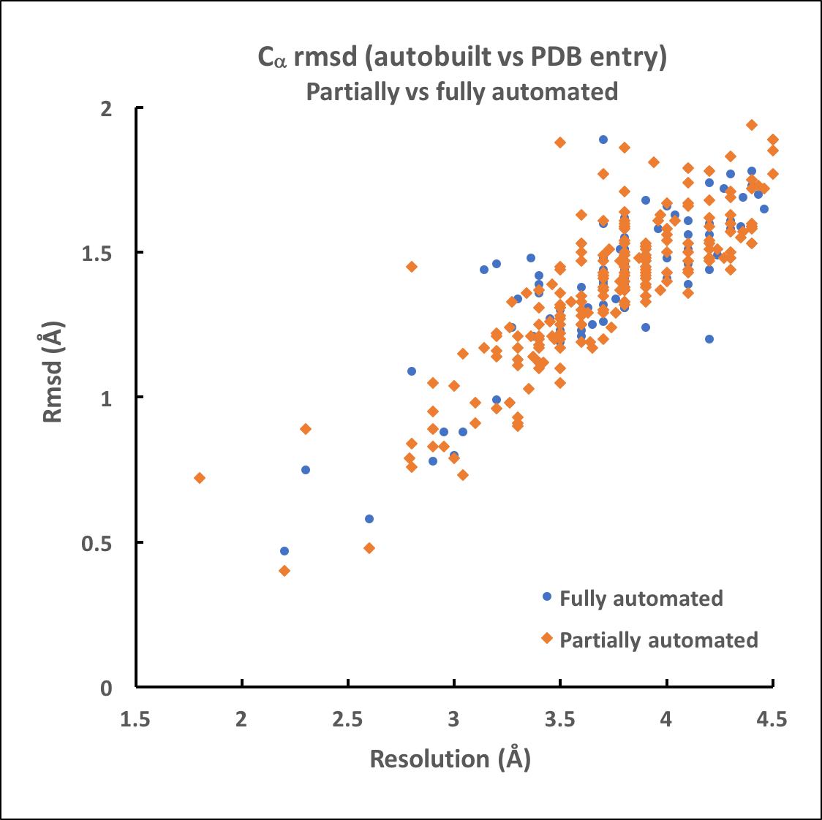
Building 209 unique structures from EMDB/PDB
2.2-4.5 Å
Model accuracy
Fully automated vs cutting out map using unique part of model
Notes:
X-ray using autosol preliminary model-building; EM using map_to_model

Slide 36
Perspectives…
Can run automated model-building on a cluster or laptop
Takes on average about 350 cpu hr to build a model with current defaults
Can be much faster with slight decrease in coverage (ribosome model in challenge required 422 hr)
Other model-building tools could be added as plug-ins

Slide 37





The Phenix Project
Lawrence Berkeley Laboratory
Paul Adams, Pavel Afonine, Dorothee Leibschner, Nigel Moriarty, Nicholas Sauter, Oleg Sobolev, Billy Poon
Los Alamos National Laboratory
Tom Terwilliger, Li-Wei Hung
Duke University
Randy Read, Airlie McCoy, Gabor Bunkoczi, Rob Oeffner, Richard Mifsud, Tristan Croll
Jane & David Richardson, Chris Williams, Bryan Arendall, Bradley Hintze
Cambridge University
An NIH/NIGMS funded
Program Project

