Slide 1
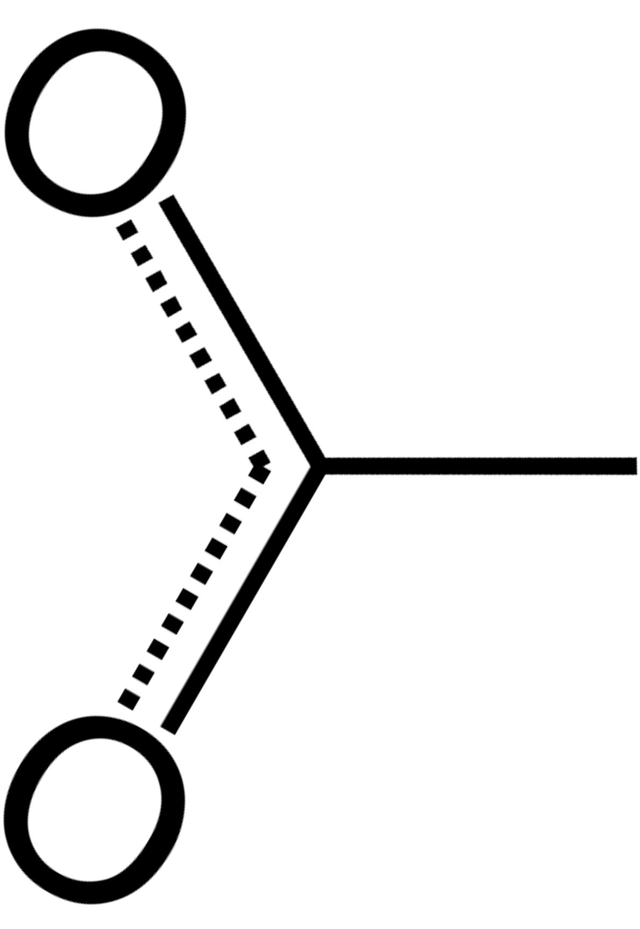
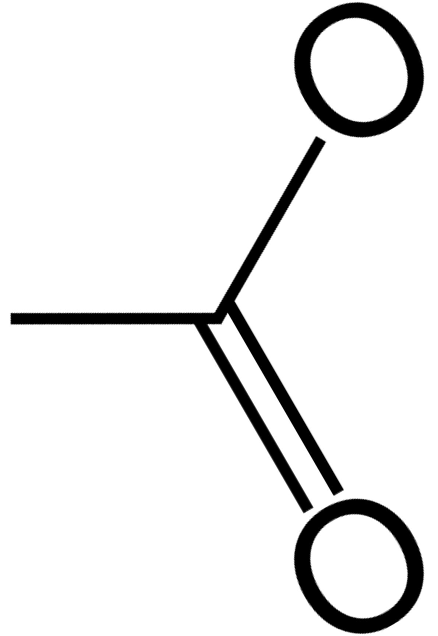
a
b
c
Lin et al.
Refinement start
GeoStd (ideal)
O
O
O
D24
1.22 $Å$
1.25 $Å$
1.25 $Å$
1.30 $Å$
1.02 $Å$
1.33 $Å$
E15
1.25 $Å$
1.25 $Å$
1.25 $Å$
O
H
O
O
O
O
H
O
I I I I I
1.27 $Å$
I I I I I I I I I I I I I I
1.25 $Å$
I I I I I I I I I I
1.25 $Å$
2.49 $Å$
2.50 $Å$
1.26 $Å$
O
1.25 $Å$
O
1.25 $Å$
O
d
e
f
Unrestrained
phenix.refine
AQuaRef
O
O
1.23 $Å$
(1.25 $Å$)
O
1.21 $Å$
(1.22 $Å$)
1.19 $Å$
1.32 $Å$
1.27 $Å$
(1.26 $Å$)
1.03 $Å$
1.31 $Å$
(1.32 $Å$)
O
H
O
O
O
O
O
I I I I I
1.26 $Å$
I I I I I I I I I I I I I I
1.26 $Å$
(1.25 $Å$)
I I I I I I I I I I I I I I
1.26 $Å$
(1.26 $Å$)
2.50 $Å$
2.51 $Å$
(2.55 $Å$)
2.51 $Å$
(2.50 $Å$)
1.27 $Å$
O
1.25 $Å$
(1.25 $Å$)
O
1.27 $Å$
(1.25 $Å$)
O
Figure X. Wild-type DJ-1 (PDB code: 5SY6). Bond distances in the moiety of hydrogen bond between O𝜀2 (E15) and Oδ2 (D24): (a) as measured in downloaded from PDB model, (b) starting geometry for all refinements (H is present only in AQuaRef refinement), (c) ideal library values in Phenix; geometry of –COOH or –COO groups is the same for Asp and Glu residues, (d) unrestrained and (e) restrained refinement with phenix.refine, (f) refinement with AQuaRef. Distances in parentheses correspond to refinement using resolution-truncated data at 2 Å. H atom is shown only if it was explicitly modelled (present in the PDB model file).

Slide 2
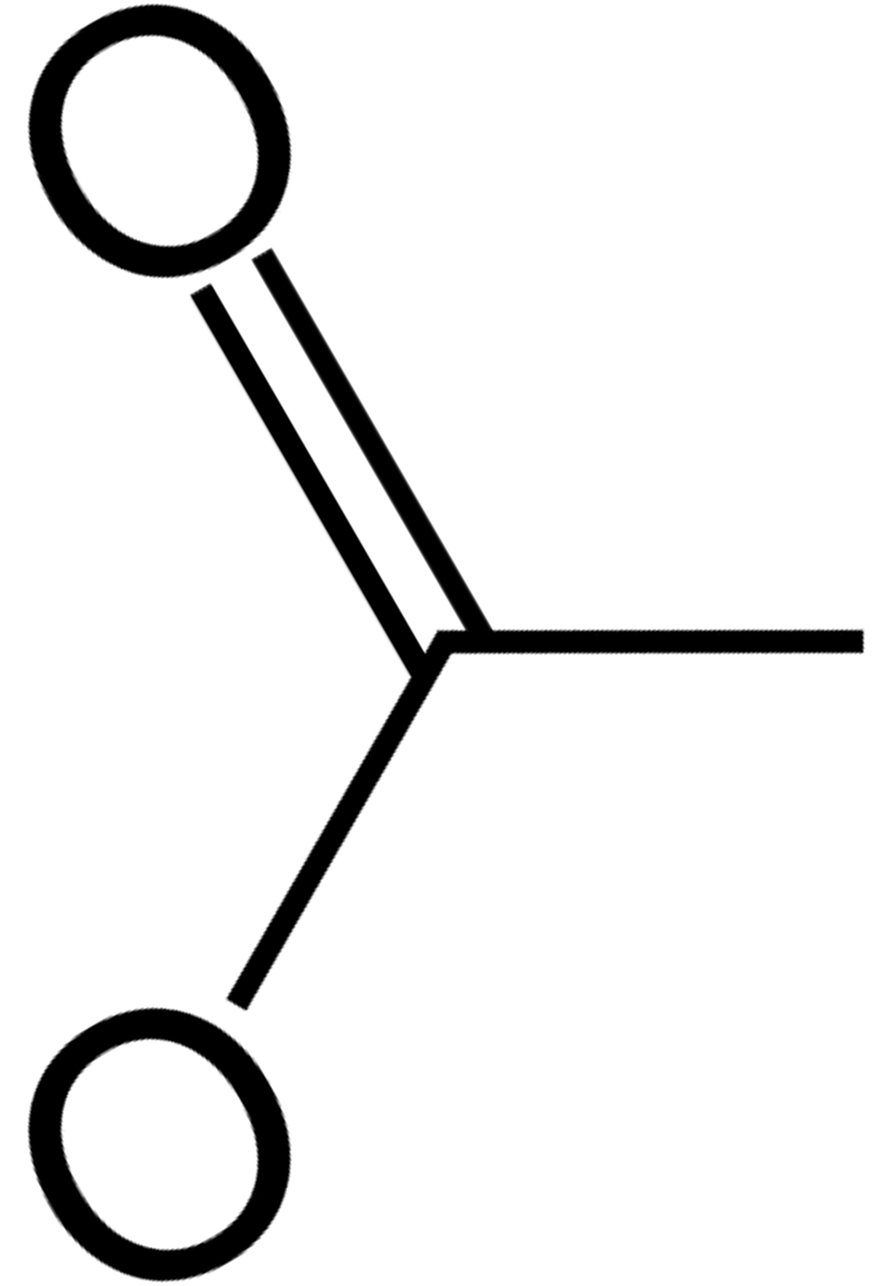
a
b
Lin et al.
Unrestrained
D23
D23
O
O
1.23 $Å$
1.23 $Å$
1.21 $Å$
1.20 $Å$
E14
E14
2.44 $Å$
2.45 $Å$
2.44 $Å$
2.44 $Å$
1.29 $Å$
1.28 $Å$
1.32 $Å$
1.31 $Å$
O
O
O
O
1.27 $Å$
1.30 $Å$
I I I I I I I I I I I I I I
1.28 $Å$
1.32 $Å$
I I I I I I I I I I I I I I
T16
T16
I I I I I I I I I I I I I I
I I I I I I I I I I I I I I
2.72 $Å$
2.71 $Å$
2.72 $Å$
2.71 $Å$
O
O
O
1.24 $Å$
1.22 $Å$
O
O
1.24 $Å$
1.20 $Å$
O
c
d
phenix.refine
AQuaRef
O
O
O
1.24 $Å$
1.24 $Å$
O
1.23 $Å$
1.23 $Å$
2.46 $Å$
2.46 $Å$
1.26 $Å$
1.26 $Å$
1.16 $Å$ 1.27 $Å$
1.08 $Å$ 1.35 $Å$
1.30 $Å$
1.28 $Å$
O
O
O
H
O
1.25 $Å$
1.26 $Å$
I I I I I I I I I I I I I I
1.27 $Å$
1.31 $Å$
I I I I I I I I I I
1.72 $Å$
1.75 $Å$
H
I I I I I I I I I I I I I I
I I I I I
2.73 $Å$
2.72 $Å$
O
O
O
O
1.25 $Å$
1.25 $Å$
O
1.25 $Å$
1.21 $Å$
O
1.02 $Å$
1.01 $Å$
O
O
Figure Y. E. coli YajL (PDB code: 5SY4). Bond distances in the moiety of hydrogen bond between O𝜀2 (E14) and Oδ2 (D23) across chains A (blue) and B (orange): (a) as measured in downloaded from PDB model, (b) unrestrained and (c) restrained refinement using phenix.refine, (d) refinement with AQuaRef. H atom is shown only if it was explicitly modelled (present in the PDB model file).

Slide 3
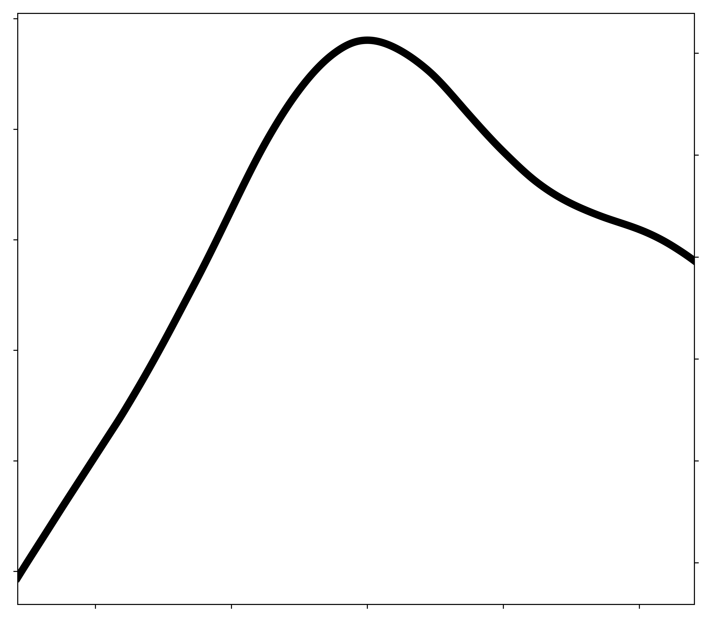
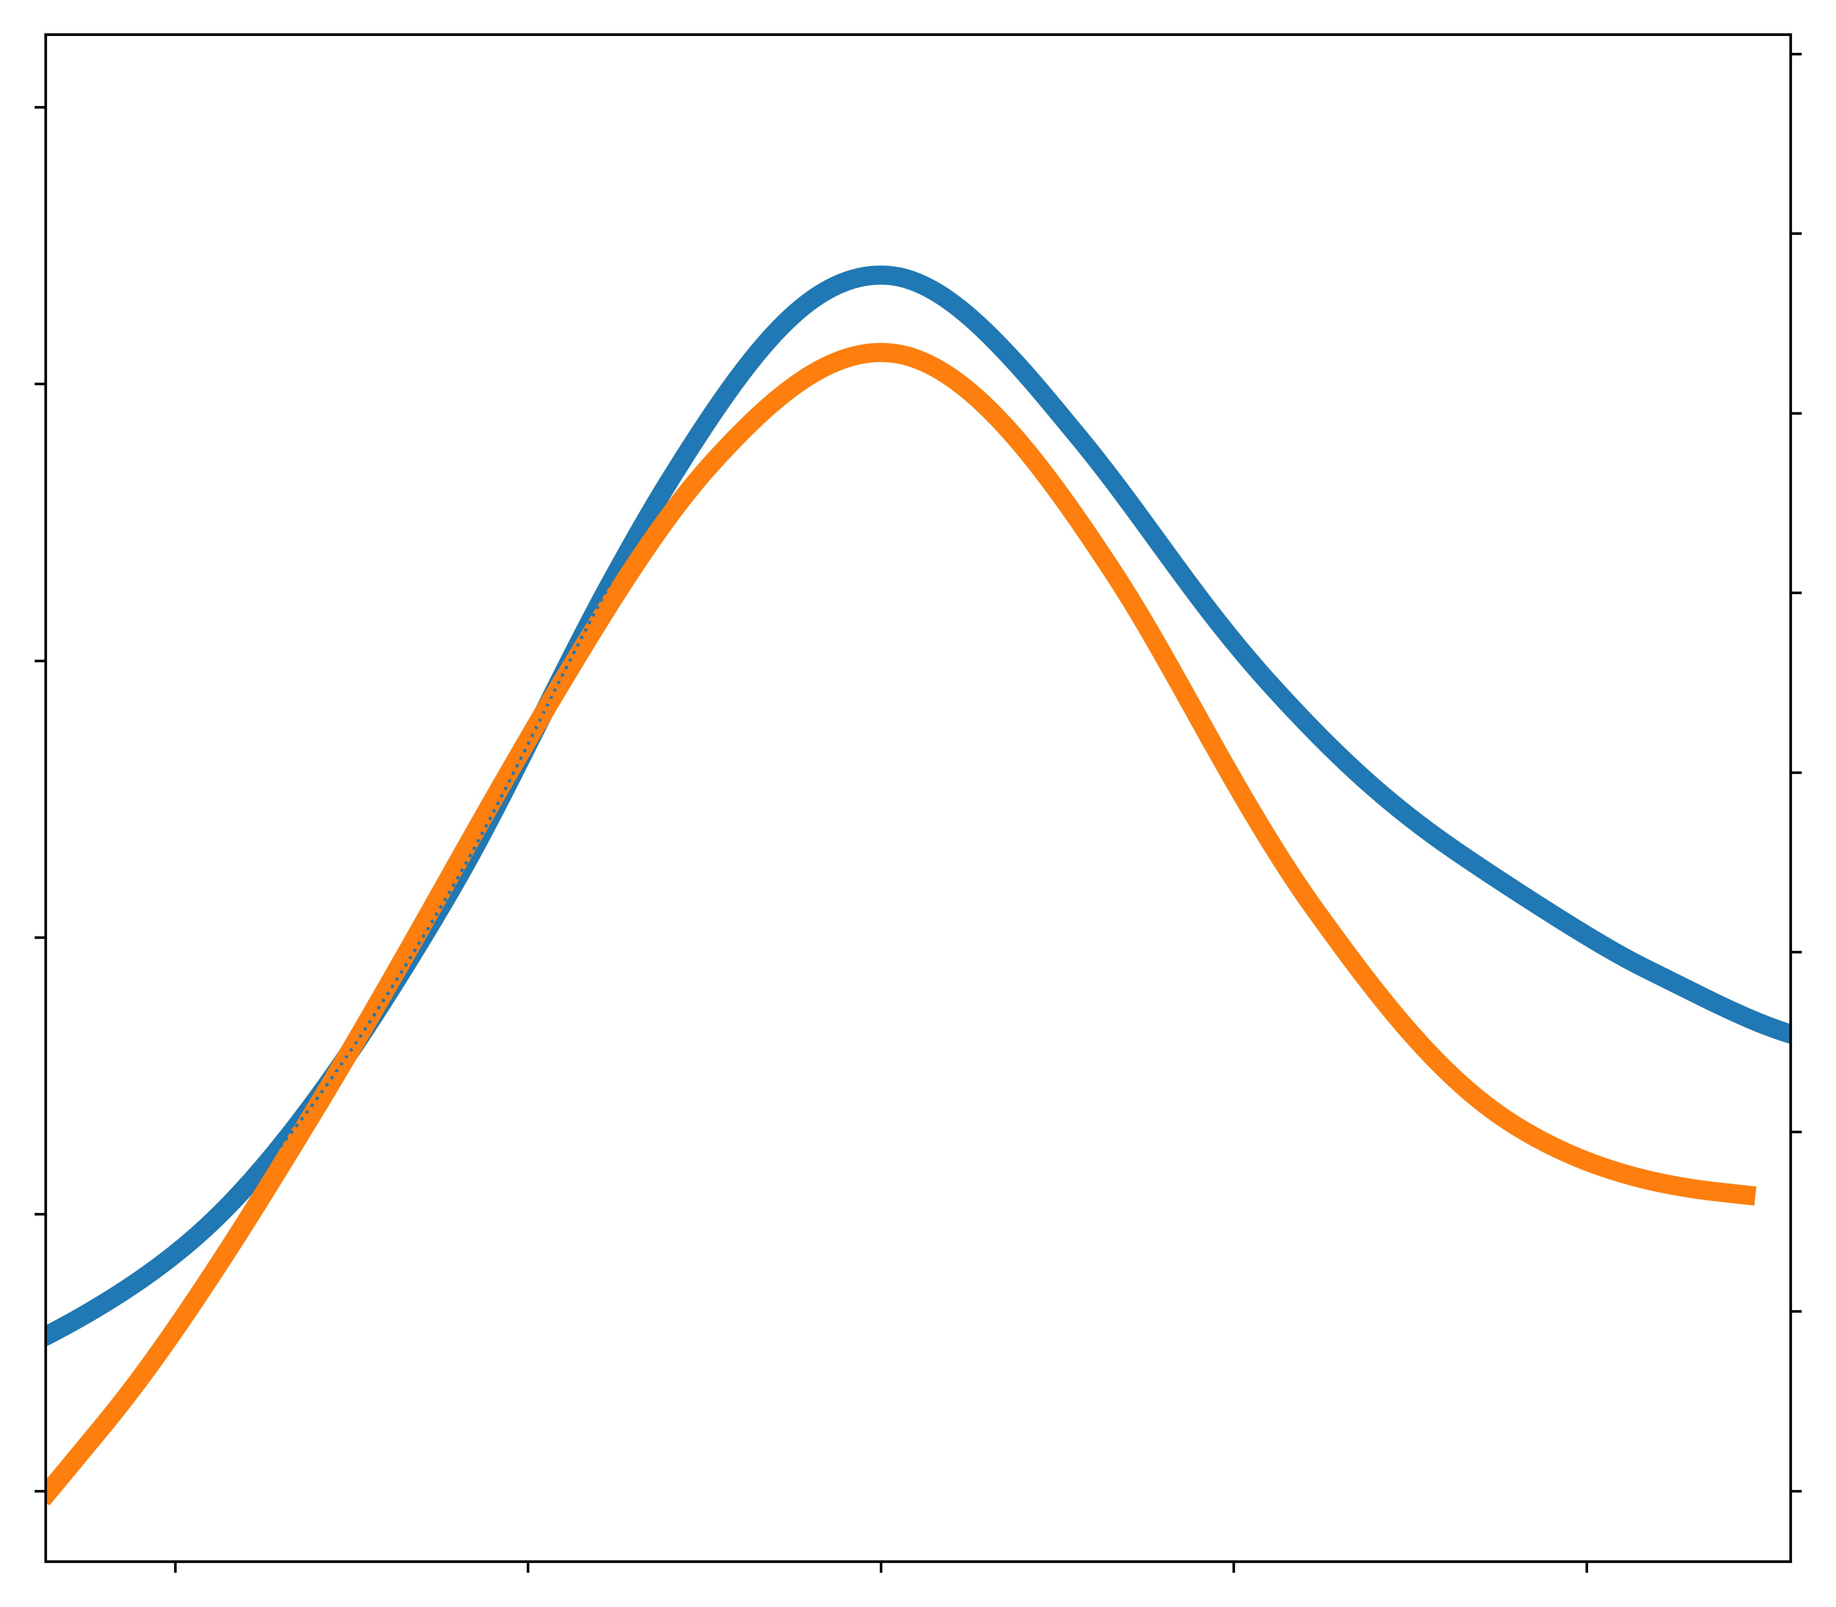
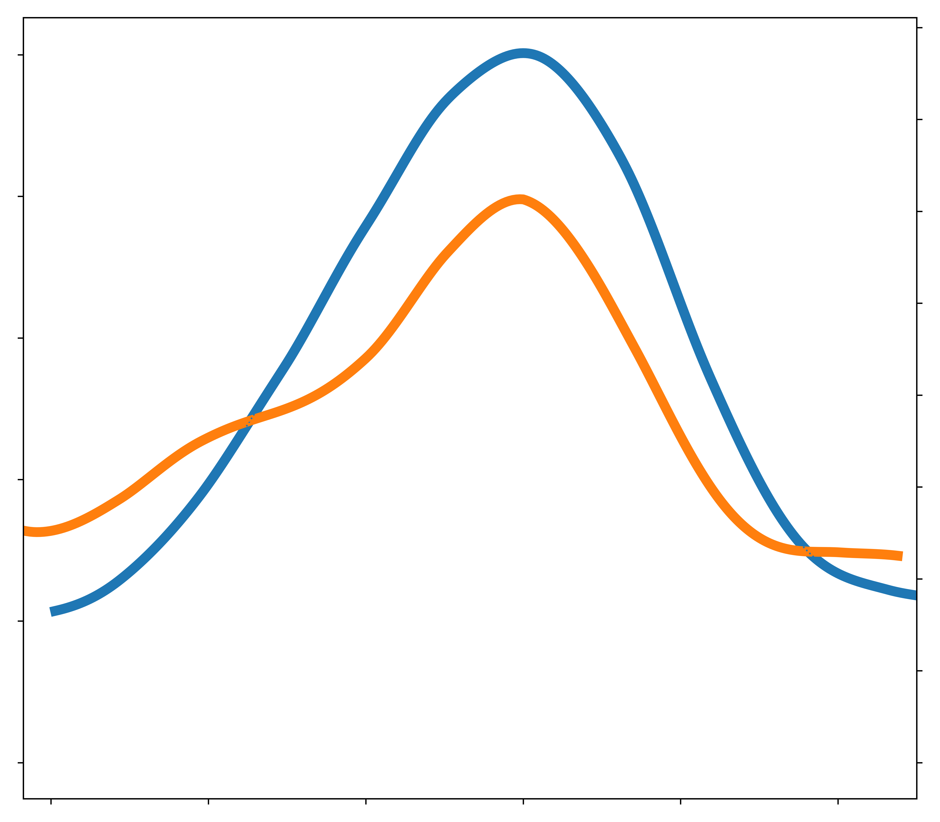
E15 – D24
E14 – D23
D23 – T16
0.20
a
b
c
2
0.5
4
0.5
4
0.4
3
0.4
3
0.10
1
0.3
2
0.3
2
<Fo-Fc> $e/Å3$
<Fo-Fc> $e/Å3$
<Fo-Fc> $e/Å3$
s.d.
s.d.
s.d.
0.2
1
0.2
1
0.00
0
0.1
0.1
H
0.0
H
0
0.0
H
0
I
I
I
O$ε2$ 1.30
0
1.21 O$δ2$
1.19 O$ε2$
1.11 O$ε2$
0
O$δ2$ 1.23
O$δ2$ 1.32
1.50 O$δ2$
1.59 O$γ1$
0
O$γ$1 1.24
O$δ2$ 1.13
Distance ($Å$)
Distance ($Å$)
Distance ($Å$)
Figure Z. Mean values of the difference density map, shown in absolute units (e/Å³) and as standard deviation values along the O-H vector for the analyzed bonds for: (a) DJ-1 and (b-c) E. coli YajL models. All peak centers are aligned to the origin. Atoms belonging to chains A and B are shown in blue and orange, correspondingly.

Slide 4
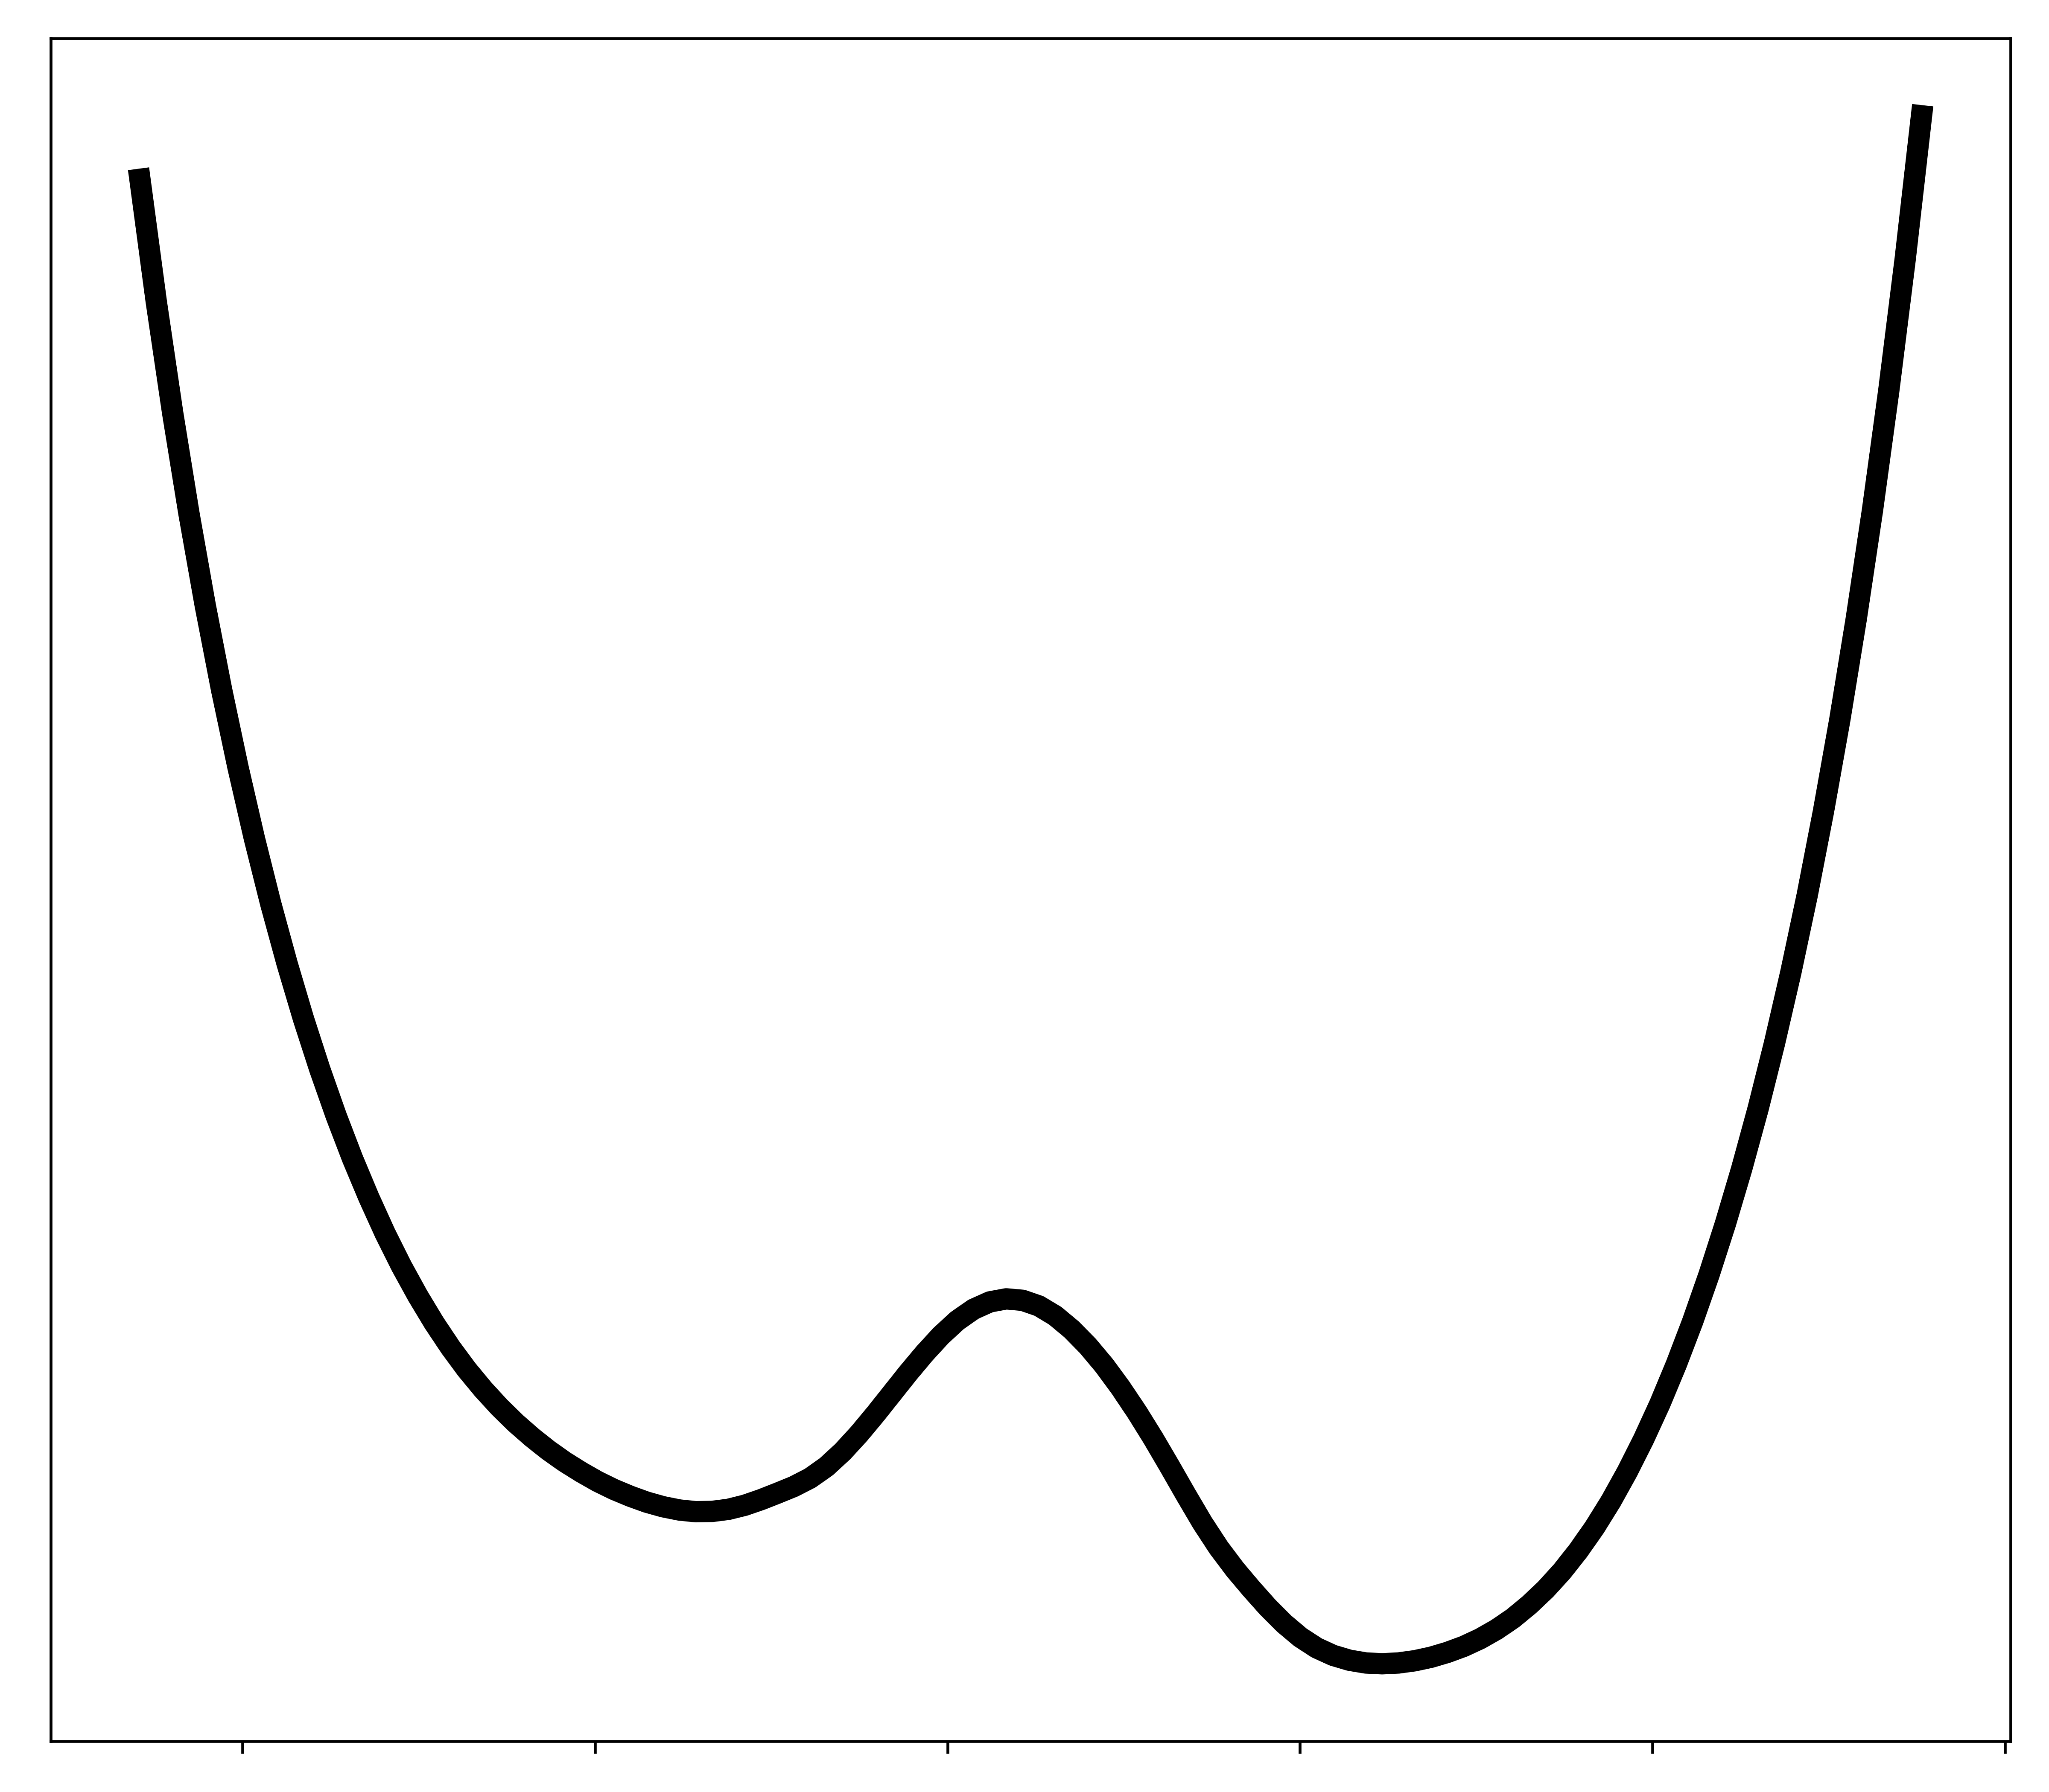
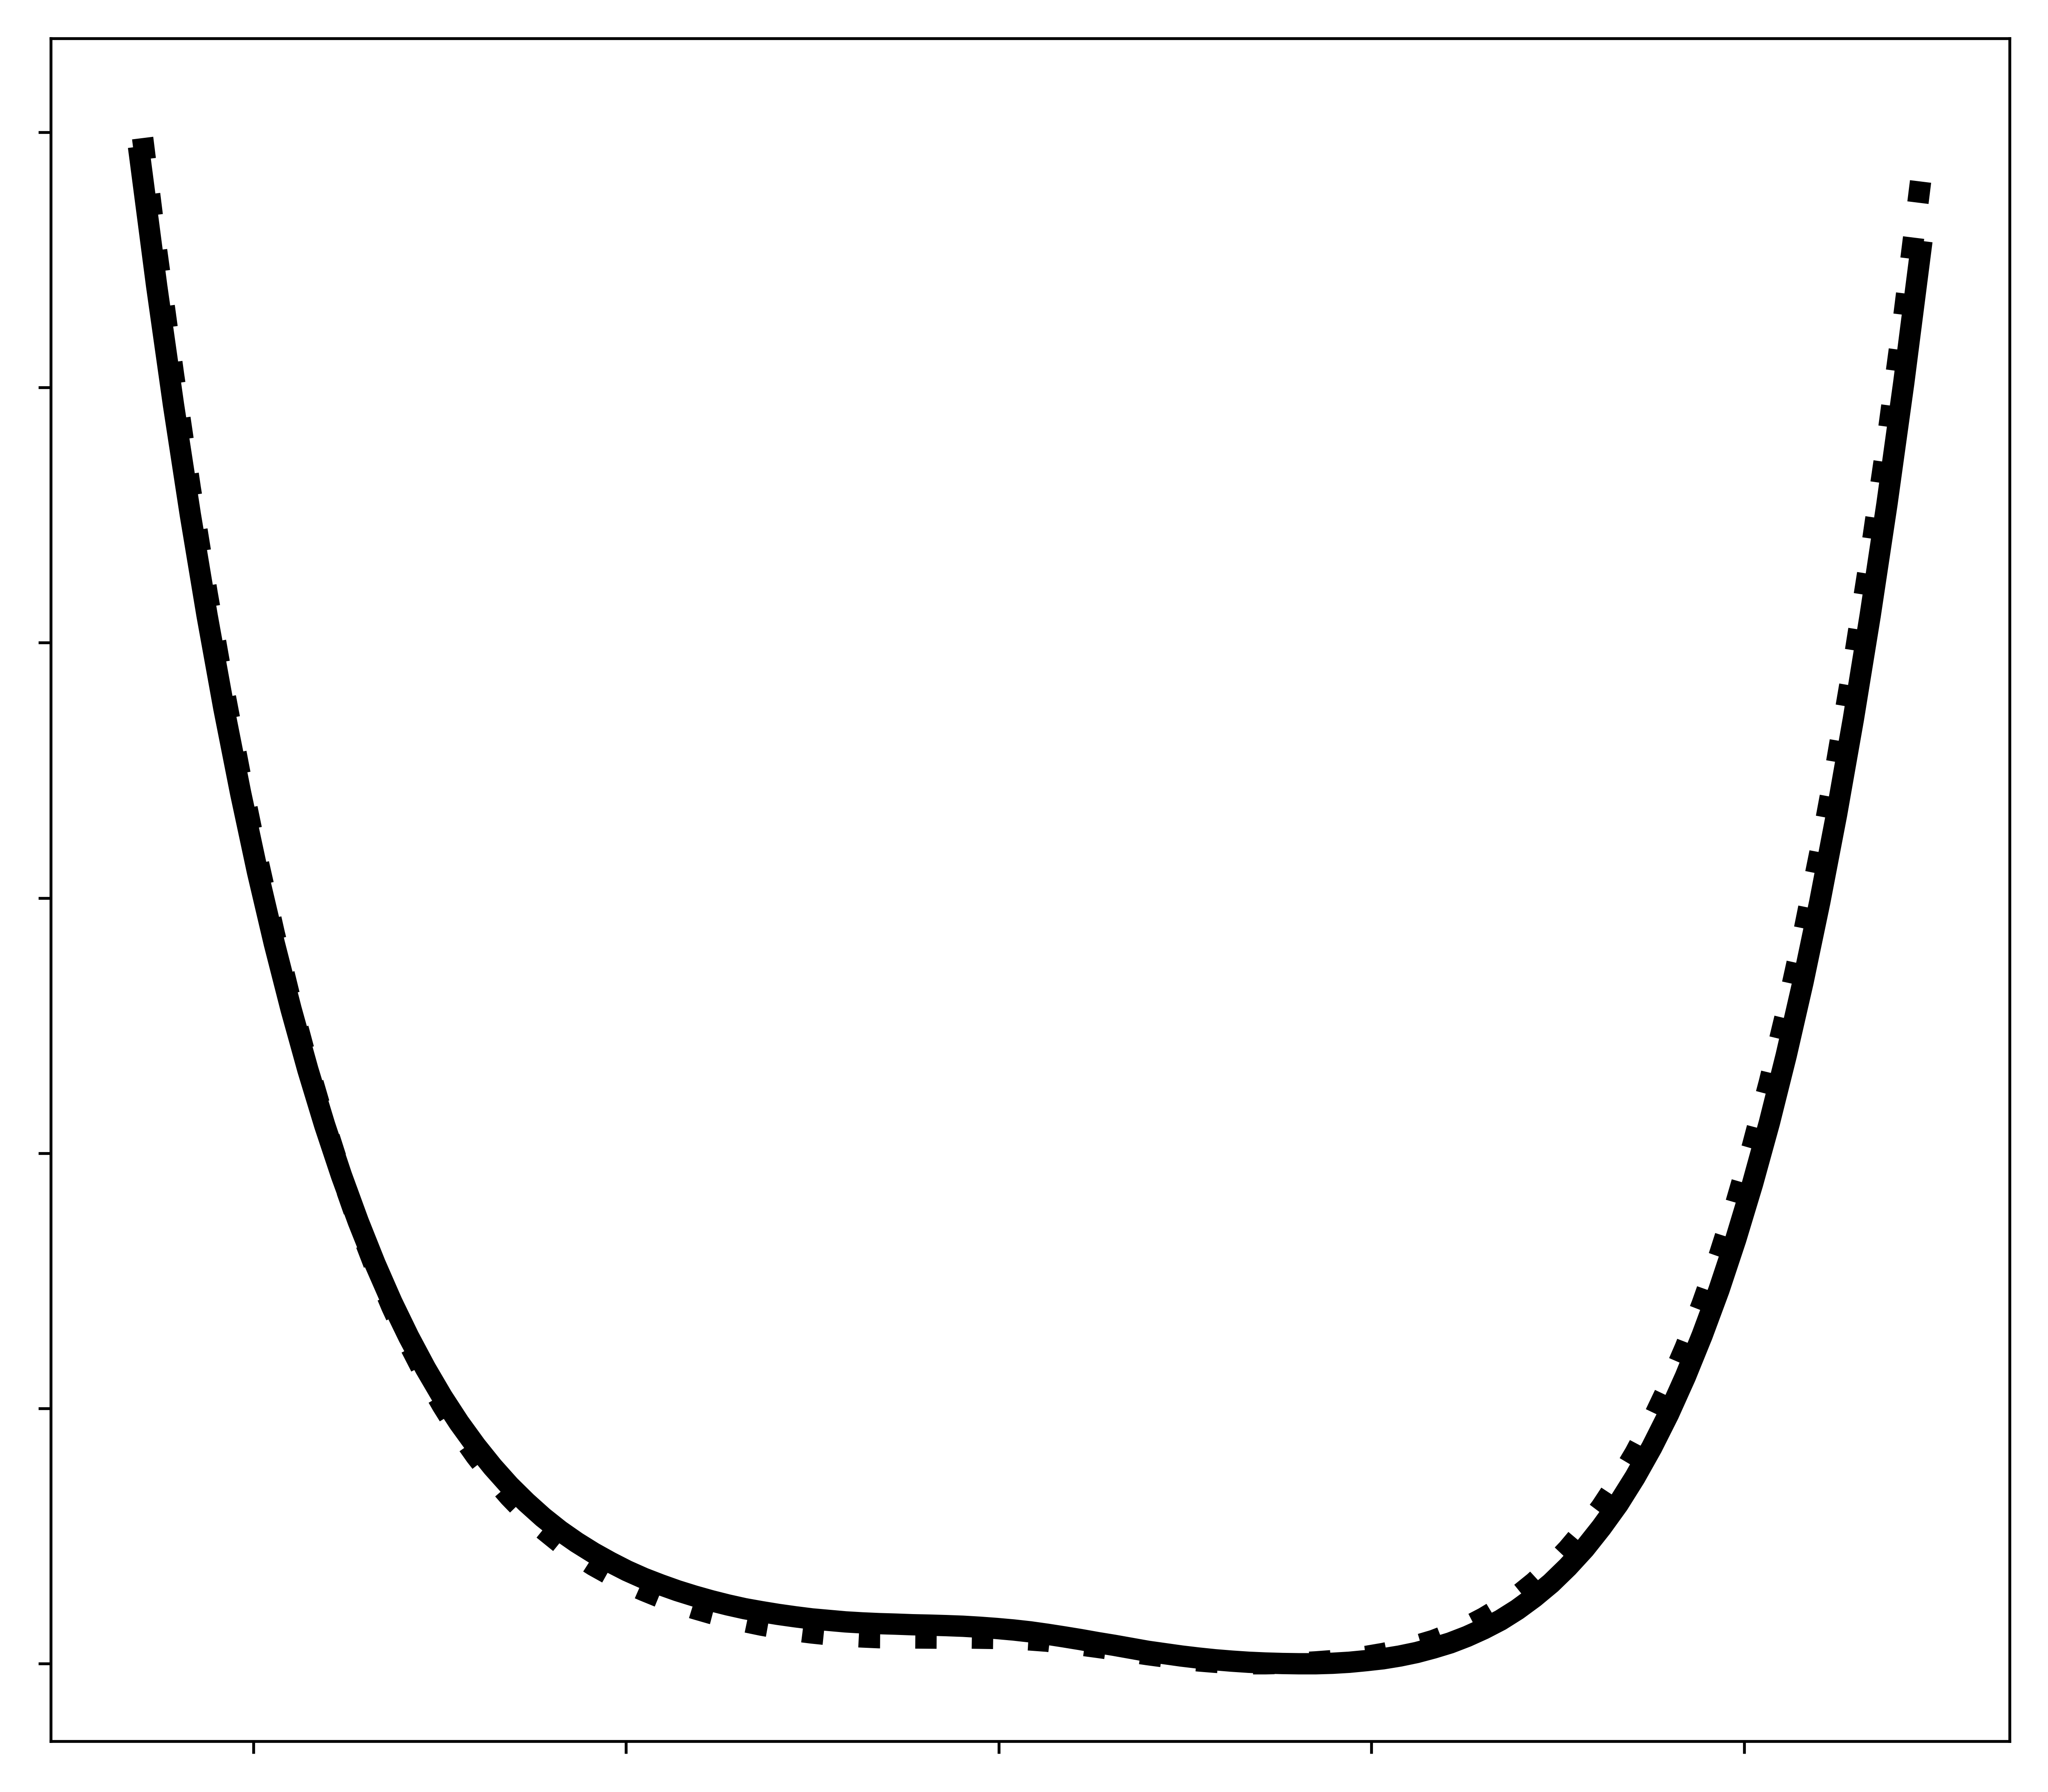
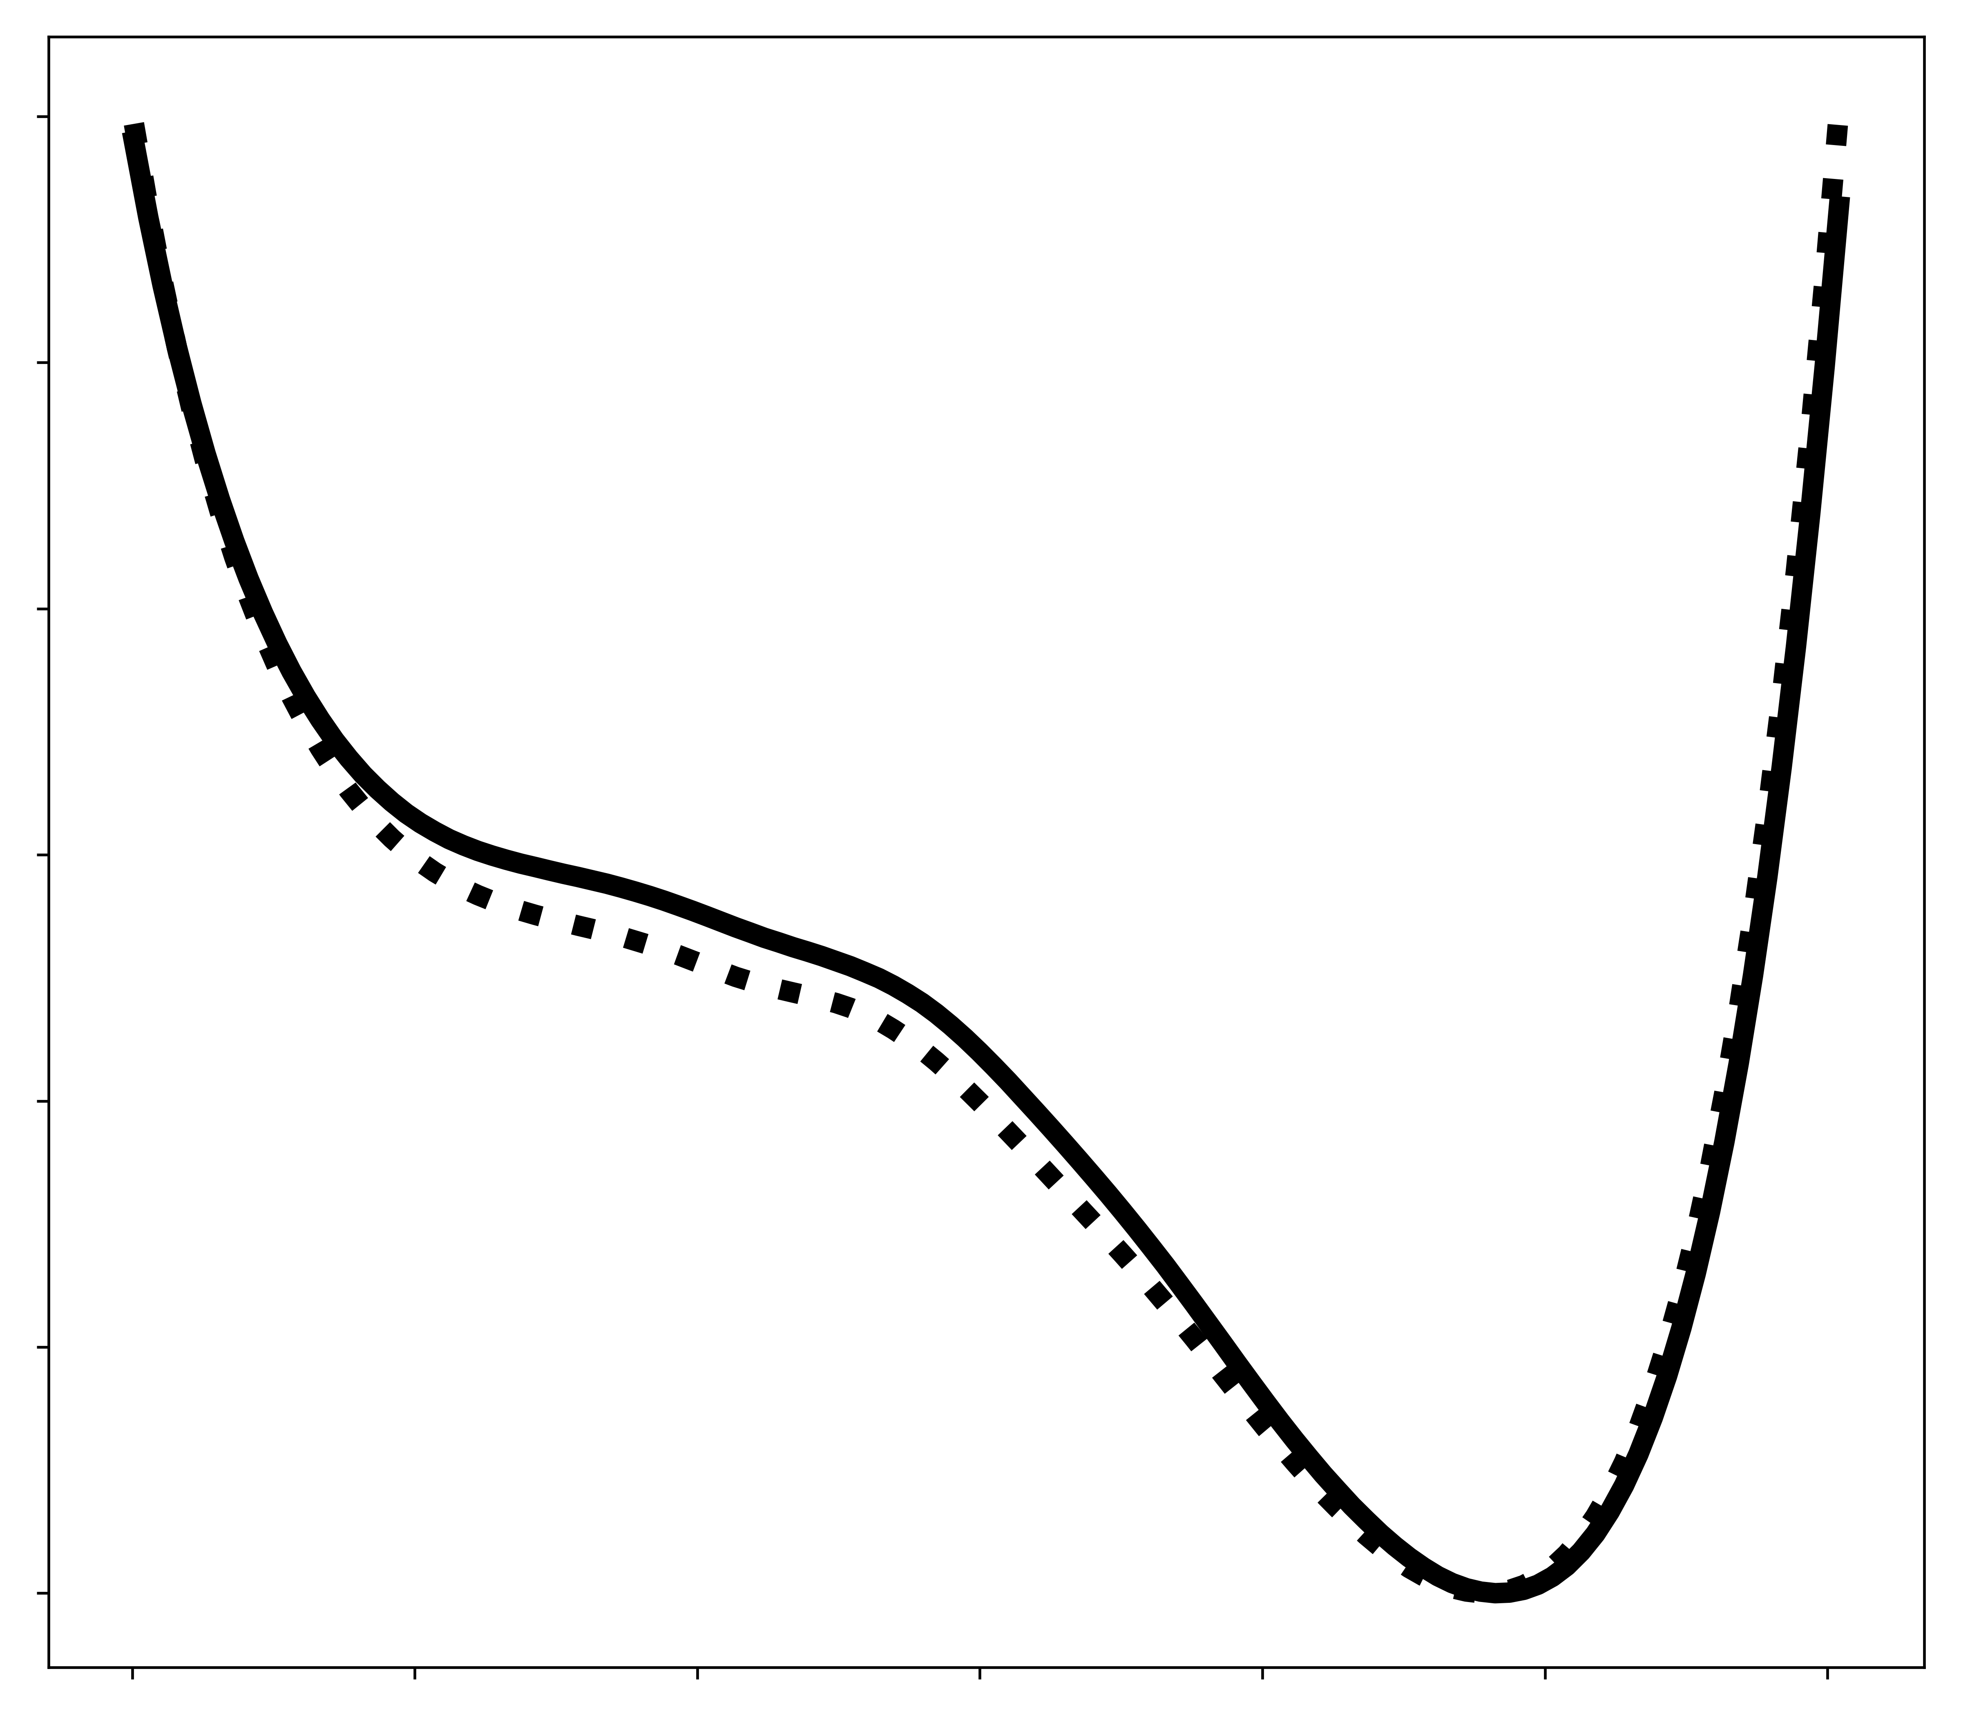
3.0
a
3.0
b
3.0
c
2.0
O𝜀2 I I I I I I I O$δ2$
2.0
O𝜀2 I I I I I I I O$δ2$
2.0
O$δ2$ I I I I I I I O$γ$1
$∆$ Energy, kcal/mol
$∆$ Energy, kcal/mol
$∆$ Energy, kcal/mol
1.0
1.0
1.0
0.0
0.8 1.0 1.2 1.4 1.6
0.0
0.8 1.0 1.2 1.4 1.6
0.0
Distance ($Å$)
0.8 1.2 1.6 2.0
Distance ($Å$)
Distance ($Å$)
Figure W. AIMNet2 energy values relative to their minimum as a function of hydrogen position between corresponding oxygen atoms: (a) Oδ2 (D24) and O𝜀2 (E15) in DJ-1, (b) Oδ2 (D23) and O𝜀2 (E14) in YajL, and (c) Oδ2 (D23) and Oγ1 (T16) in YajL. Solid and dashed lines represent two instances of the bond in the YajL model.

