Slide 1
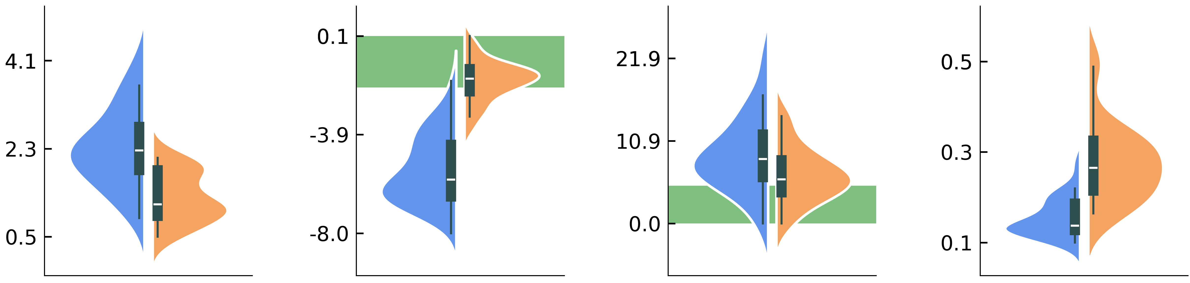
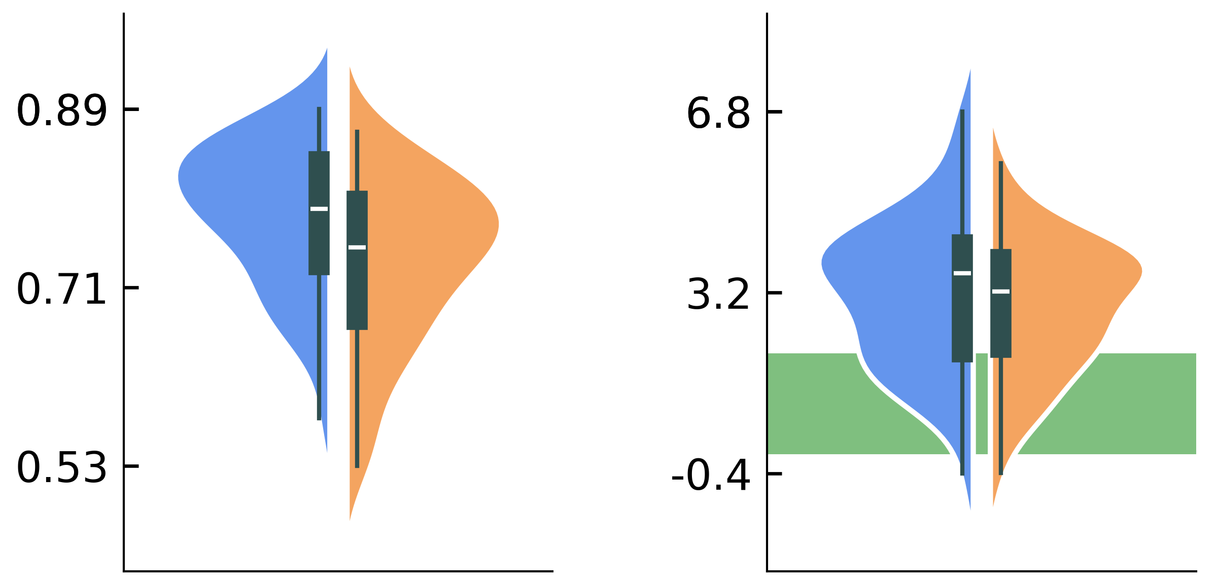
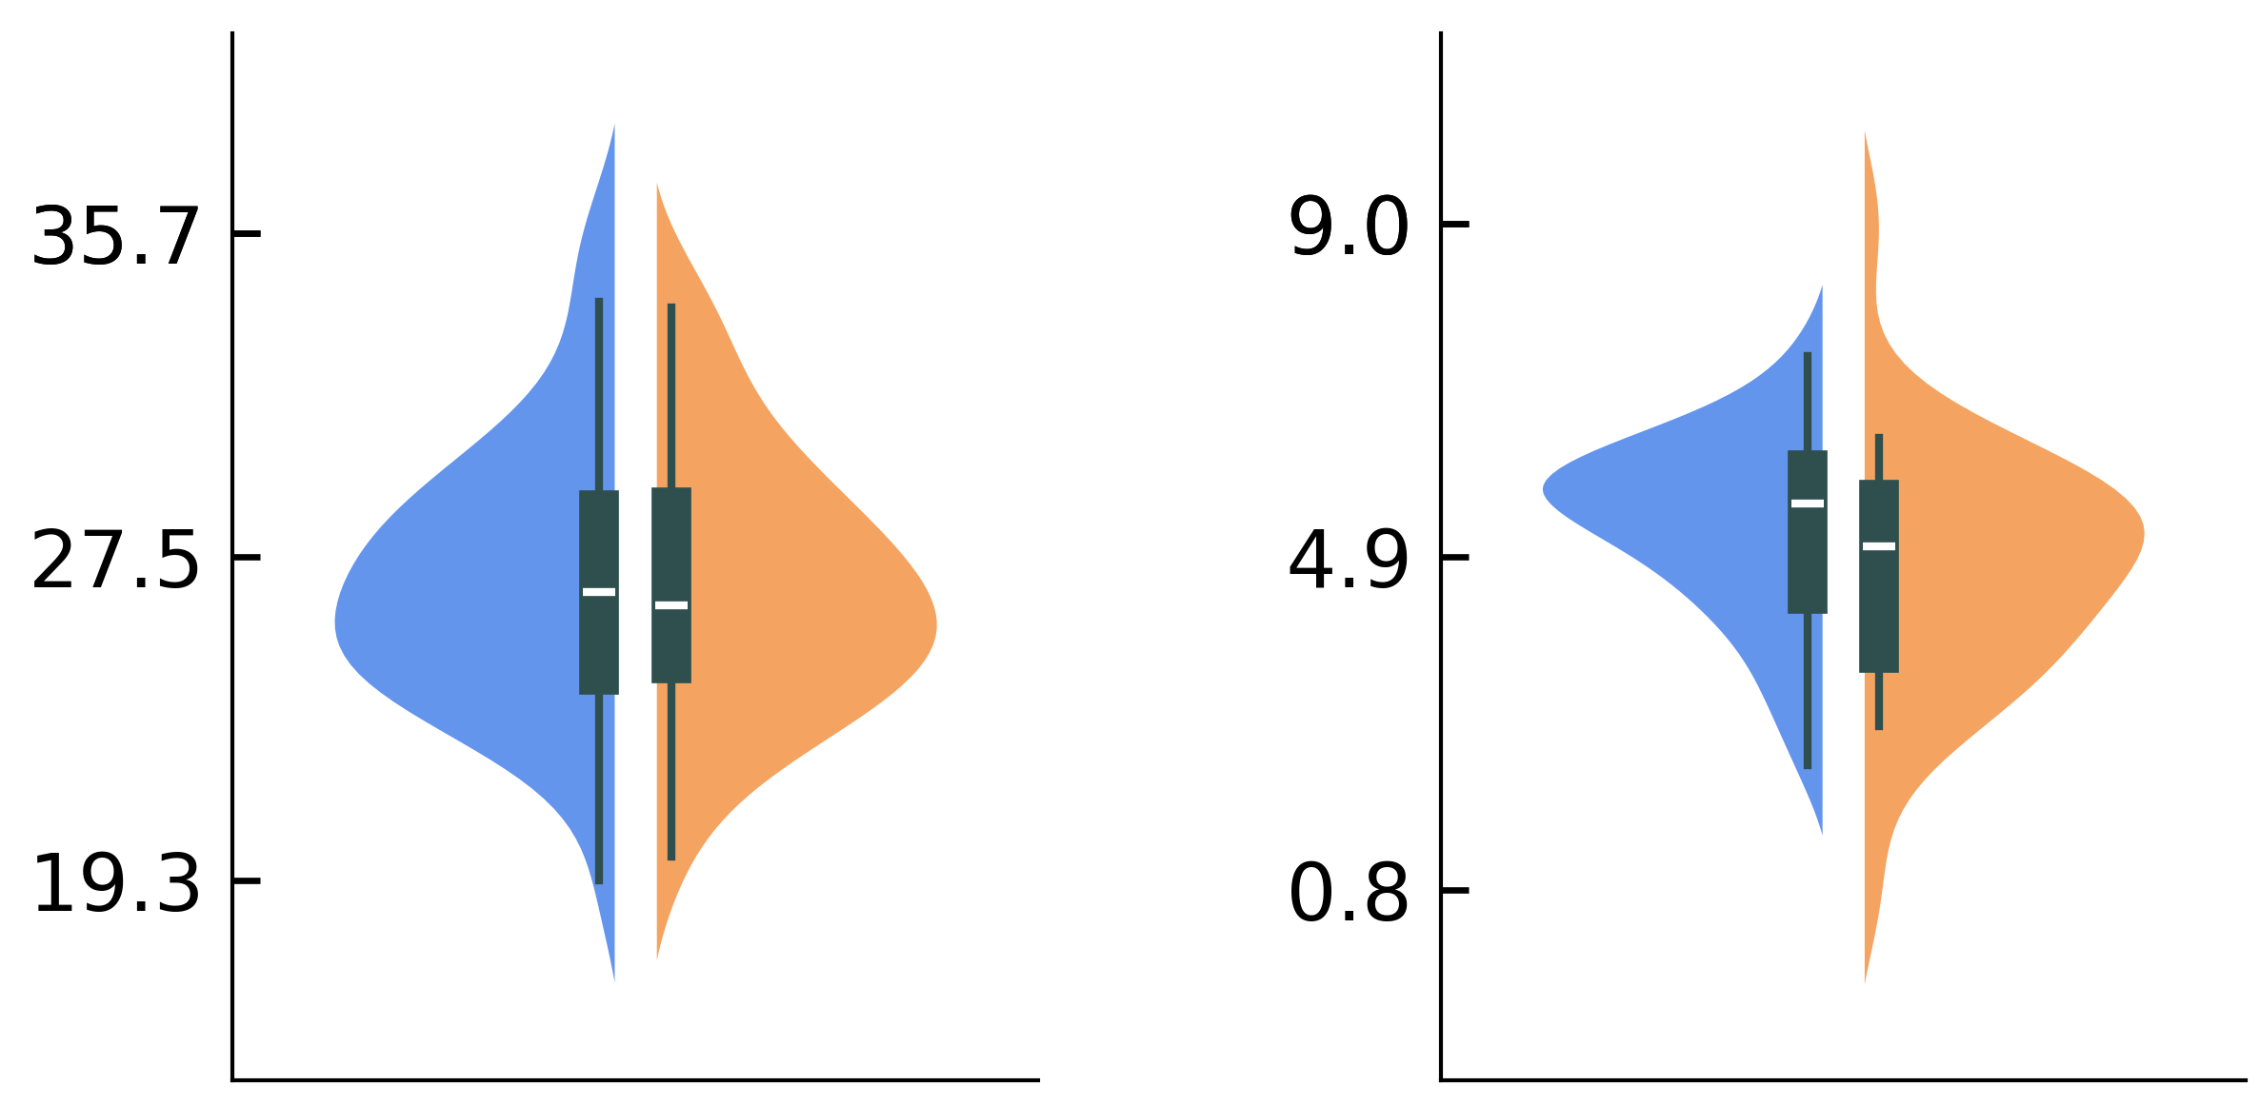
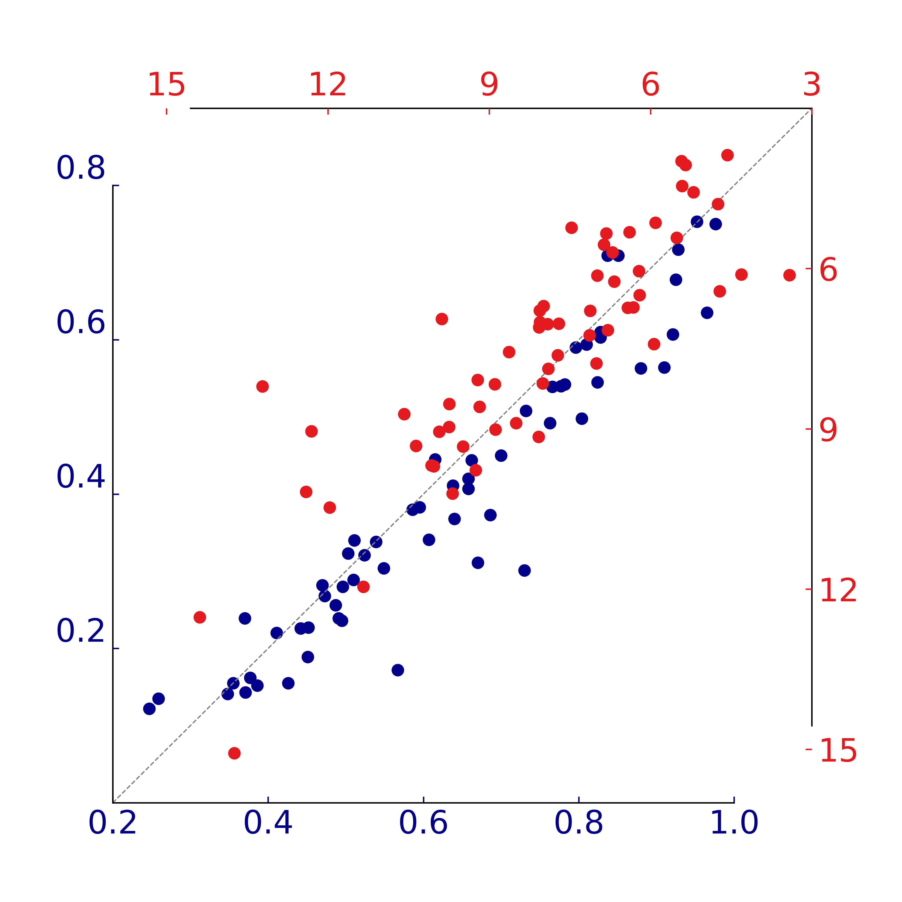
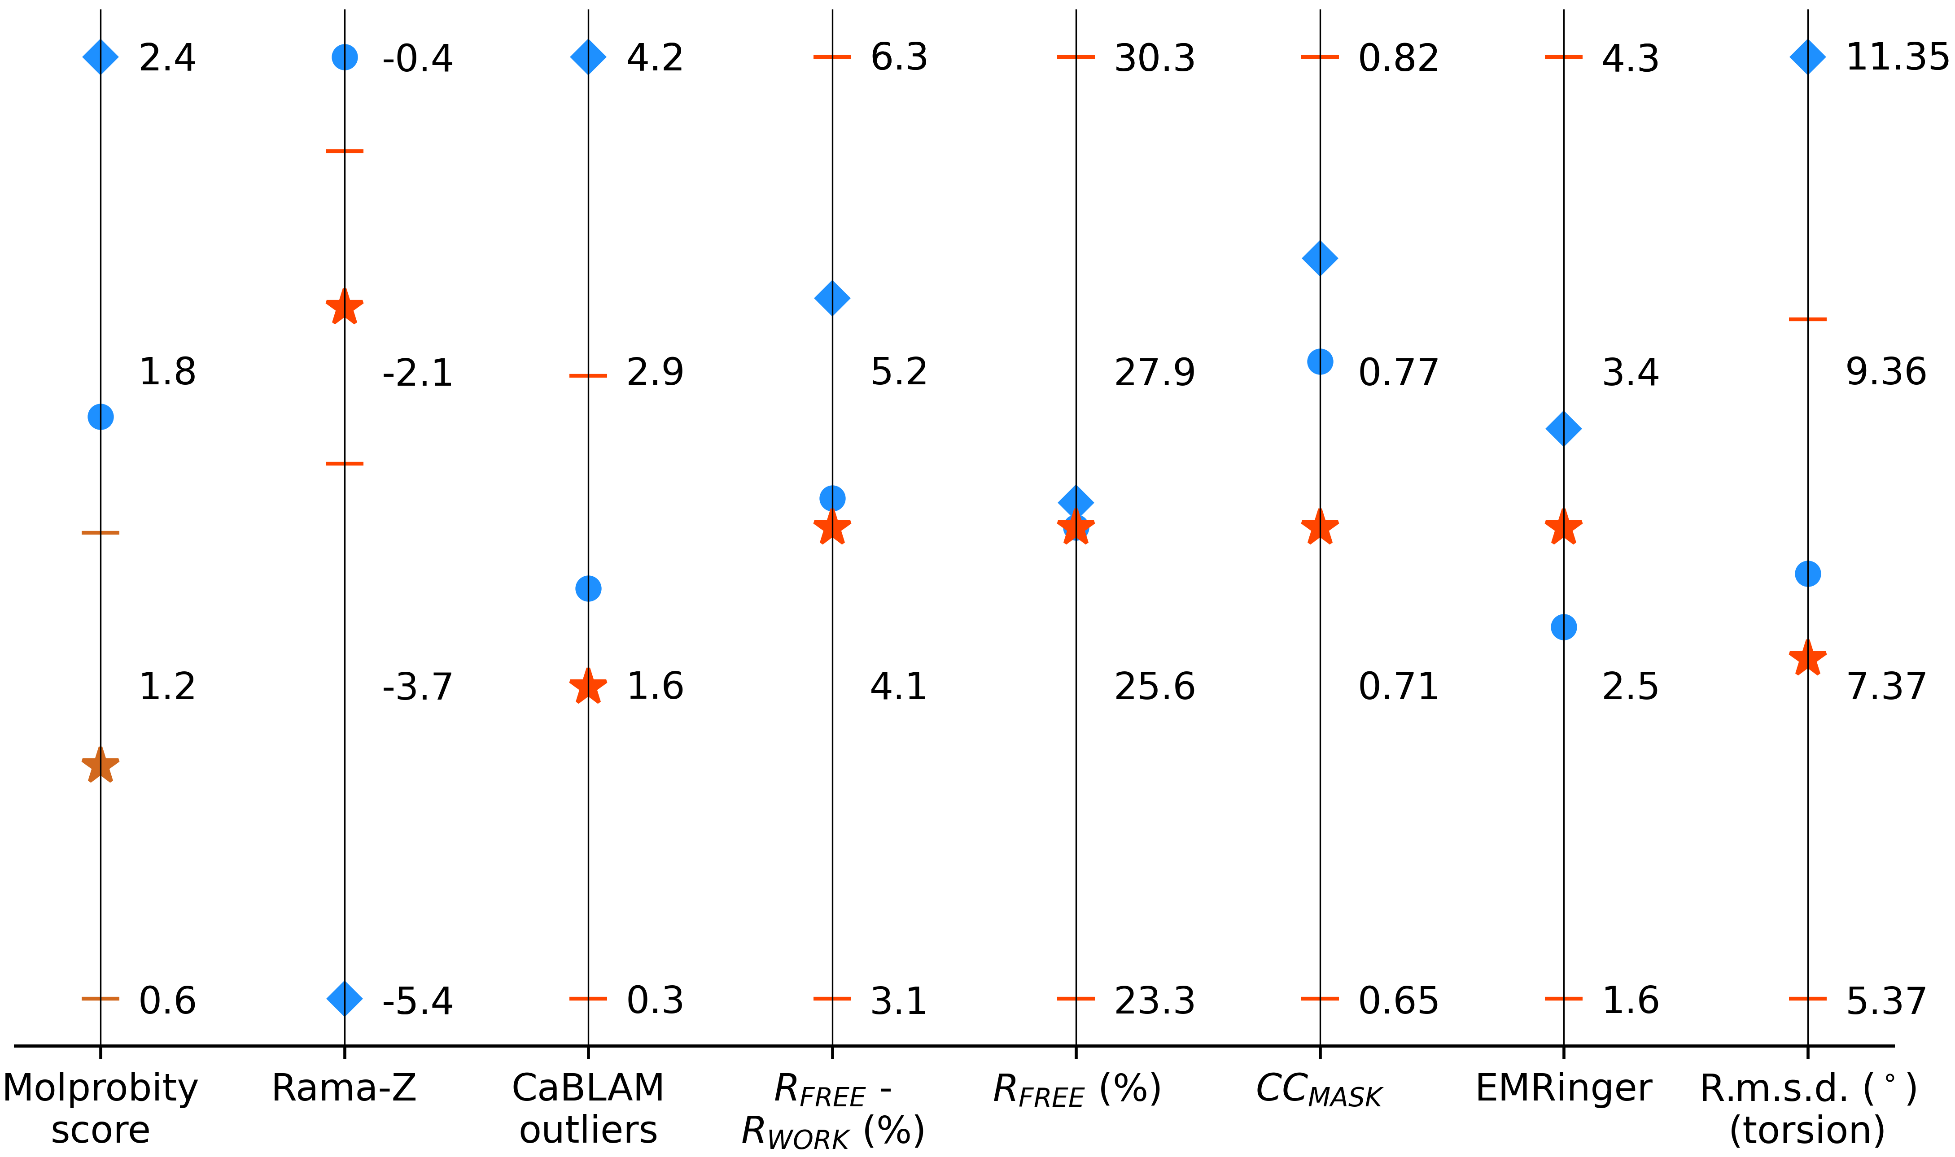
a
MolProbity score
Rama-Z
CaBLAM disfavored
R.m.s.d. from start (Å)
Standard
AQuaRef
Standard
AQuaRef
Standard
AQuaRef
Standard
AQuaRef
b
CC_{MASK}
EMRinger
c
R_{FREE} (%)
R_{FREE} – R_{WORK} (%)
d
Standard
AQuaRef
Standard
AQuaRef
Standard
AQuaRef
Standard
AQuaRef
Standard restraints
Standard + additional restraints
AQuaRef
e
R.m.s.d. (°), Phenix
f
R.m.s.d. (Å), AQuaRef
R.m.s.d. (°), AQuaRef
R.m.s.d. (Å), Phenix

Slide 2
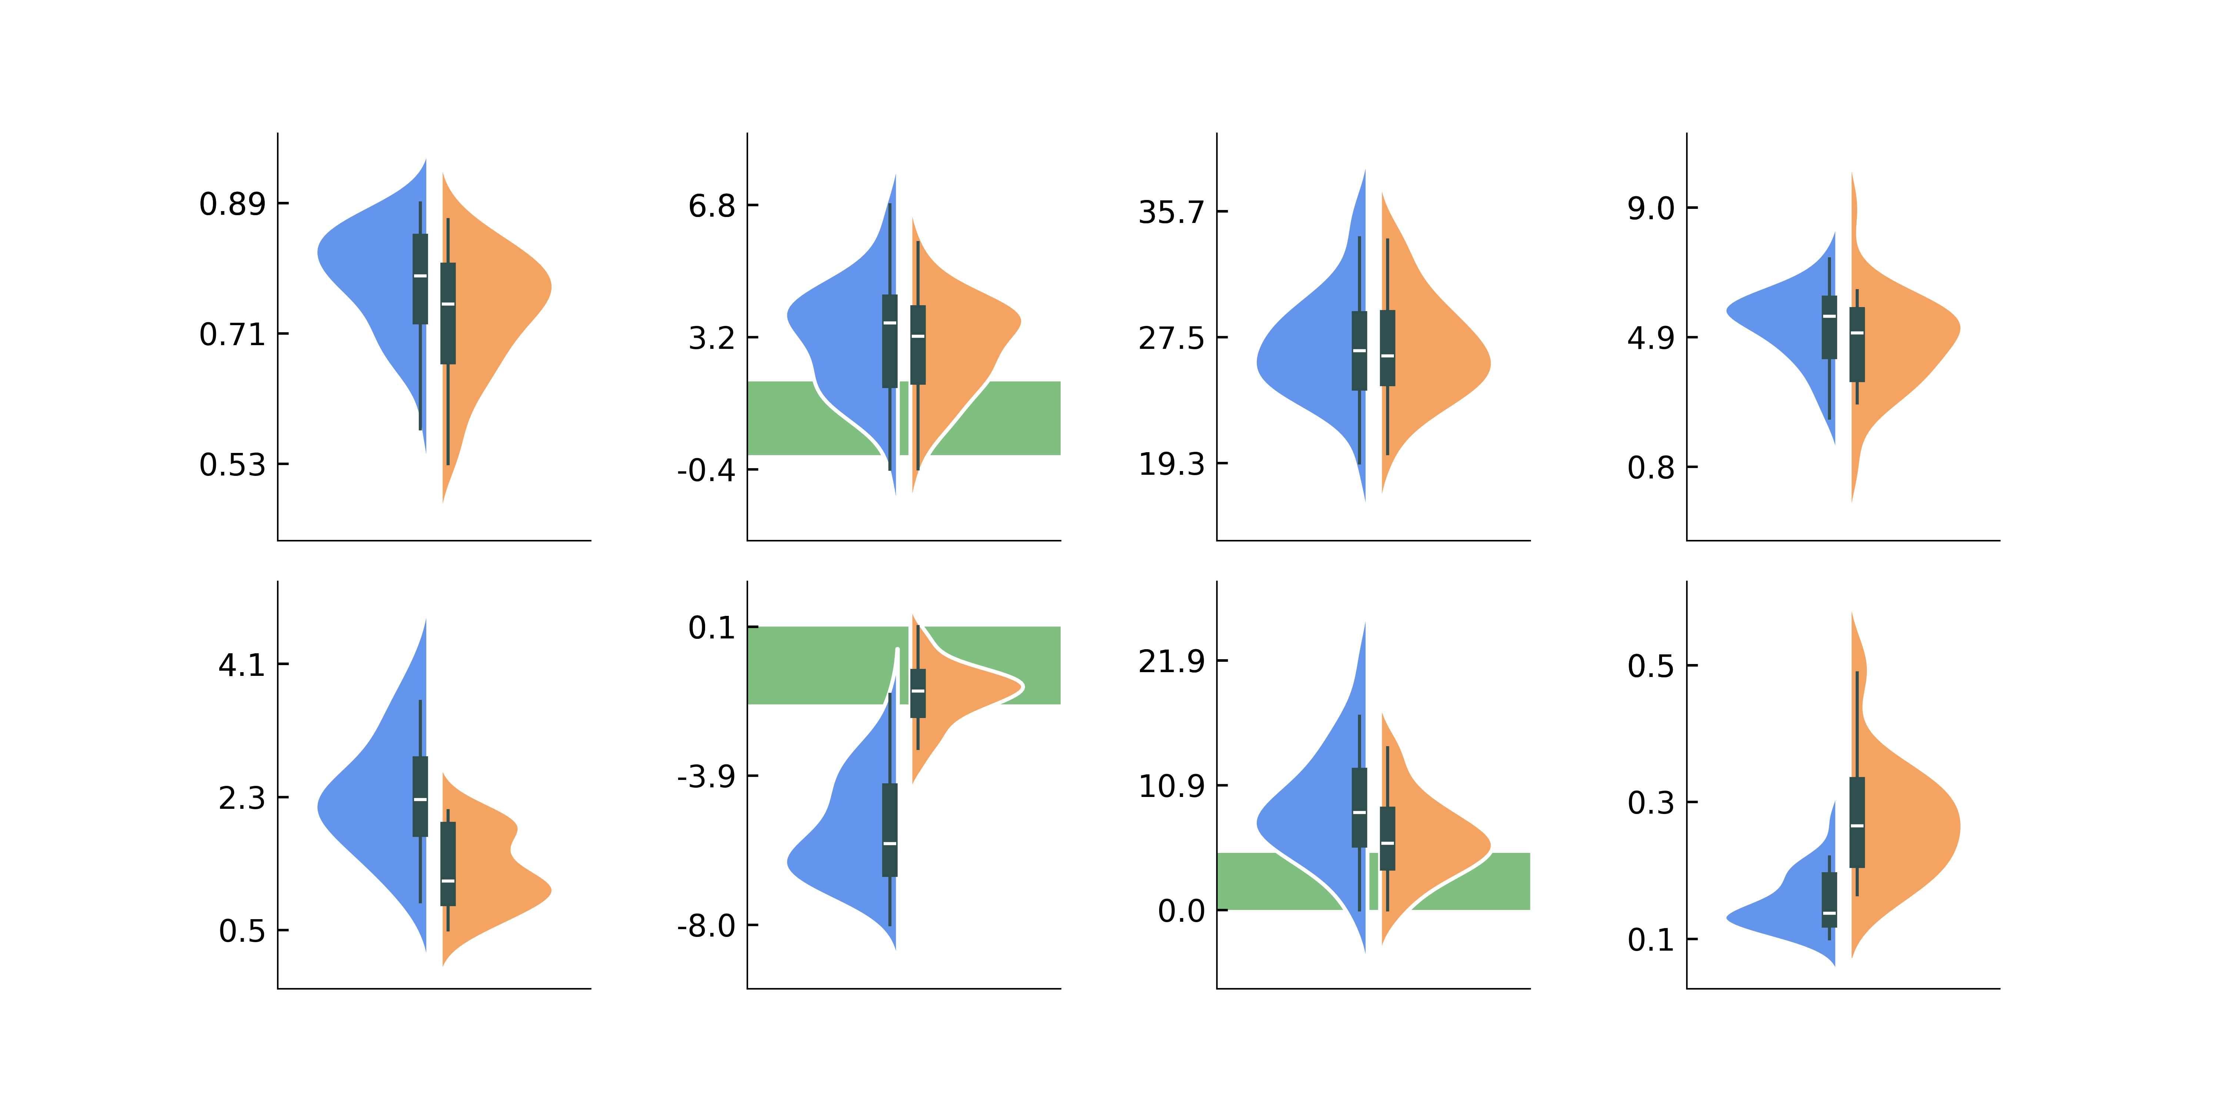
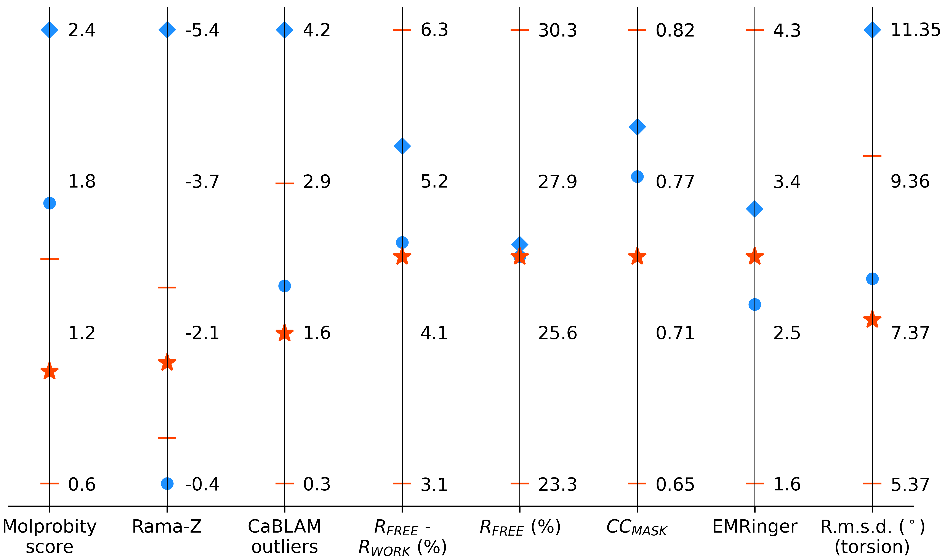
a
MolProbity score
Rama-Z
CaBLAM disfavored
R.m.s.d. from start (Å)
b
CC_{MASK}
EMRinger
c
R_{FREE} (%)
R_{FREE} – R_{WORK} (%)
d
Standard restraints
Standard + additional restraints
AQuaRef
e
R.m.s.d. (°), Phenix
f
R.m.s.d. (Å), AQuaRef
R.m.s.d. (°), AQuaRef
R.m.s.d. (Å), Phenix

Slide 3
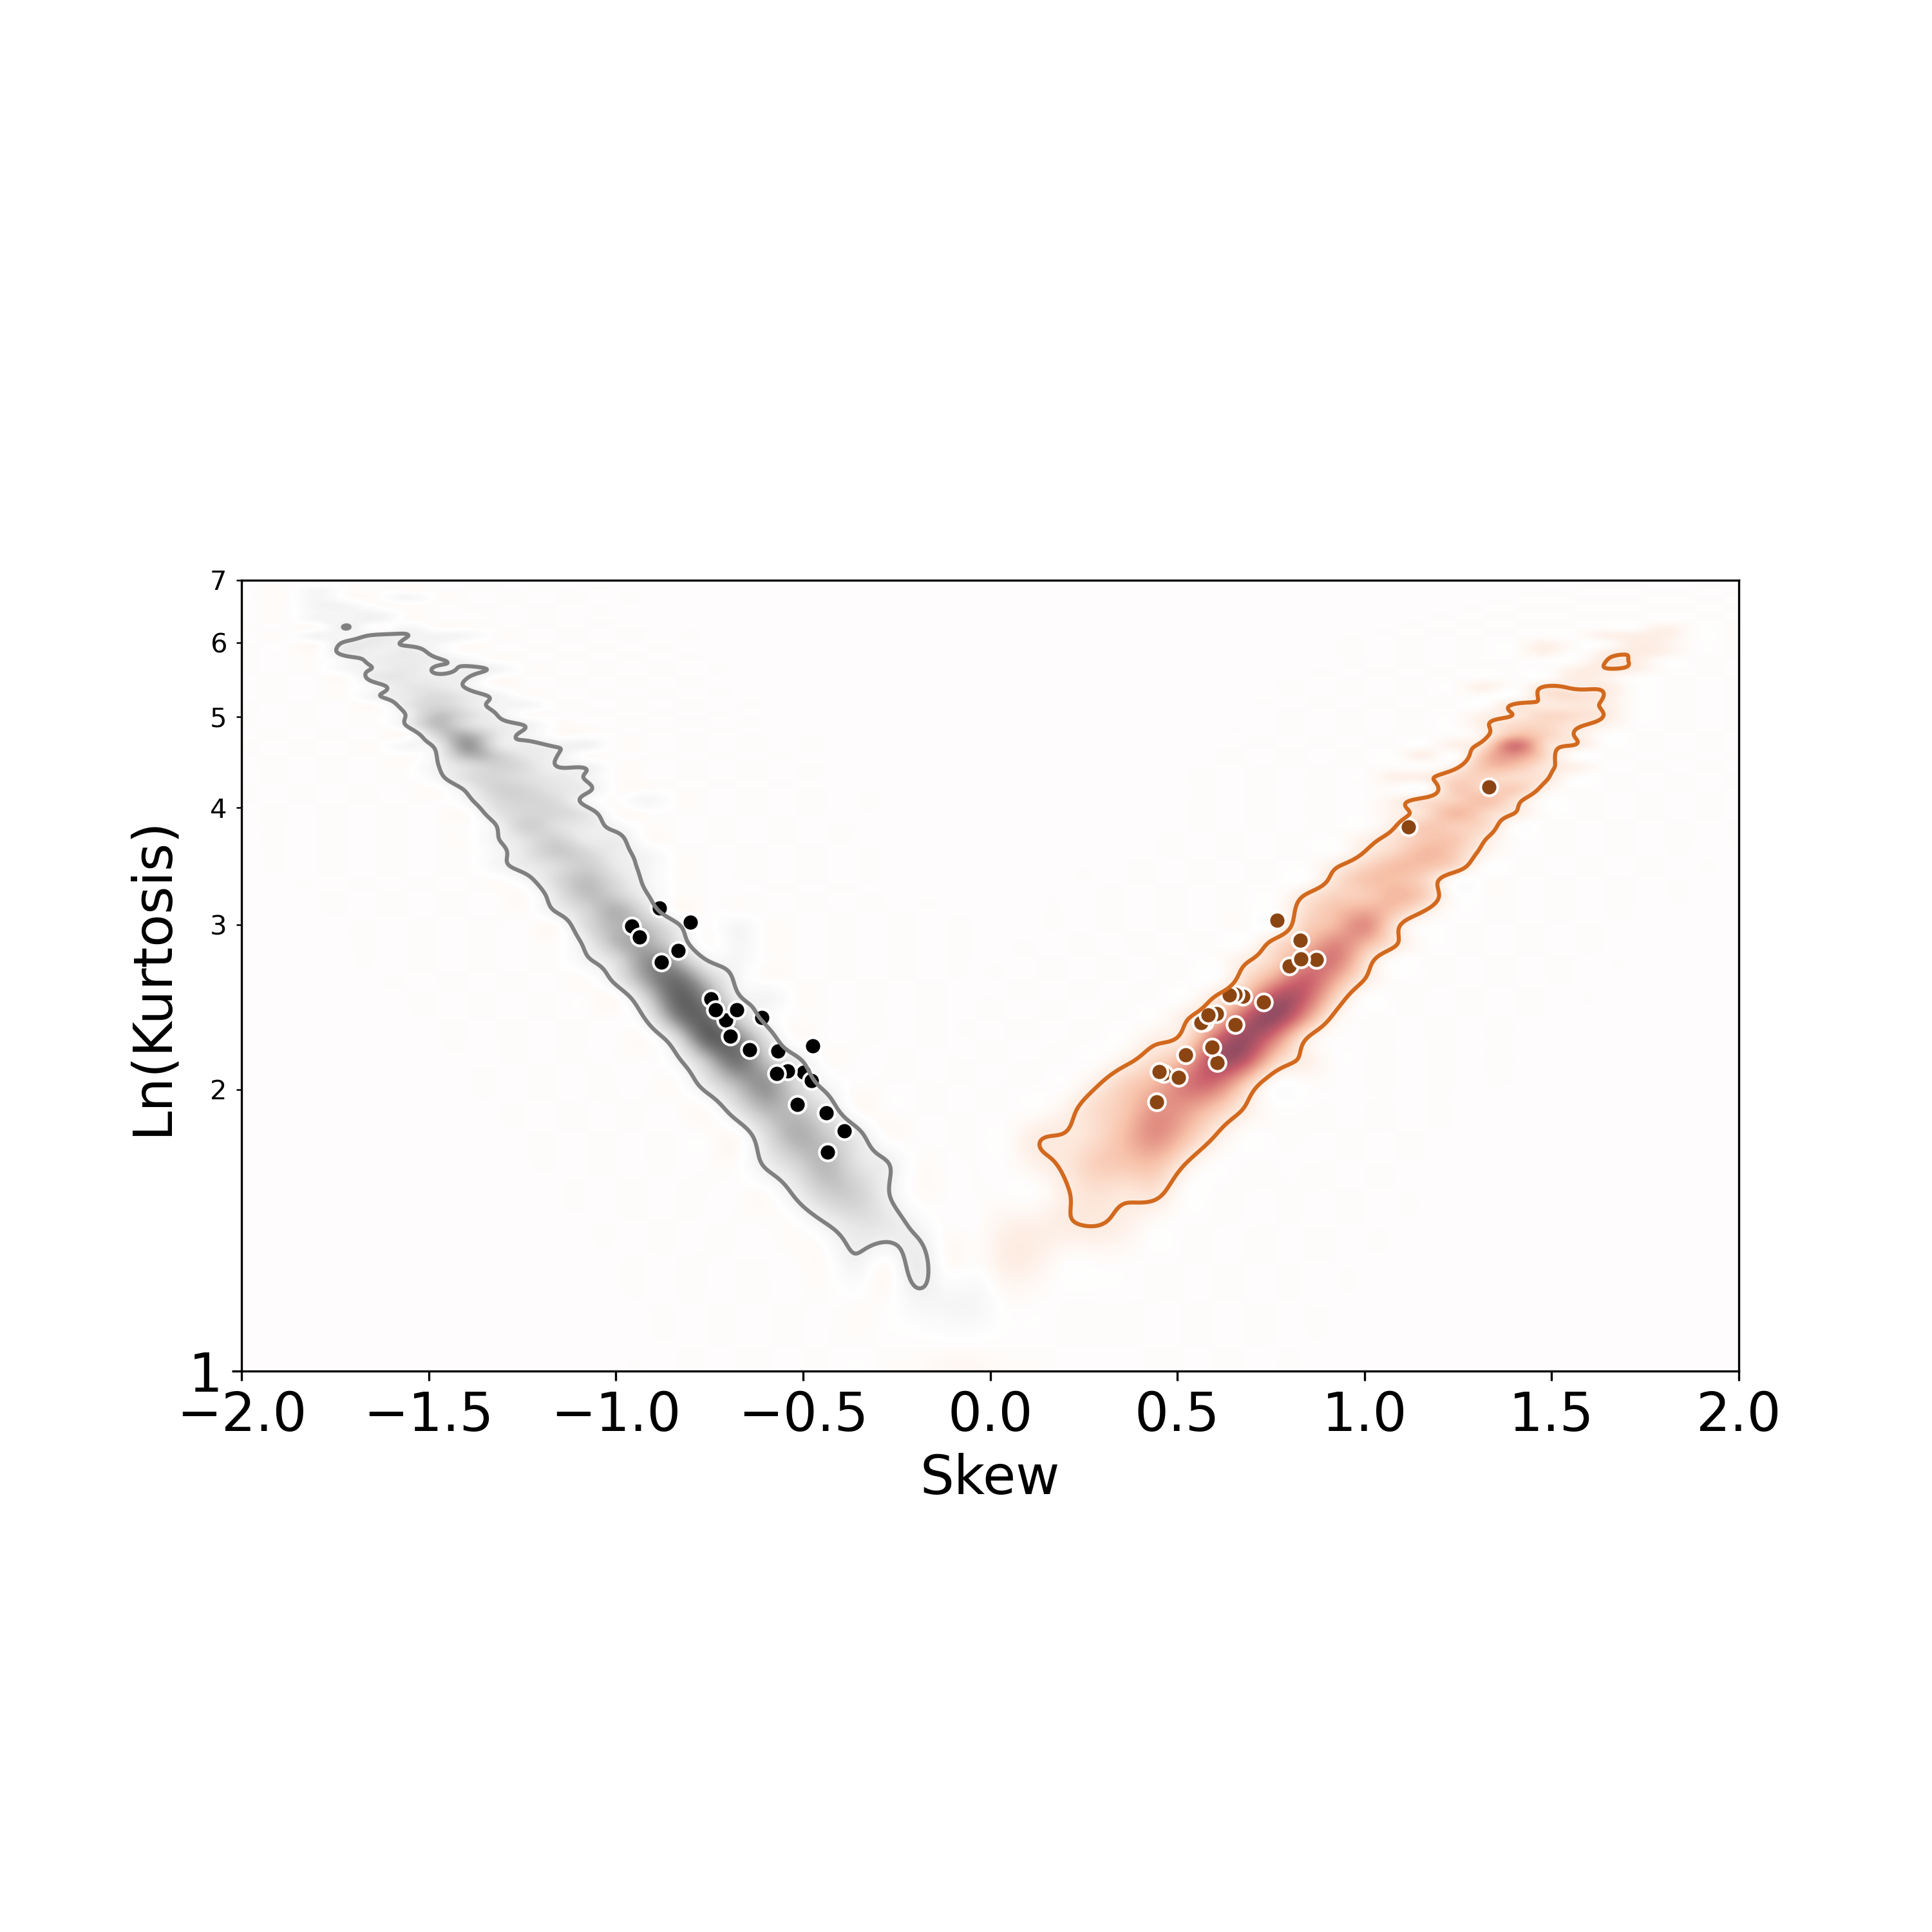
6
5
4
6
3
5
4
2
3
2

Slide 4

6
5
4
6
3
5
4
2
3
2

Slide 5
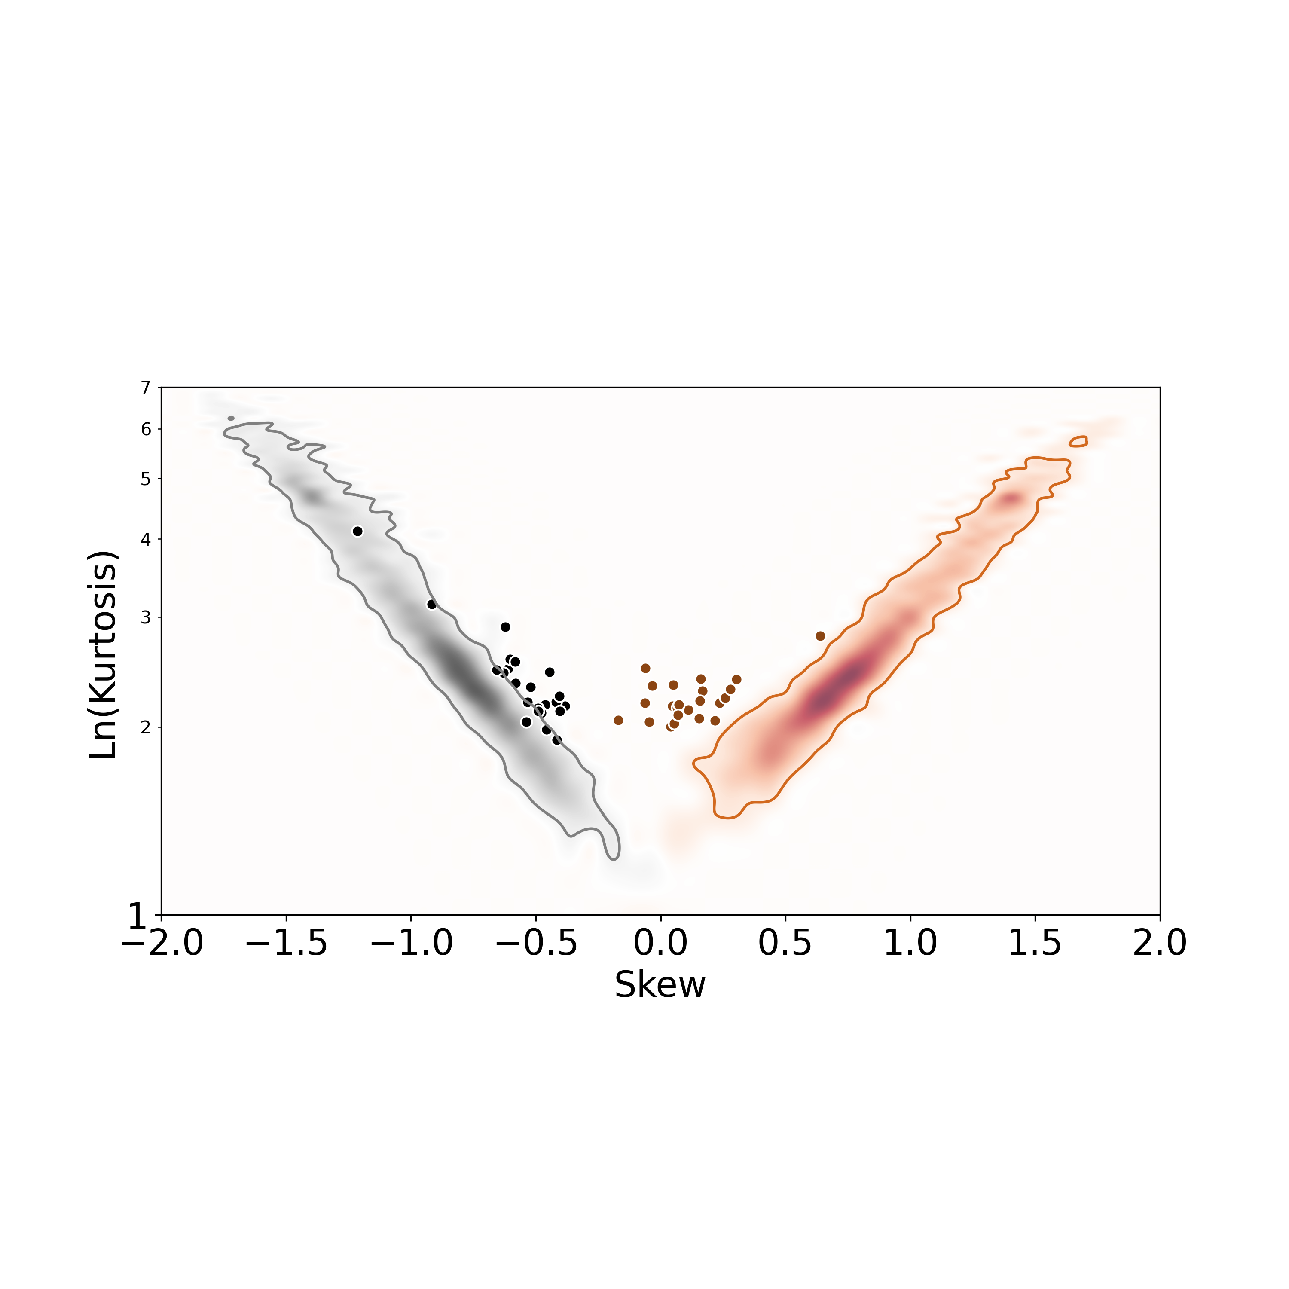
6
5
4
3
6
5
2
4
3
2

