Slide 1
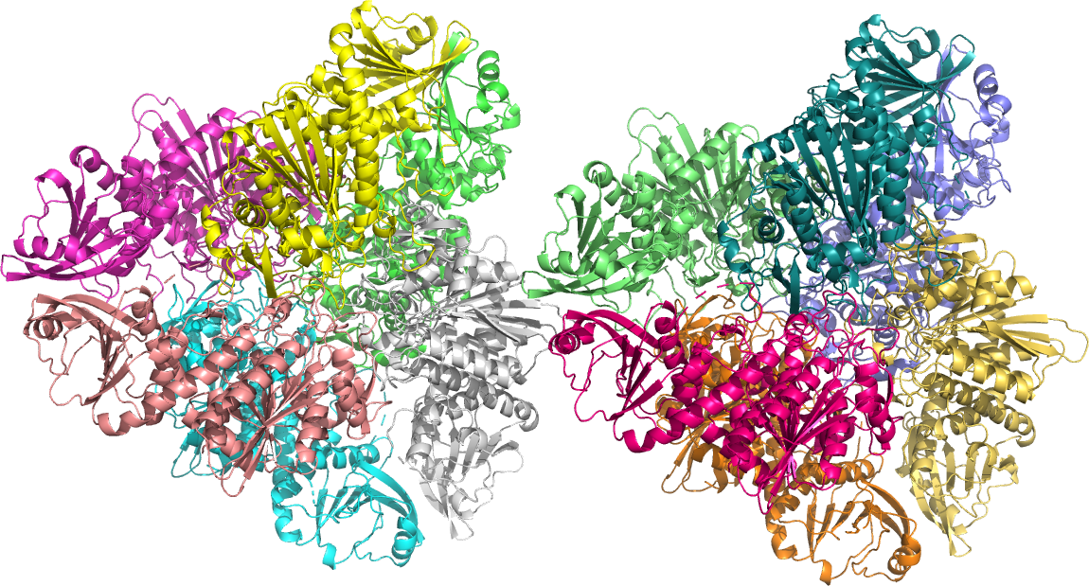
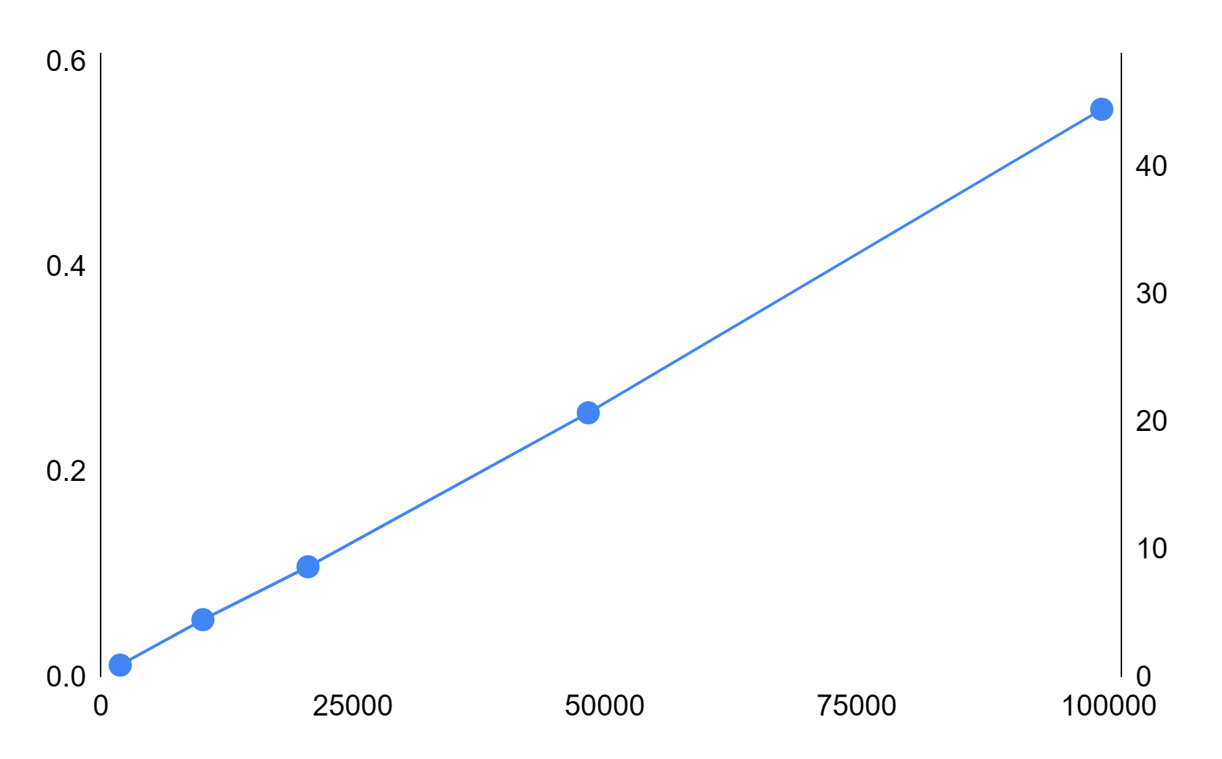
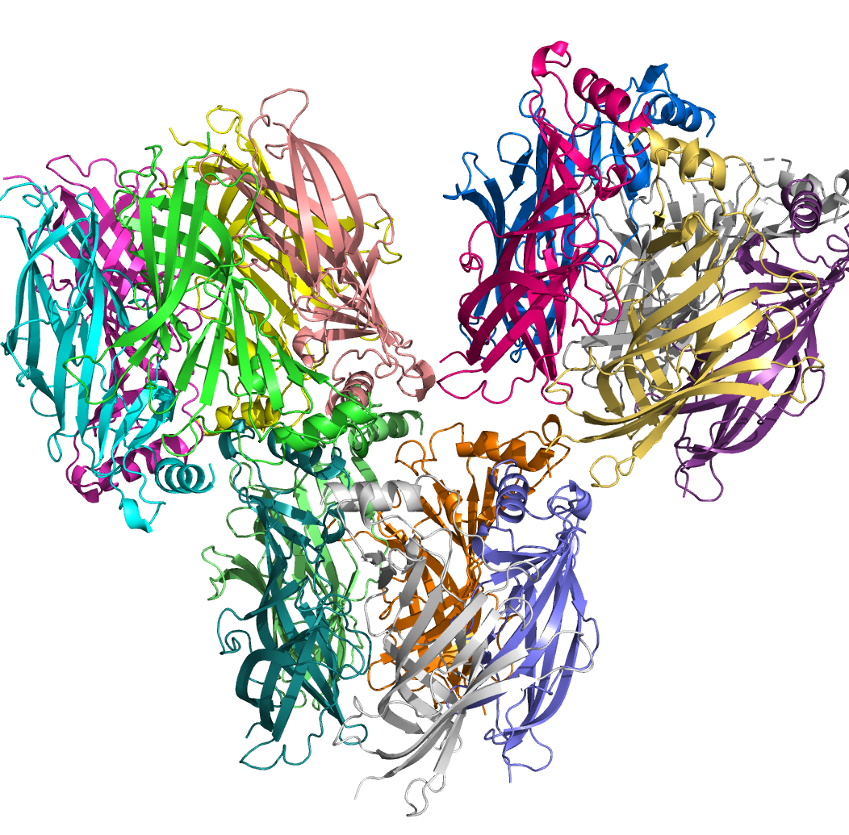
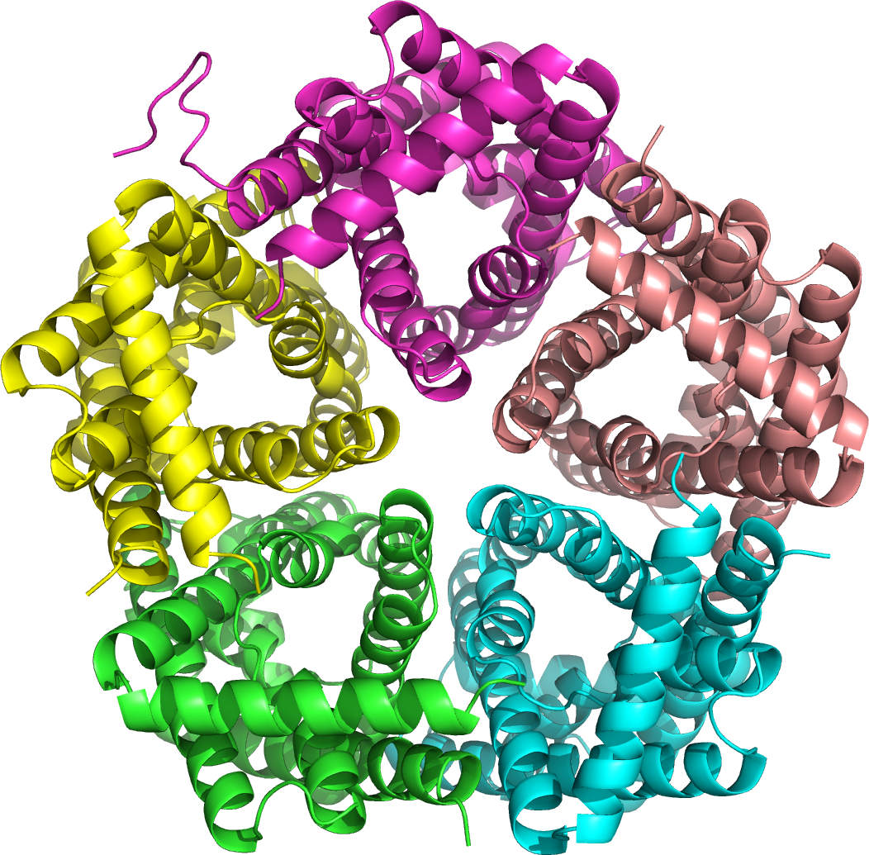
Time (s)
GPU memory (Gb)
Number of atoms
Figure 2. Computational scaling of the AIMNet2-QR model. Time to compute energy and forces, and peak GPU memory usage, benchmarked on a Nvidia H100 PCIE 80GB GPU.

