Slide 1
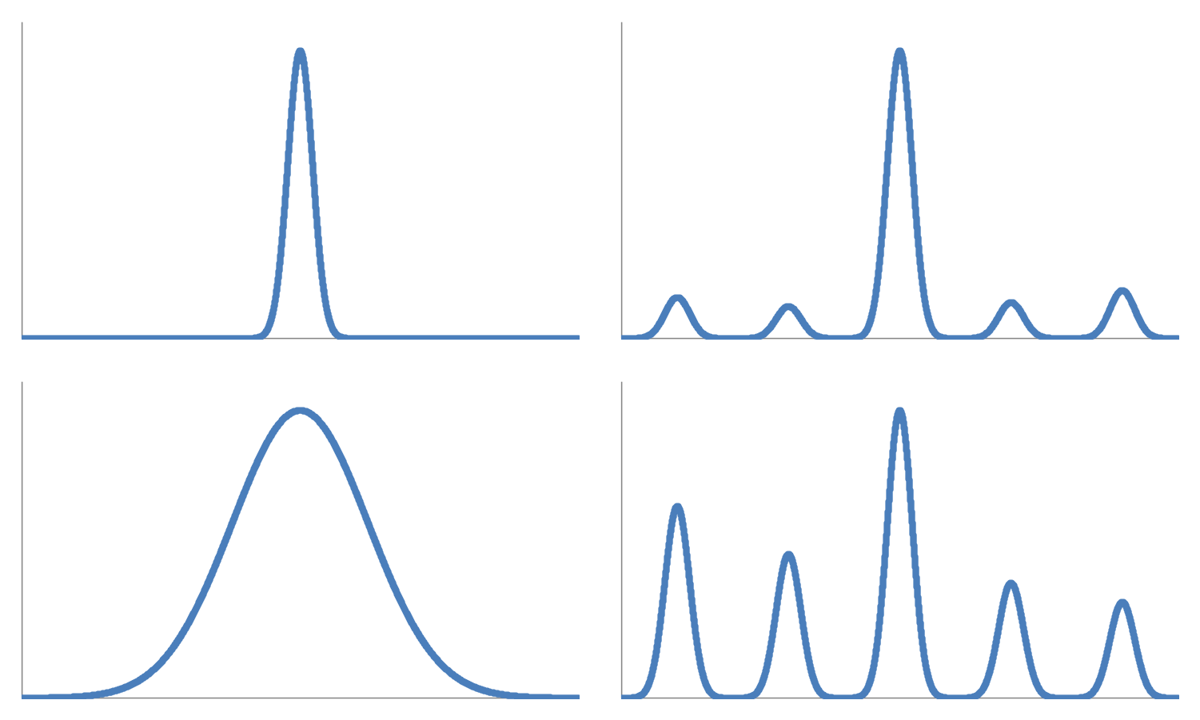
Kurtosis = 16
Kurtosis = 14
Kurtosis = 2
Kurtosis = 5

