Slide 1
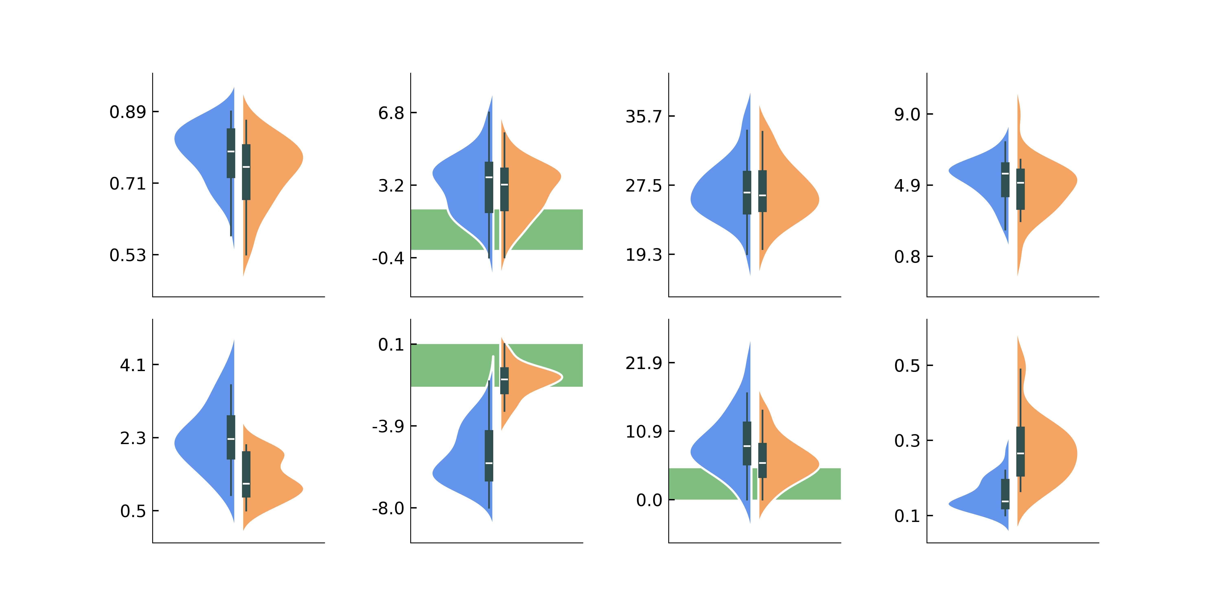
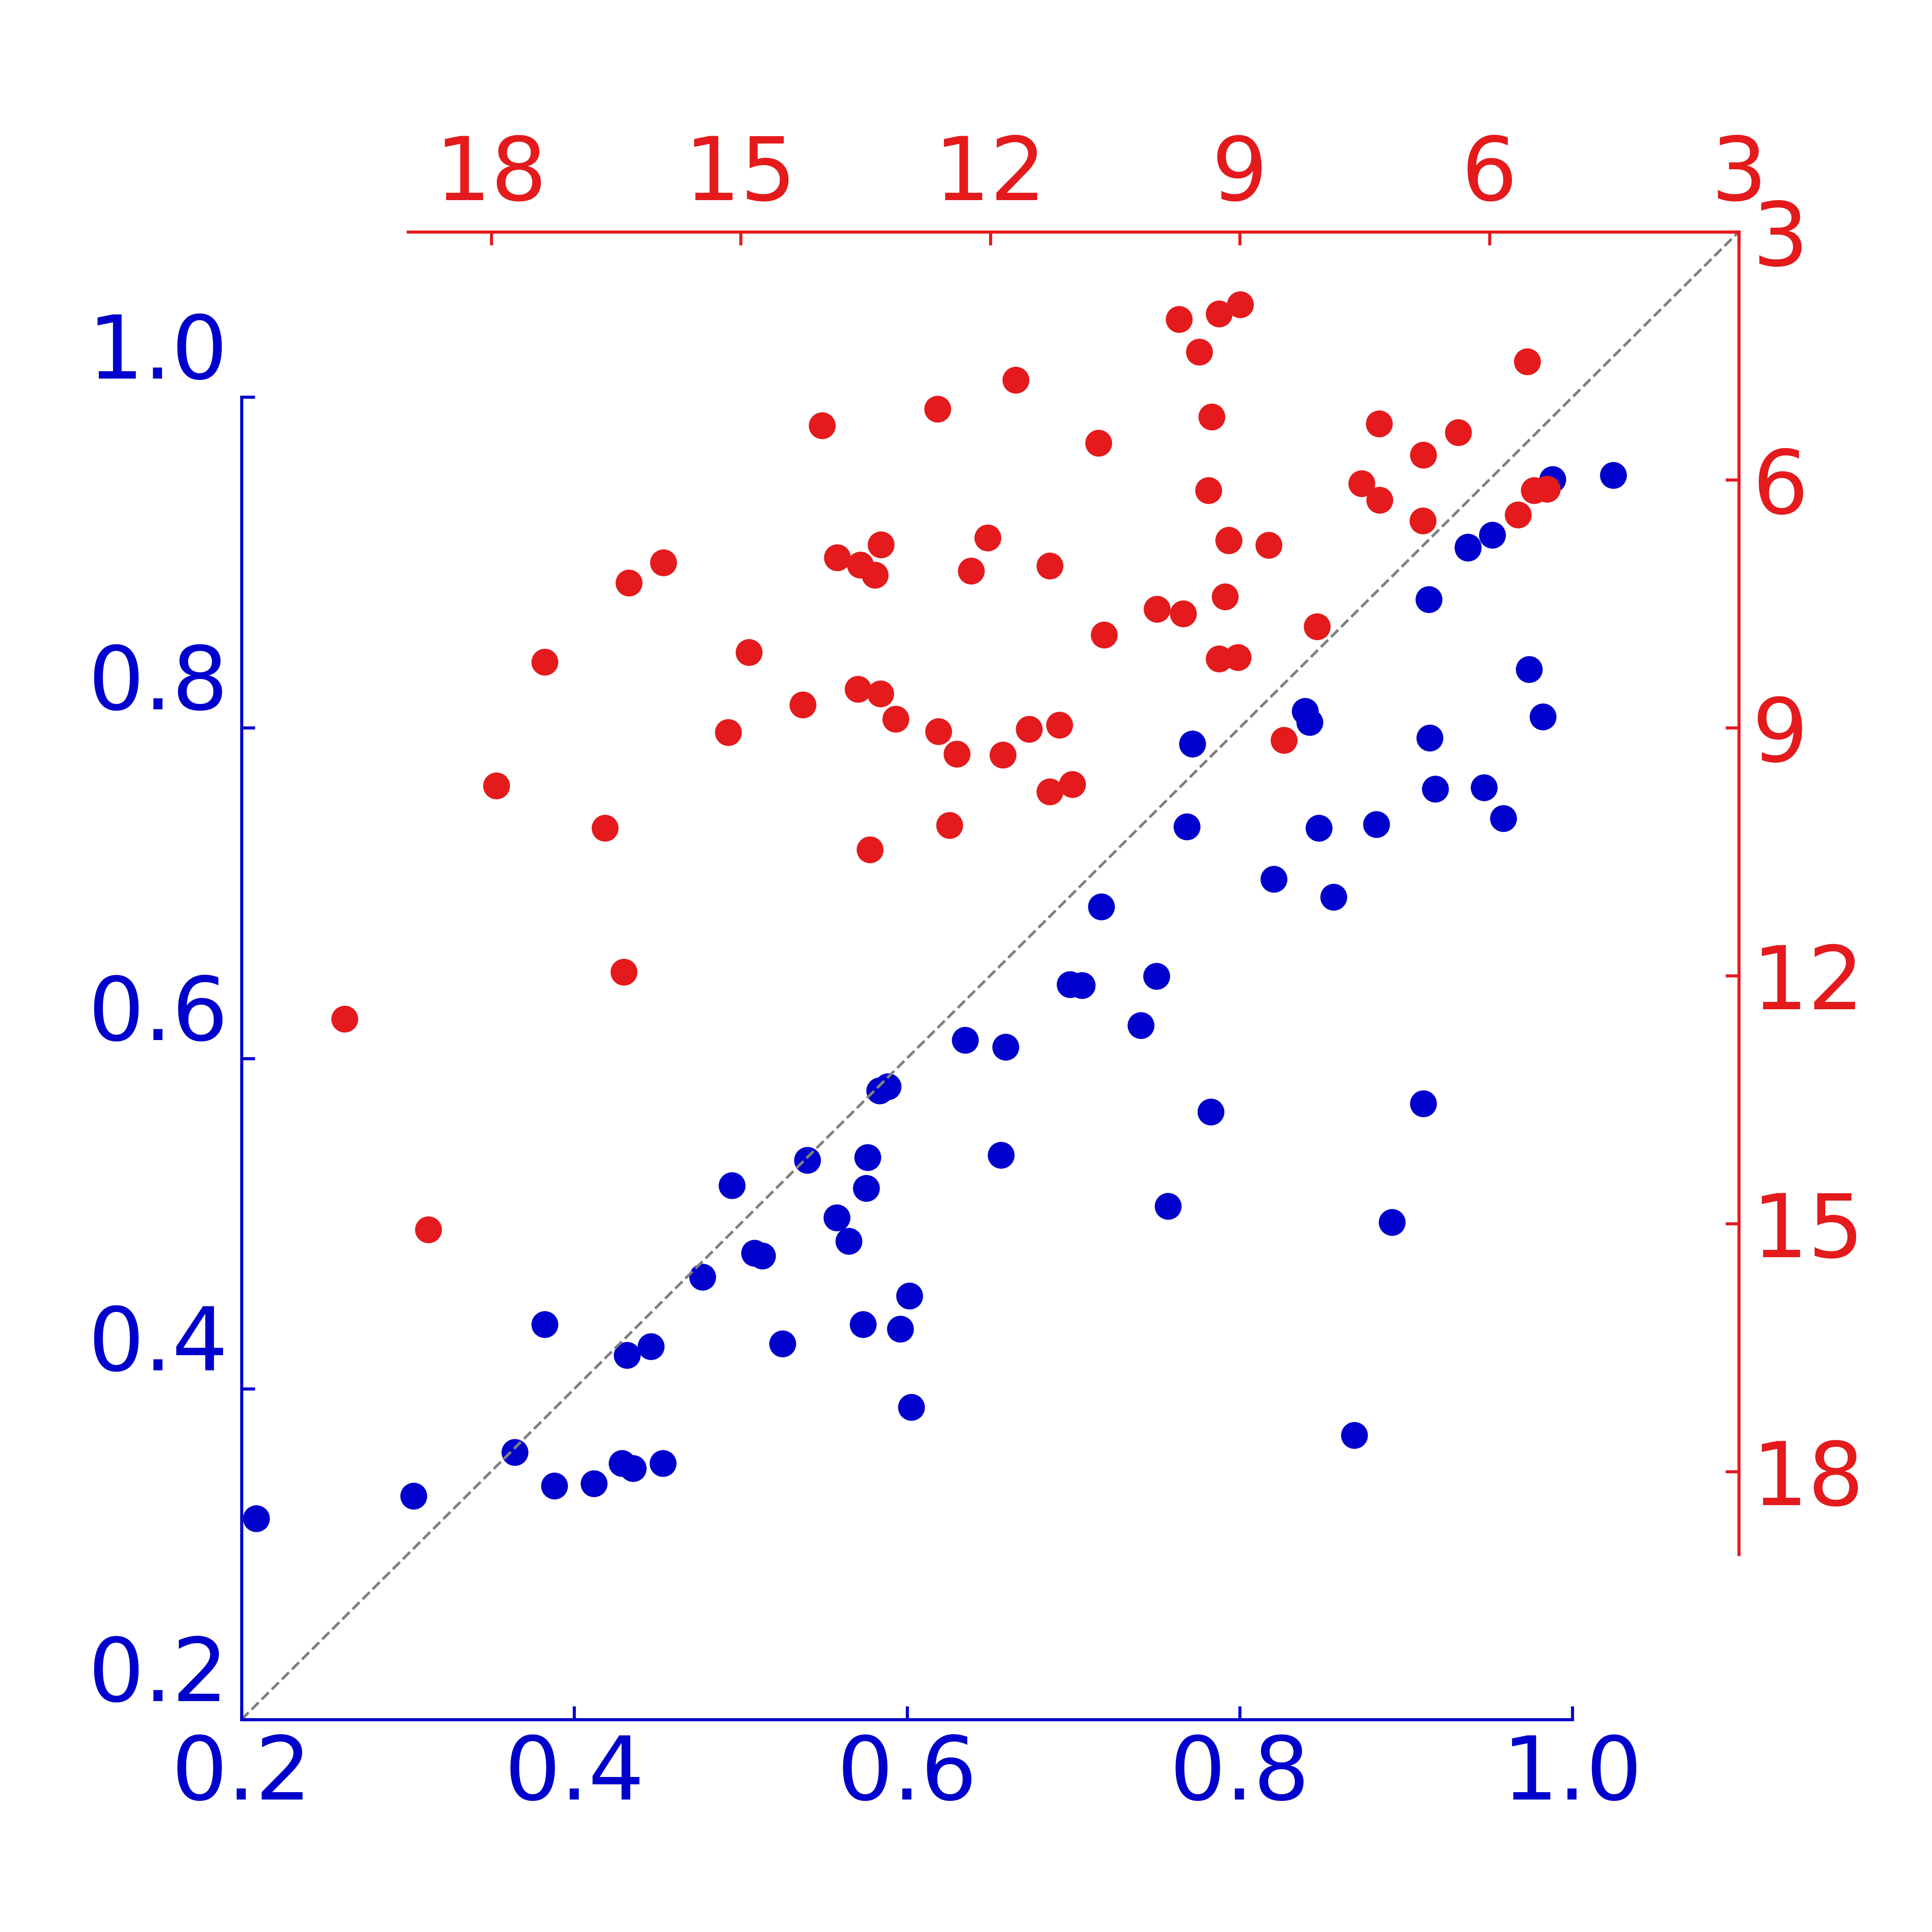
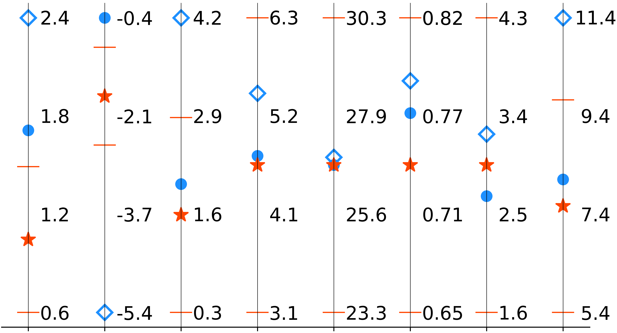
a
MP score
Rama-Z
CaBLAM
R.m.s.d. from start (Å)
b
CC_{MASK}
EMRinger
c
R_{FREE} (%)
ΔR (%)
d
Standard restraints
Standard + additional restraints
AQuaRef
Ln(Kurtosis)
Ln(Kurtosis)
Ln(Kurtosis)
1 2 4 6
1 2 4 6
1 2 4 6
-2 1 0 1 2
-2 1 0 1 2
-2 1 0 1 2
Skew
Skew
Skew
e
R.m.s.d. (°), Phenix
f
R.m.s.d. (Å), AQuaRef
R.m.s.d. (°), AQuaRef
R.m.s.d. (Å), Phenix
MP score
Rama-Z
Ca-BLAM
ΔR (%)
R_{FREE}(%)
CC_{MASK}
EM Ringer
R.m.s.d. (°)

