Slide 1
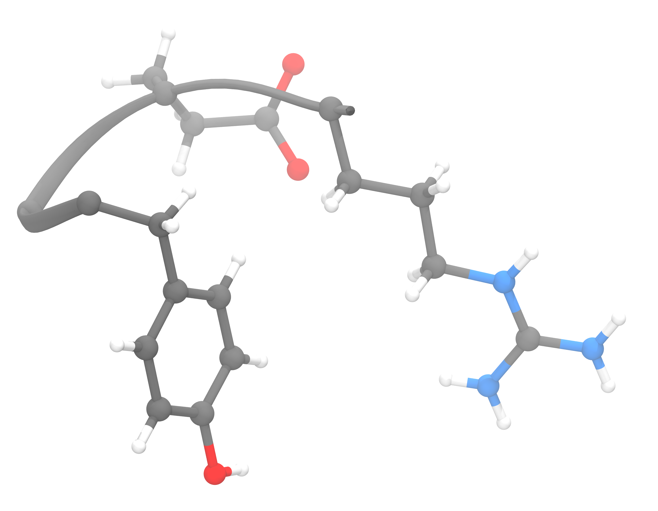
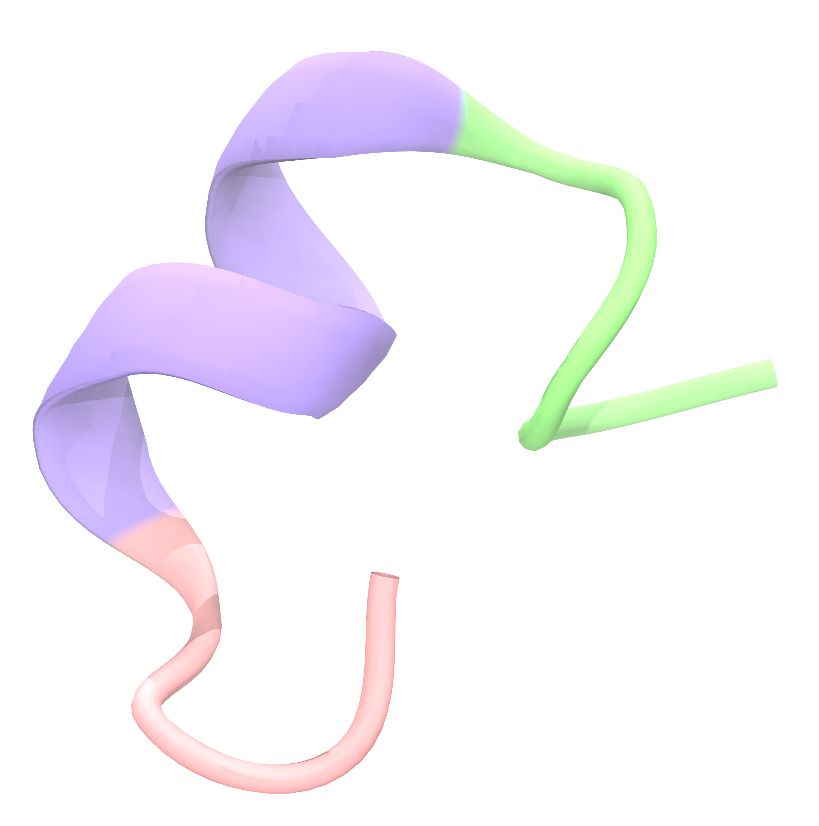
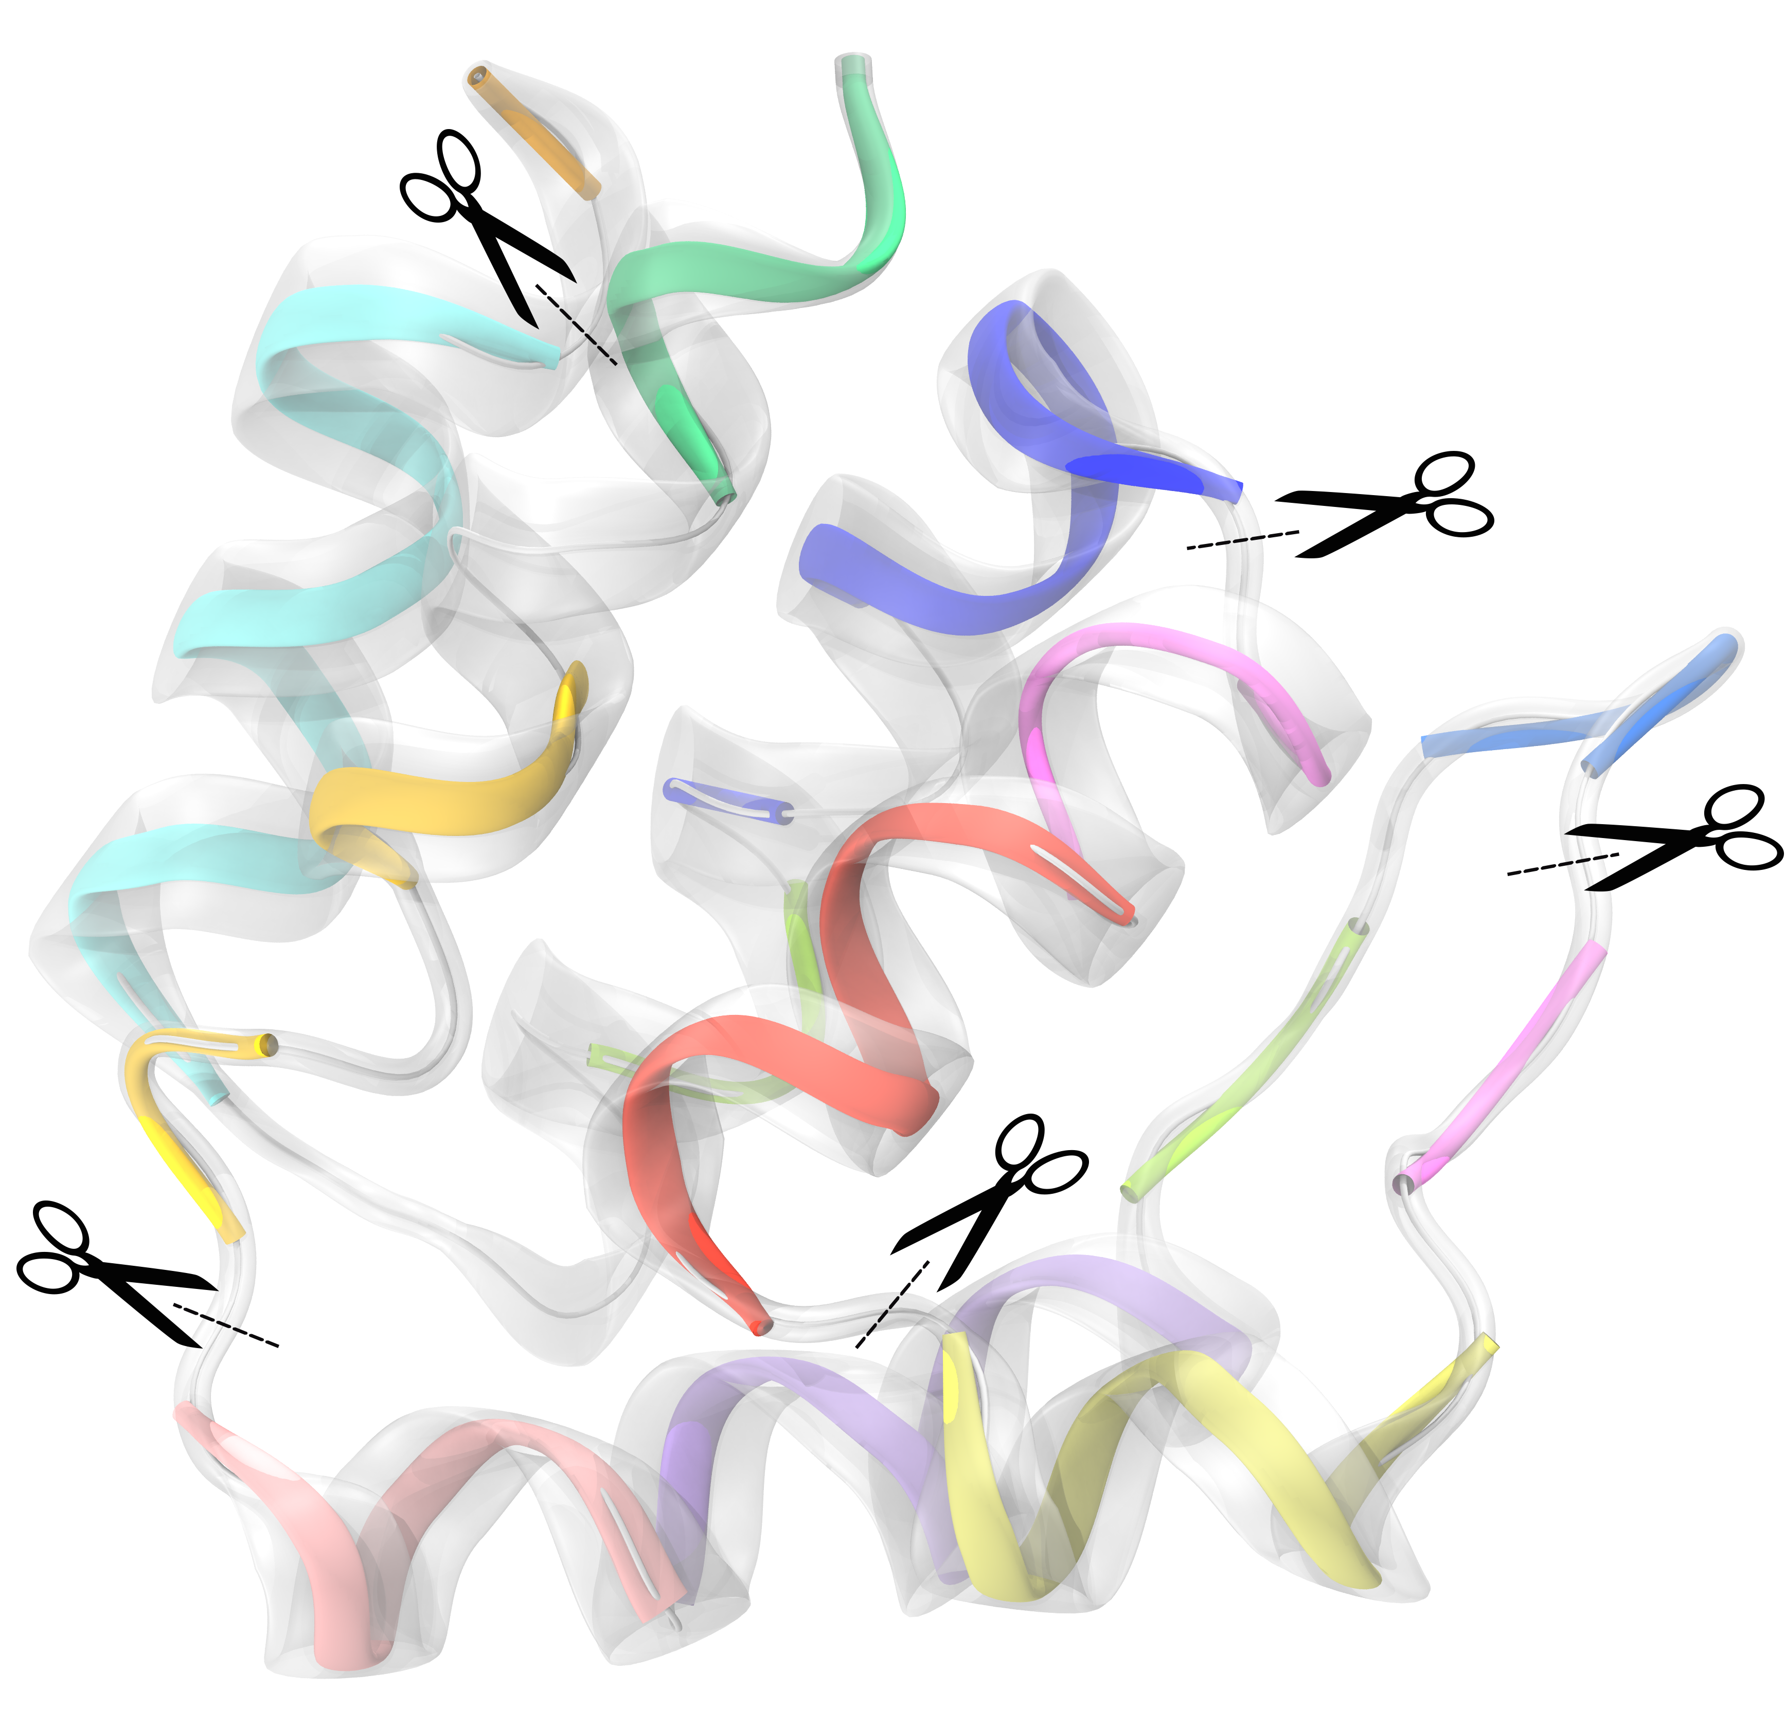
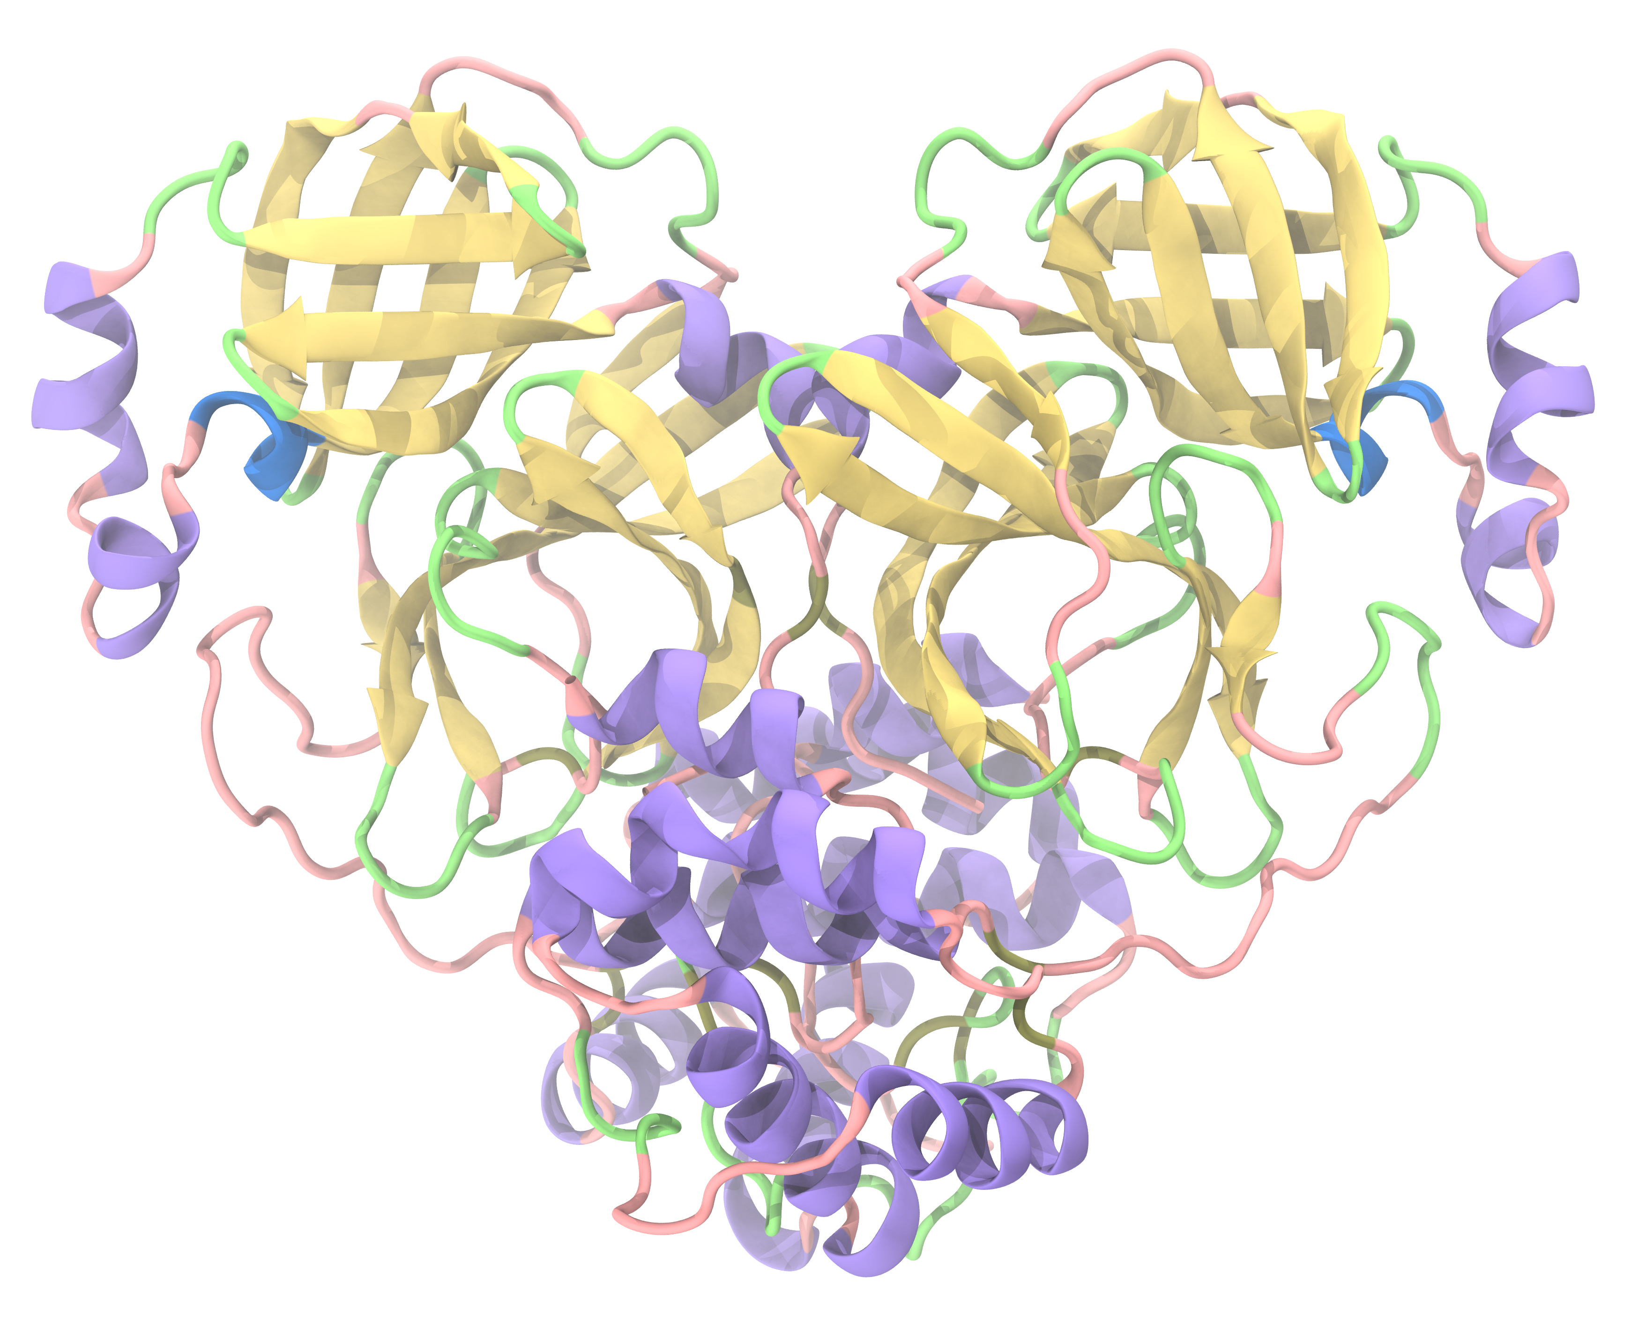
Impossible
Limited
Possible
Practical
2010
2012
2017
2024
QM Calculations
GPU Accelerated QM
Q|R with Fragmentation
ML Potentials
Impossible for proteins. Limited to small molecules only
Limited to peptides and very small proteins (~hundreds of atoms)
QM-based protein refinement. Slow, resource-intensive, no inherent size limit
Fast, rivaling classical force fields, with QM-level accuracy and no fragmentation required

